Slide 1
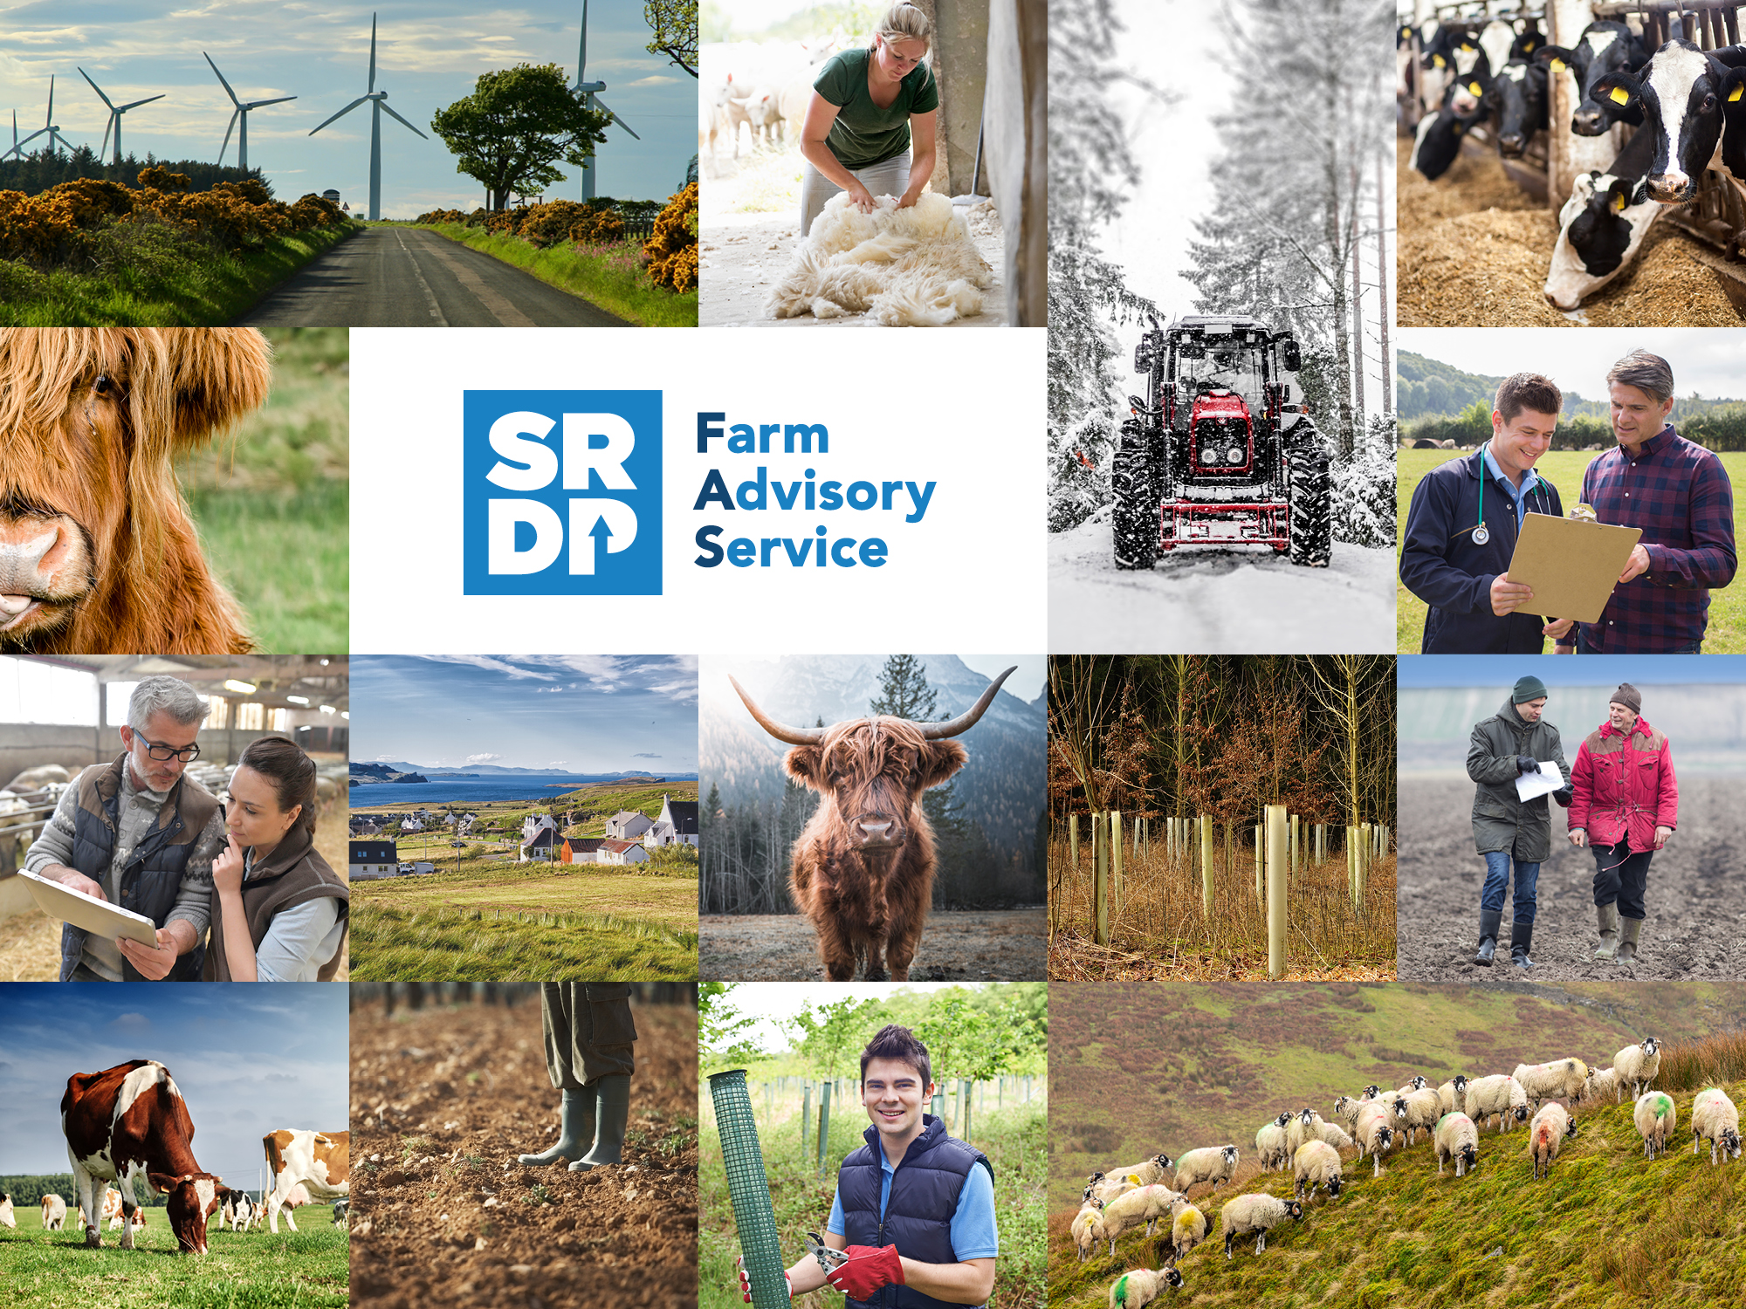
Farm Advisory Service
One-to-one advice and funding stakeholder pack: Autumn 2023

Slide 2
Support for farmers, crofters and livestock in a changing climate
Welcome to the Autumn 2023 edition of the FAS stakeholder pack.
Every farm and croft is unique. Even though businesses are facing similar challenges, everyone has different needs when it comes to advice. In this edition, we share a variety of examples of how grant-funded FAS advice can be used to both address challenges faced by the agricultural community and to take your business from functioning to flourishing.
FAS can support your business whether it’s with lifestyle, biodiversity gains or starting out in the industry. Also, look out for links to our short stakeholder pack survey – designed to gather your feedback on what you’d like to see more or less of in the future.
Help spread the word by sharing this pack’s contents with your networks and contacts!

Slide 3
1. Text for your newsletter:
(Funding support information)
Managing change and uncertainty
Working in agriculture can be very rewarding, but it can be physically and emotionally demanding on you and your family. During times of change and uncertainty, whether personal, professional, or political, questions around the long-term resilience of your farming business may take their toll on your physical and mental health.
If you have concerns about the future of your business and how best to respond to change, Scotland’s Farm Advisory Service (FAS) can help. Specialist Advice is available on a range of topics to support farm businesses through change, including:
Resilience planning – for businesses looking to increase their financial resilience to threats, changes in the market or personal circumstances. It can include financial analysis, output/profit/margin analysis, business risks and opportunities.
Farm Business Efficiency – assess the efficiency of your business with a professional analysis of finances, areas of development, grassland management and soil health, labour, machinery and vehicles, capital, assets and liabilities, diversification options, external sources of finance/funding and more.
Succession planning – expert guidance through one of the hardest stages of running a business to give you the confidence to change your lifestyle, knowing your business is in safe hands. It can include advice on the financial position of your business, its viability, retirement options, successors, legal considerations, and tax implications.
Up to £2,000 of funding is available to your business for specialist advice on two topics through FAS. More information about advice topics, funding and how to apply can be found at fas.scot/specialist-advice or contact FAS on advice@fas.scot or 0300 323 0161.
If you are struggling with your health or know anyone that needs support, the FAS Health is your Wealth pages bring together a range of experts to cover mental health, physical health, nutrition and the support available to farmers and crofters.
✂
228 words

Slide 4
2. Text for your newsletter:
(Funding support information)
Legumes in rotations: benefits for the environment and your budget
Introducing legume crops into rotations on your farm or croft has multiple benefits and can positively impact your budget and the environment. Legume crops fix nitrogen from the atmosphere and do not rely on the input of artificial fertilisers. They also leave nitrogen behind in the soil after harvest, which can be used by the following crop. Legumes work well as spring crops, allowing you to spread planting and harvesting throughout the year. Environmental benefits from legumes, whether used as a main crop or as a cover crop, include improved biodiversity on-farm both above ground for pollinating insects and below ground for beneficial microbes and improved soil structure. Livestock benefit from legumes in rotations because these deliver more digestible protein at a lower environmental cost than conventional rotations.
Interested in introducing legumes into your rotations? The Farm Advisory Service (FAS) can help. Get funded up to £1,000 for targeted guidance on introducing legumes from a specialist adviser you trust by selecting the soil and nutrient management option. For more information and to apply for funding visit www.fas.scot/specialist-advice or contact FAS at advice@fas.scot or 0300 323 0161.
✂
196 words

Slide 5
3. Text for your newsletter:
(Funding support information)
Ammonia, why you should care and what you can do about it
Ammonia is a colourless, pungent-smelling gas, both naturally occurring and man-made. In 2020, agriculture accounted for around 90% of ammonia emissions in Scotland. Ammonia reacts with other pollutants in the atmosphere that can be harmful to the environment and human health. Ammonia deposition can disrupt ecosystems, leading to a loss of biodiversity while runoff can contaminate waterways affecting water quality.
It is important for farmers and crofters to be aware of the causes and effects of ammonia emissions so they can maintain healthy ecosystems on their land and comply with legislation that aims to limit emissions. Scottish farmers and crofters can improve livestock and manure management as well as optimised fertiliser use, which are important considerations for any business, and how those resources are managed can have an influence on the level of ammonia emitted. Low emission spreading equipment and covering slurry stores are just a few methods to help reduce emissions.
Specialist advice provided through the Scottish Farming Advice Service on soil and nutrient management and animal welfare can be used to help reduce ammonia emissions. For advice on which options to choose, help finding an adviser, and to apply for funding, contact FAS at advice@fas.scot or 0300 323 0161. More information can be found on the FAS website at www.fas.scot/specialist-advice.
✂
224 words

Slide 6
3. Text for your newsletter:
(Funding support information)
Water pollution mitigation support
Agricultural production covers 80% of the land in Scotland, so farmers and crofters play a key role in sustainable water management. Fertiliser, pesticide loading, and soil erosion cause a risk of diffuse pollution from farmland. Individually, these activities may not be problematic, but at the scale of a catchment, they can have a significant effect. The Farm Advisory Service (FAS) can be an essential ally in safeguarding waterways and can help you combat such challenges on your farm or croft. Specialist advice is available for water pollution, prevention, and control to support you to maintain and improve the water quality on your land. It can include hydro-geological surveys, wetland creation and management, watercourse buffering, and species and habitat surveys and advice.
Funding is available for one-on-one time with a qualified adviser allowing you to discuss problems. You will receive a detailed report with directions to useful resources, ensuring compliance with SEPA, and addressing cross-compliance.
Information on this specialist advice topic and others that could be address in conjunction with it, such as soil and nutrient management, is available at www.fas.scot/specialist-advice/. For help applying for funding or finding an advisor, contact FAS at advice@fas.scot or on 0300 323 0161.
✂
224 words

Slide 7
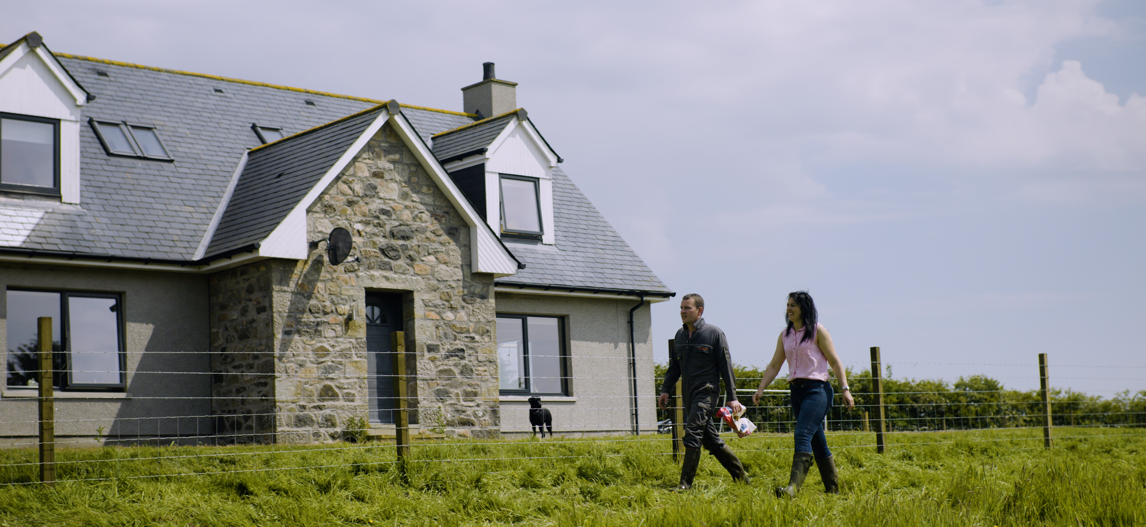
4. Text for your newsletter:
(Funding support information)
Integrated Land Management Plan: Becky and Bruce MacAngus
In this case study, Bruce and Becky MacAngus tell us about their experience getting an Integrated Land Management Plan (ILMP) through FAS and how they benefited from a comprehensive business review with an independent advisor, which helped them plan their farm's future.
‘It really put into perspective, what we want to achieve, where do we want to be in five to ten years' time and realistically how we were going to get there.’ - Becky MacAngus, Little Glencoe Farm
Share this case study video with your farming community to help them understand the benefits of an ILMP.
✂
Integrated Land Management Plan: Becky and Bruce MacAngus: https://www.youtube.com/watch?v=GXTXJ_zsnzc

Slide 8
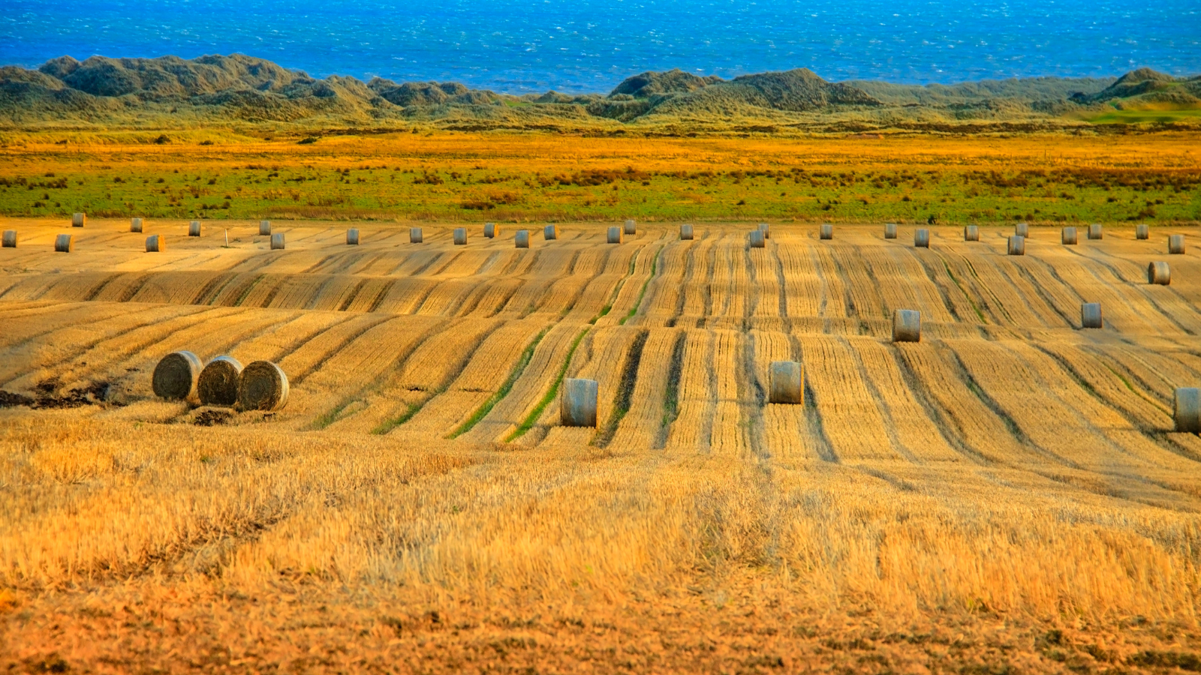
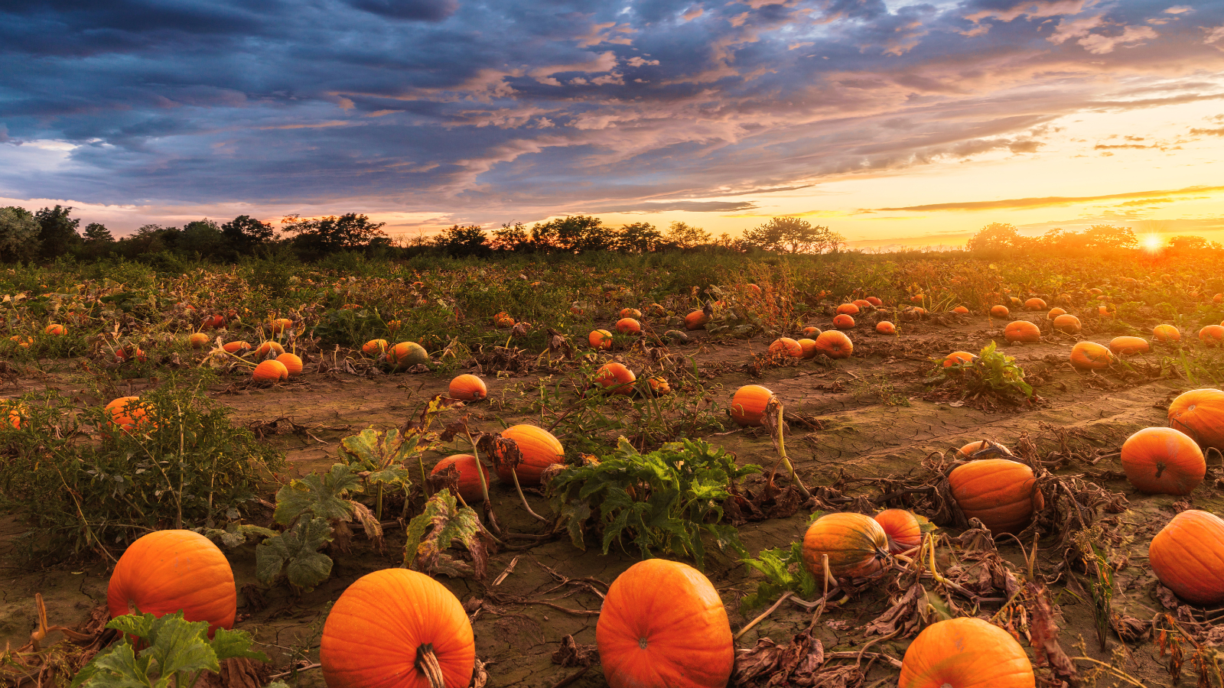
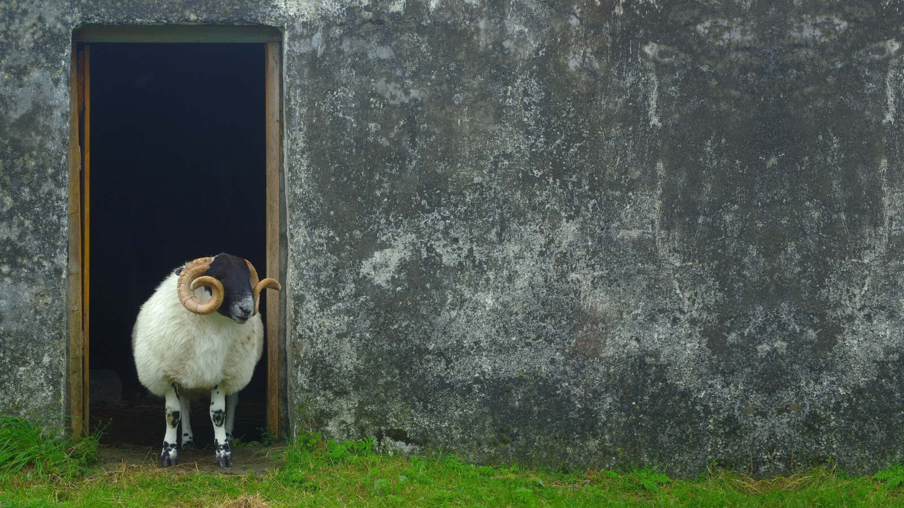
Images to use with newsletter text/online

Slide 9
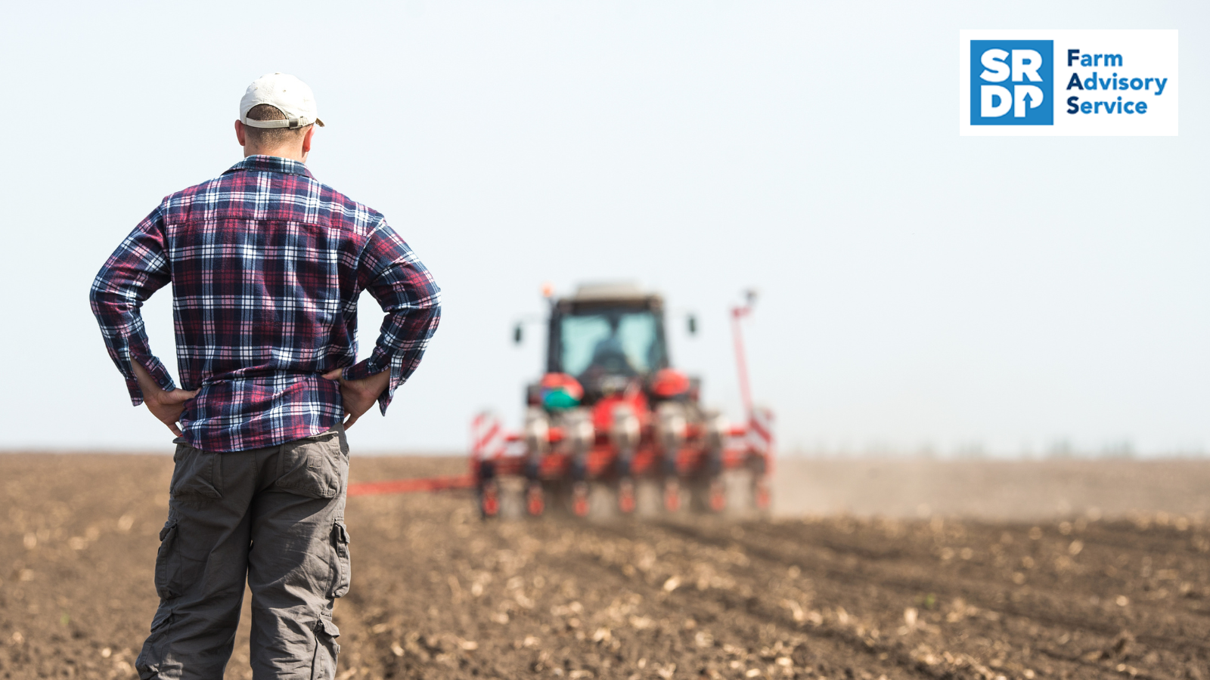
Suggested Tweet & image to share
Keep #ScottishFarming feeling rewarding! 🐂🌾🤗 Build resilience to change and manage physical and emotional demands with @FASScot specialist advice.
Info on topics such as resilience planning and applying for up to £2,000 of funding is available at 👉www.fas.scot/specialist-advice
✂

Slide 10
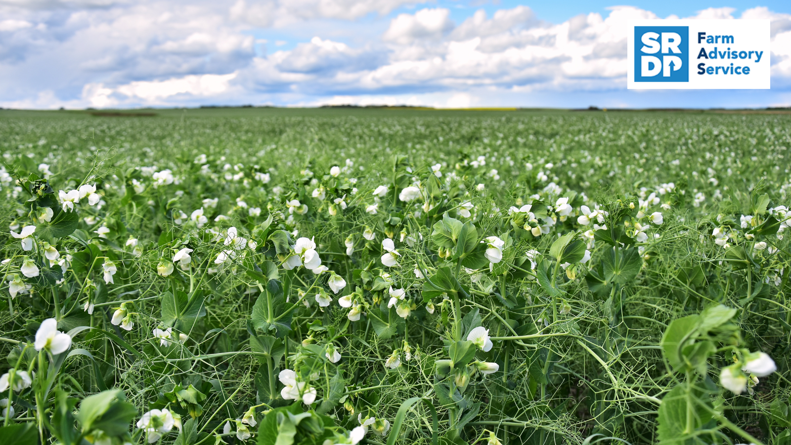
Suggested Tweet & image to share
Benefit your #ScottishFarming business and the environment by introducing legumes into crop rotations. ✔️
Get £1,000 of funding for targeted guidance from a specialist @FASScot adviser with the soil and nutrient management option: www.fas.scot/advice-grants/
✂

Slide 11
Suggested Tweet & image to share
Reduce ammonia emissions, maintain healthy ecosystems and comply with the legislations relevant to your #ScottishFarming business ✔️ with advice on soil and nutrient management and animal welfare.
Get funded £2K for specialist advice through @FASScot 👉 www.fas.scot/specialist-advice/
✂

Slide 12
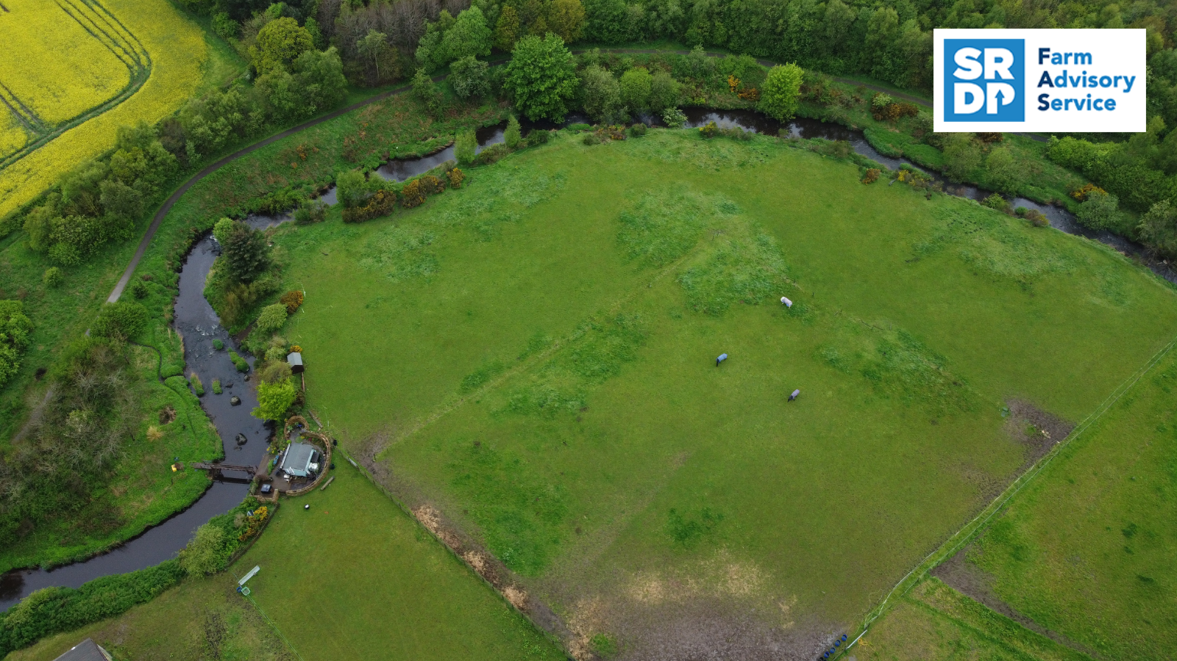
Suggested Tweet & image to share
Maintain and improve the water quality on and around your #ScottishFarming business and play your role in avoiding diffuse pollution. 🌊
Up to £1k in funding is available through @FASScott for water pollution, prevention, and control specialist advice 👉 www.fas.scot/specialist-advice/
✂

Slide 13
Posts to share on LinkedIn and Facebook
Keep #ScottishFarming feeling rewarding! 🐂🌾🤗 Build resilience to change and manage physical and emotional demands with @Scotland's Farm Advisory Service - FAS specialist advice.
Info on topics such as resilience planning and applying for up to £2,000 of funding is available at 👉www.fas.scot/specialist-advice
Benefit your #ScottishFarming business and the environment by introducing legumes into crop rotations. ✔️
Get £1,000 of funding for targeted guidance from a specialist @Scotland's Farm Advisory Service - FAS adviser with the soil and nutrient management option: www.fas.scot/advice-grants/
✂
✂
✂
Reduce ammonia emissions, maintain healthy ecosystems and comply with the legislations relevant to your #ScottishFarming business ✔️ with advice on soil and nutrient management and animal welfare.
Get funded £2K for specialist advice through @Scotland's Farm Advisory Service - FAS 👉 www.fas.scot/specialist-advice/
✂
Maintain and improve the water quality on and around your #ScottishFarming business and play your role in avoiding diffuse pollution. 🌊
Up to £1k in funding is available through @Scotland's Farm Advisory Service - FAS for water pollution, prevention, and control specialist advice 👉 www.fas.scot/specialist-advice/

Slide 14
Take our stakeholder pack survey
Help us improve the content brought to you in this pack

Slide 15
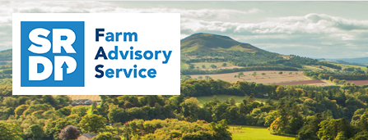
For all the latest updates
to share with your network…
Follow us on Twitter:
https://twitter.com/FASScot
Follow us on Facebook:
https://www.facebook.com/FASScot
Follow us on YouTube:
https://www.youtube.com/channel/UCKuK1UOD-A4eBxAue__MR_Q
Visit our website:
https://www.fas.scot/

Slide 16
For further information, please contact:
0300 323 0161
advice@fas.scot

