Slide 1
Women in Agriculture Jenny McKerr
New Lanark
14th March 2018

Slide 2
Background ……
From Paisley
SAC Auchincruive graduate
Employed by Stoddarts
Married to Rocket
A Mum of three girls
A Rural Leader
A New entrant farmer
Very lucky
Determined to make a difference

Slide 3
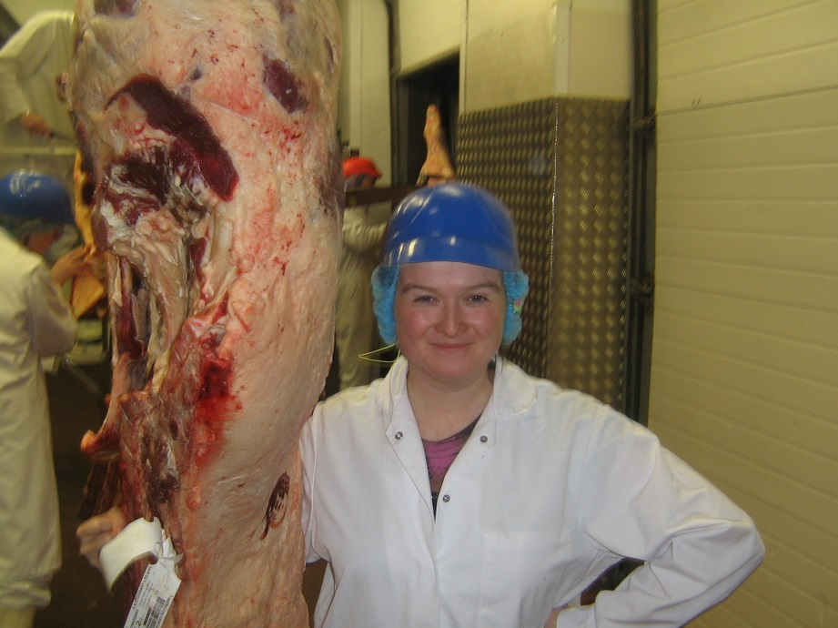
The Day Job
Group Operations Manager
3 factories
1000 cattle /wk
200 ops employees
Low margin, high throughput
Over 2000 farmer suppliers
Premium customers

Slide 4
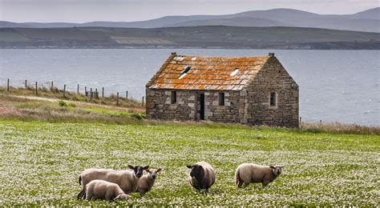
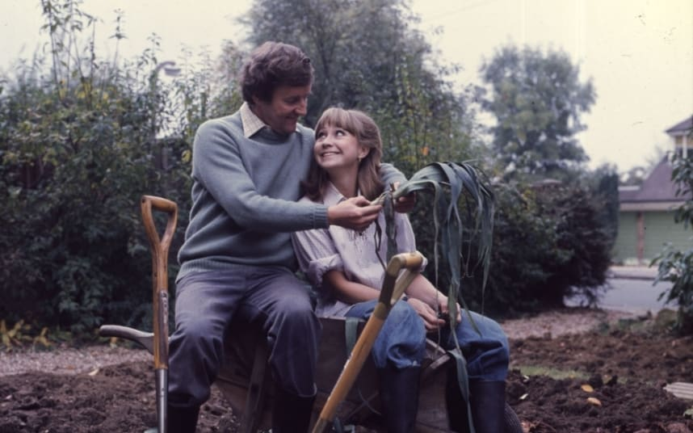
The Dream

Slide 5
The Reality
We used a broker to help secure a commercial mortgage.
We took the maximum amount we could on personal loans and borrowed from family
Our new home came with a handbrake and a £800 pricetag.
Bought a farm by accident in Aug 2016 with no funds and 3 months to make it happen.
Our house sold in 3 days and we made ourselves homeless.
I then found out I was in calf expecting our 3rd baby.
My employer of 10 years sold the company to private investors.

Slide 6
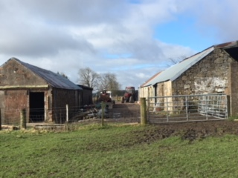
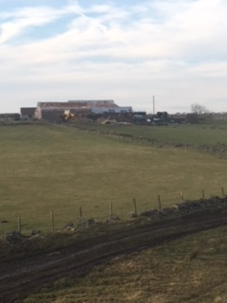
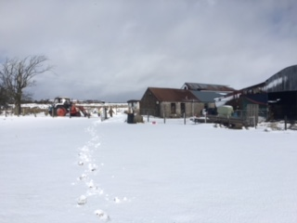
Forth Mains Farm
Nov 2016
44 acres owned
50 acres leased

Slide 7
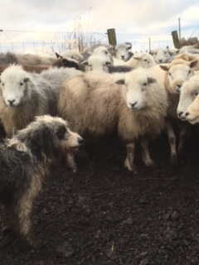
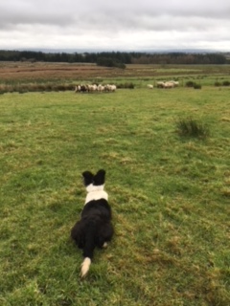
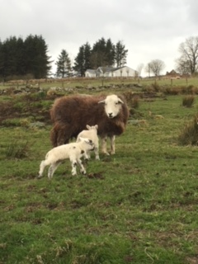
Built flock from 50 to 160 sheep

Slide 8
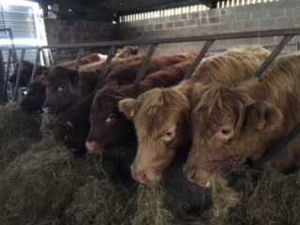
Started our Wagyu beef enterprise

Slide 9
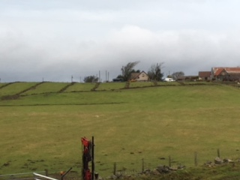
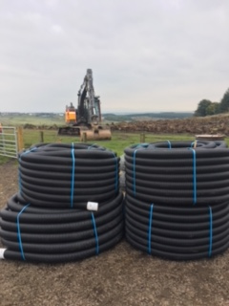
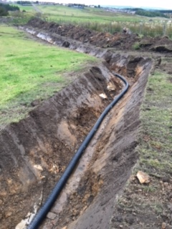
Farm Improvement

Slide 10
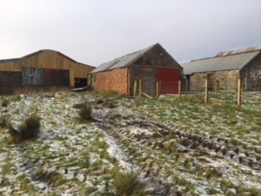
Planning Permission for House and Shed

Slide 11
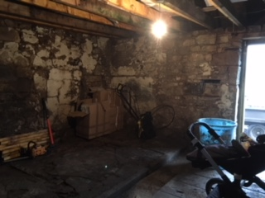
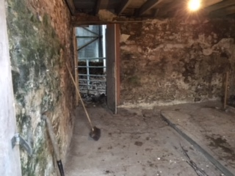
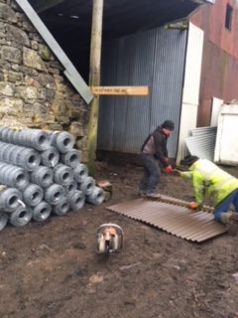
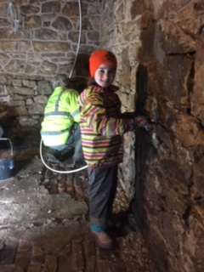
The Old Byre

Slide 12
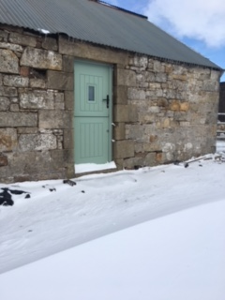
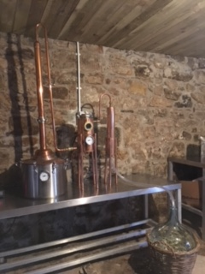
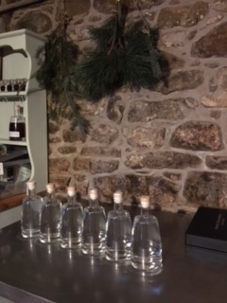
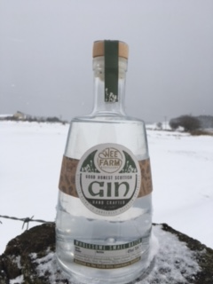

Slide 13
Continue to Learn ……………..
Take every opportunity to network, travel and learn
Rural Leader 2014
RASC South Africa Mission 2017
Nourish Scotland 2018
SAC New entrants programme
ILMP Review

Slide 14
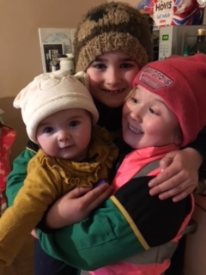
What next:
Farming, food and drink education
Tourism (Distill and chill breaks)
Niche production (truffles)
Enterprises for the girls
Pay it forward
Enjoy it

