Slide 1
PLANNING TO SUCCEED

Slide 2
€3bn – annual CAP payment to UK farmers
Notes:
Although there is significant uncertainty to the future of the UK’s subsidy position following the Brexit vote, we must ensure our clients are able to make the most of the current CAP, and are well-positioned to continue to take advantage of the future subsidies, in whatever form they take.

Slide 3
Let’s ensure you keep your hard earned money

Slide 4
Client
Structure
Accounting period
Capital purchases
Salary v Dividends
Other income
Tax
Notes:
Many things to consider, but centre to it all are the needs of the client.
Today, we will cover a range of these considerations.
Firstly, and most importantly, let’s ensure the client has a good foundation to build upon. Let’s take a look at the business structures available….. [next slide]

Slide 5
Sole trader
Partnership
Combination?
Company
Notes:
For years, these same three basic structures have existed for many years.
Unincorporated setups, such as sole traders and partnerships, offer great flexibility to the owner. For a single farmer, with no spouse, a sole trader will almost always be the most straightforward structure.
If there is a spouse, or other family members, or where the profits for that farmer are in excess of the higher rate band, it might be more appropriate to look at taking in another partner, or incorporating the business.
This can be especially useful when the farmer has a young family, and tax credits are available, as we’ll touch on later.
Incorporated businesses are slightly less flexible for the owner, and the reporting requirements are more onerous. However, they offer the owner limited liability from creditors in the event of financial hardship, or legal exposure, by the farming business.
[Click slides] Some of you might be wondering about the possibility of combining some of the above structures, such as in the form of a partnership with a limited company partner. [click slide again to reveal ‘STOP’ slide]

Slide 6
20 March 2013
No more mixed partnerships!
Notes:
A word of warning. [click slide]
On 20 March 2013, the chancellor announced changes to the tax regime for such ‘mixed partnership’ structures, effectively rendering them useless from a tax-planning perspective.
[click slide again]
To ensure your clients do not fall foul of any of the pitfalls of this new legislation, you should ensure they do not seek this structure without appropriate consideration of the impact.
In general, we do not endorse such structures.

Slide 7
Which rate applies?
Unincorporated – Income Tax |  | Incorporated – Corporation Tax
<£11,500 | 0% | Any profit | 19%
£11,501-£43,000 | 20%
£43,001- £100,001 | 40%
£100,002 - £123,000 | 60%*
£123,001 - £150,000 | 40%
>£150,001 | 45%
* Effectively 60%, as you lose £1 of your personal allowance for every £2 earned over £100k

Slide 8
So being incorporated is much cheaper, yes?
Whilst there are lower rates available on the trading profits, companies do not benefit from a personal allowance, like individuals.
Bear in mind
additional administration & compliance
various issues on incorporation
cost of extracting profits from the company
However, with the increase in Scottish Income Tax rates – which we’ll touch on later – using companies is becoming slightly more beneficial to Scottish taxpayers once again.
A combination might give the best of both worlds.

Slide 9
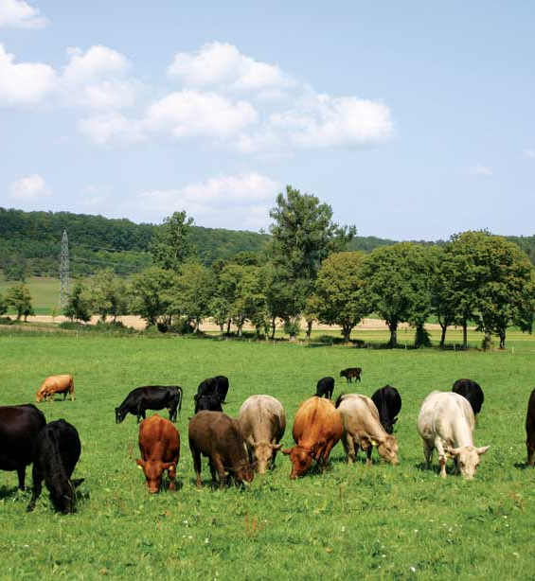
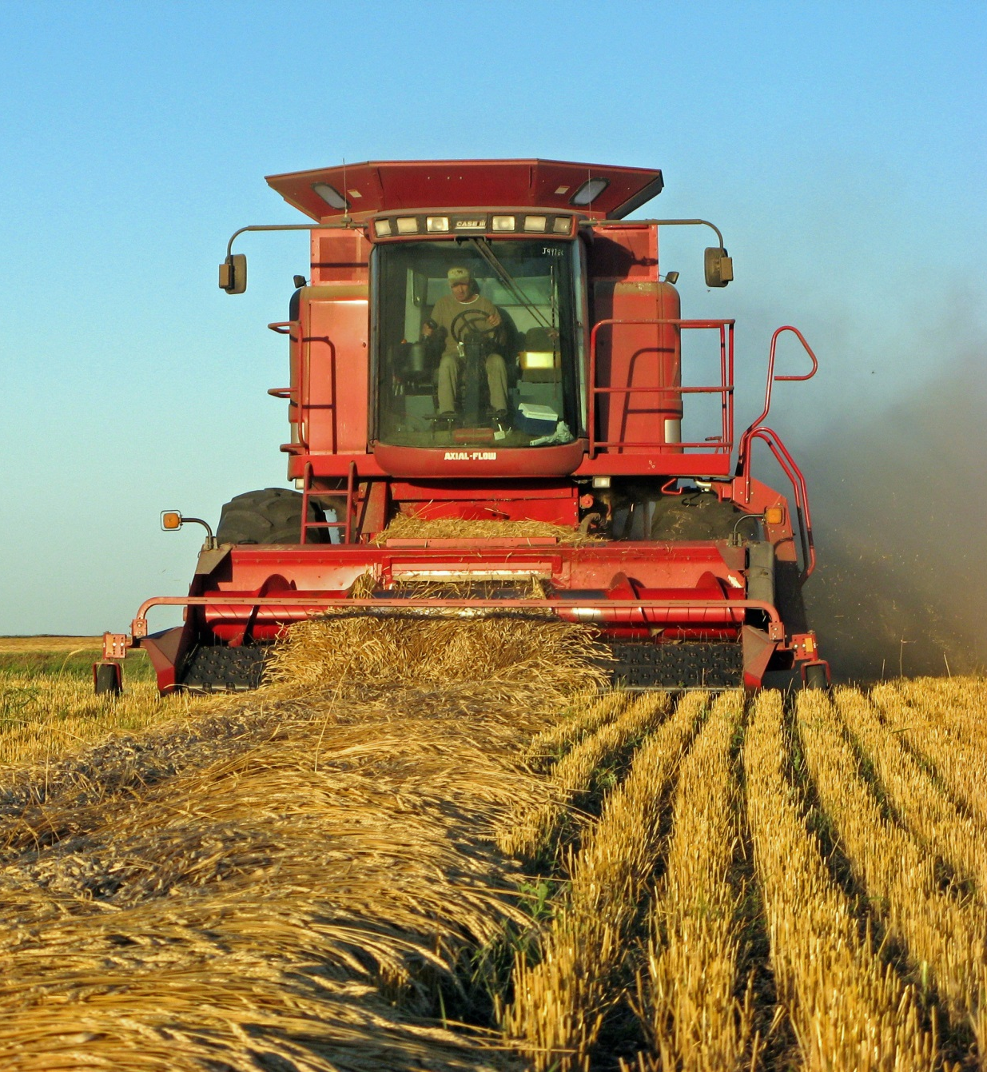
Notes:
Flexibility can still be achieved by splitting the farming business into two separate structures. For example, the unincorporated structure could be used for a farming business with relatively low profits, with a separate incorporated structure encompassing the contracting business, offering limited liability on to the owners on the contracting work as well as the advantageous Corp Tax rates on the contracting profits.
The key point is, the structure must suit the individual needs of the client.

Slide 12
Important dates – using year ended 31 March 2018
 | Unincorporated & individuals | Companies
Submission of accounts | n/a | 31 December 2018
Payment of first payment on account | 31 January 2018 | n/a
Payment of second payment on account | 31 July 2018 | n/a
Payment of tax balancing payment | 31 January 2019 | 1 January 2019
Submission of tax return | 31 January 2019 | 31 March 2019

Slide 13
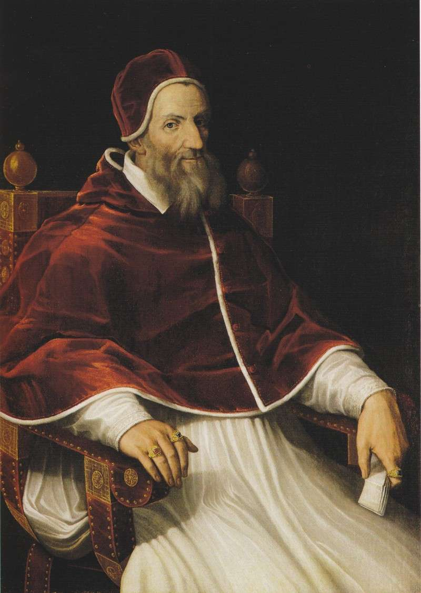
Pope Gregory XIII
Notes:
In 1582, Pope Gregory grew tired of the existing Julian calendar, and ordered it to be changed.
Being one to take the credit for this change, a new ‘Gregorian’ calendar was created. This new calendar was not only more accurate to the solar calendar, but it resulted in changing the end of the year from March to December.
As news was significantly slower to travel in the 16th century, many people ended up being caught out by this change, celebrating new year on the wrong date… [click slide]

Slide 14
Notes:
[Laugh, laugh, laugh, very funny joke]
The UK adopted Pope Gregory’s new calendar in 1752 – some time after it was originally introduced. In fact, by that time, due to differences in the Julian calendar and the solar calendar, the UK was a full 11 days behind the other countries whom had adopted the new calendar.
To catch up, the 2nd of September 1752 was immediately followed by the 14th of September.
Despite the dates changing, to avoid a loss of income taxes, the tax year continued to run for a normal 365 days. The tax year commencing 25 March 1752 therefore ran until 4 April 1753.
Another tweak to avoid further losses of tax in the year 1800 resulted in this changing by one further day, giving the 5 April tax year we know today. [click slide]

Slide 15
What a difference a day makes
Notes:
What a difference a day makes.
[Question] Hands up how many of your unincorporated clients use a year end other than either 31 March or 5 April?
For those of you who raised your hands, it might be worth your clients looking at changing their year end.
Any unincorporated client who has a year end other than 31 March or 5 April, and made a profit in their first year of trading, will have been taxed twice on part of that profit. This is called ‘overlap profit’.
Fortunately, those clients can change their year end back in line with our fiscal year, and deduct this ‘overlap profit’ from their taxable profits in the accounting period of change. This is called ‘overlap relief’.
With the value of money decreasing over time, these overlap profits are worth less and less to your clients the longer they leave them unrelieved. The time to act is now.

Slide 16
Everyone loves a new tractor
…but how does it affect my tax liability?

Slide 17
Hire Purchase
Interest charged – tax deductible
Depreciation – not deductible for tax
Finance Lease
Interest charged – tax deductible
Depreciation – tax deductible
Qualifies for Annual Investment Allowance (AIA)
Does not qualify for capital allowances
Notes:
Both methods of payment allow the farmer to take ownership of the asset from the outset.
Both are treated as assets in their accounts, and a corresponding liability will be recognised.
The fundamental difference is the timing of tax relief. HP’s allow the farmer to claim relief for the full cost in the year of acquisition (AIA), whereas only the asset depreciation and the interest charge is tax-deductible in the case of finance leases.
Cash acquisitions are treated in the same manner as HP’s for tax purposes, with the only interest payable being that of an increase overdraft, if applicable.
Of course, fundamentally, the acquisition of new plant and equipment must be commercial. It is never advisable to acquire new equipment solely for the purpose of reducing the tax liability.

Slide 18
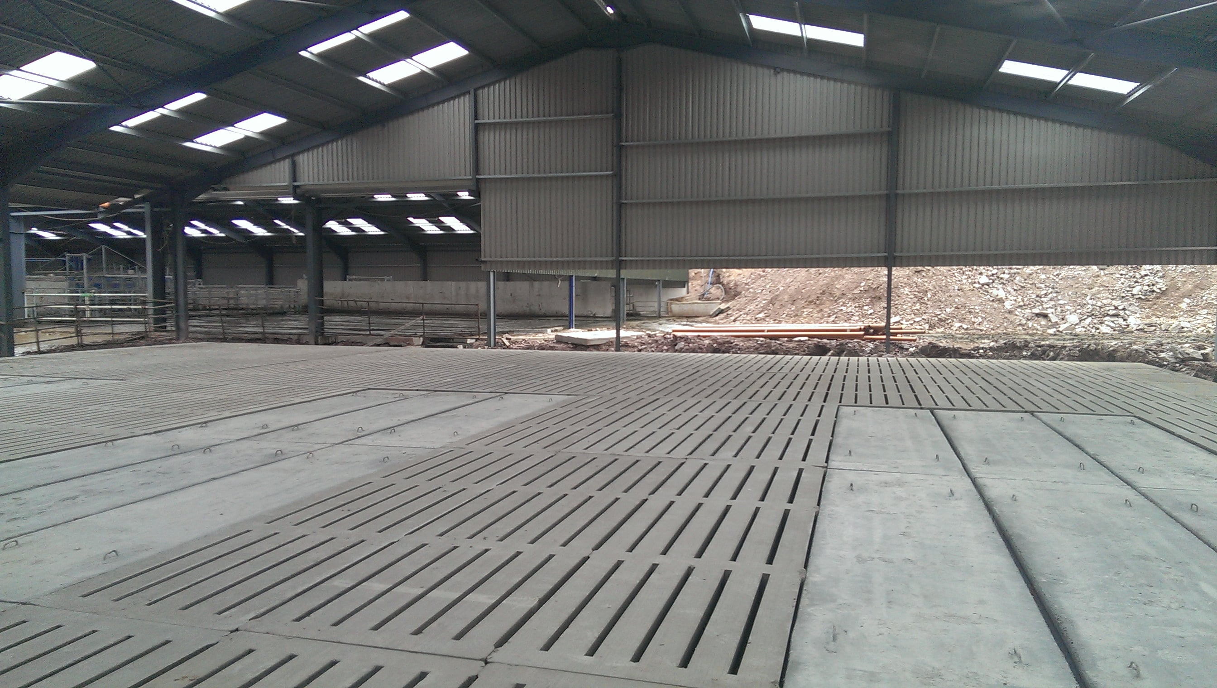
Electrical systems
Cold water systems
Space or water heating systems
Notes:
Buildings generally do not qualify for capital allowances.
However, farmers should be made aware that certain aspects of buildings might qualify. These items are called ‘integral features’. Most commonly, these include [click] Electrical Systems, [click] cold water systems, [click] and Space or water heating systems.
Therefore, a number of the items in your typical farm shed will qualify for capital allowances, including the annual investment allowance.
In addition, the tank and slats of a slatted shed are all considered plant for capital allowances, meaning all the groundwork and sub-groundwork in a shed, such as this, is deductible against the profits of the trade in the year of acquisition.
As for all capital additions, where the asset has been part-funded by a capital grant, the net amount of capital allowances available will be limited to the amount paid by the business itself, i.e. the total cost net of VAT, less capital grant received.

Slide 19
Annual Investment Allowance (AIA)
AIA is part of the total capital allowances (CA’s) a business may claim.
Up to £200,000 of additions per annum
CA’s are claimed after all other tax-adjustments.
CA’s are flexible, and do not need to be claimed in full. A business may claim less than the maximum amount if it is beneficial for tax purposes.

Slide 20
Using the Annual Investment Allowance (AIA) - example
£
Profit per accounts 20,000
Add: depreciation 25,000
Sub-total 45,000
Less: capital allowances (inc. AIA) (30,000)
Taxable profit 15,000
However, as always, capital expenditure should only be acquired where there is commercial benefit – it must not be simply to ‘reduce the tax bill’

Slide 21
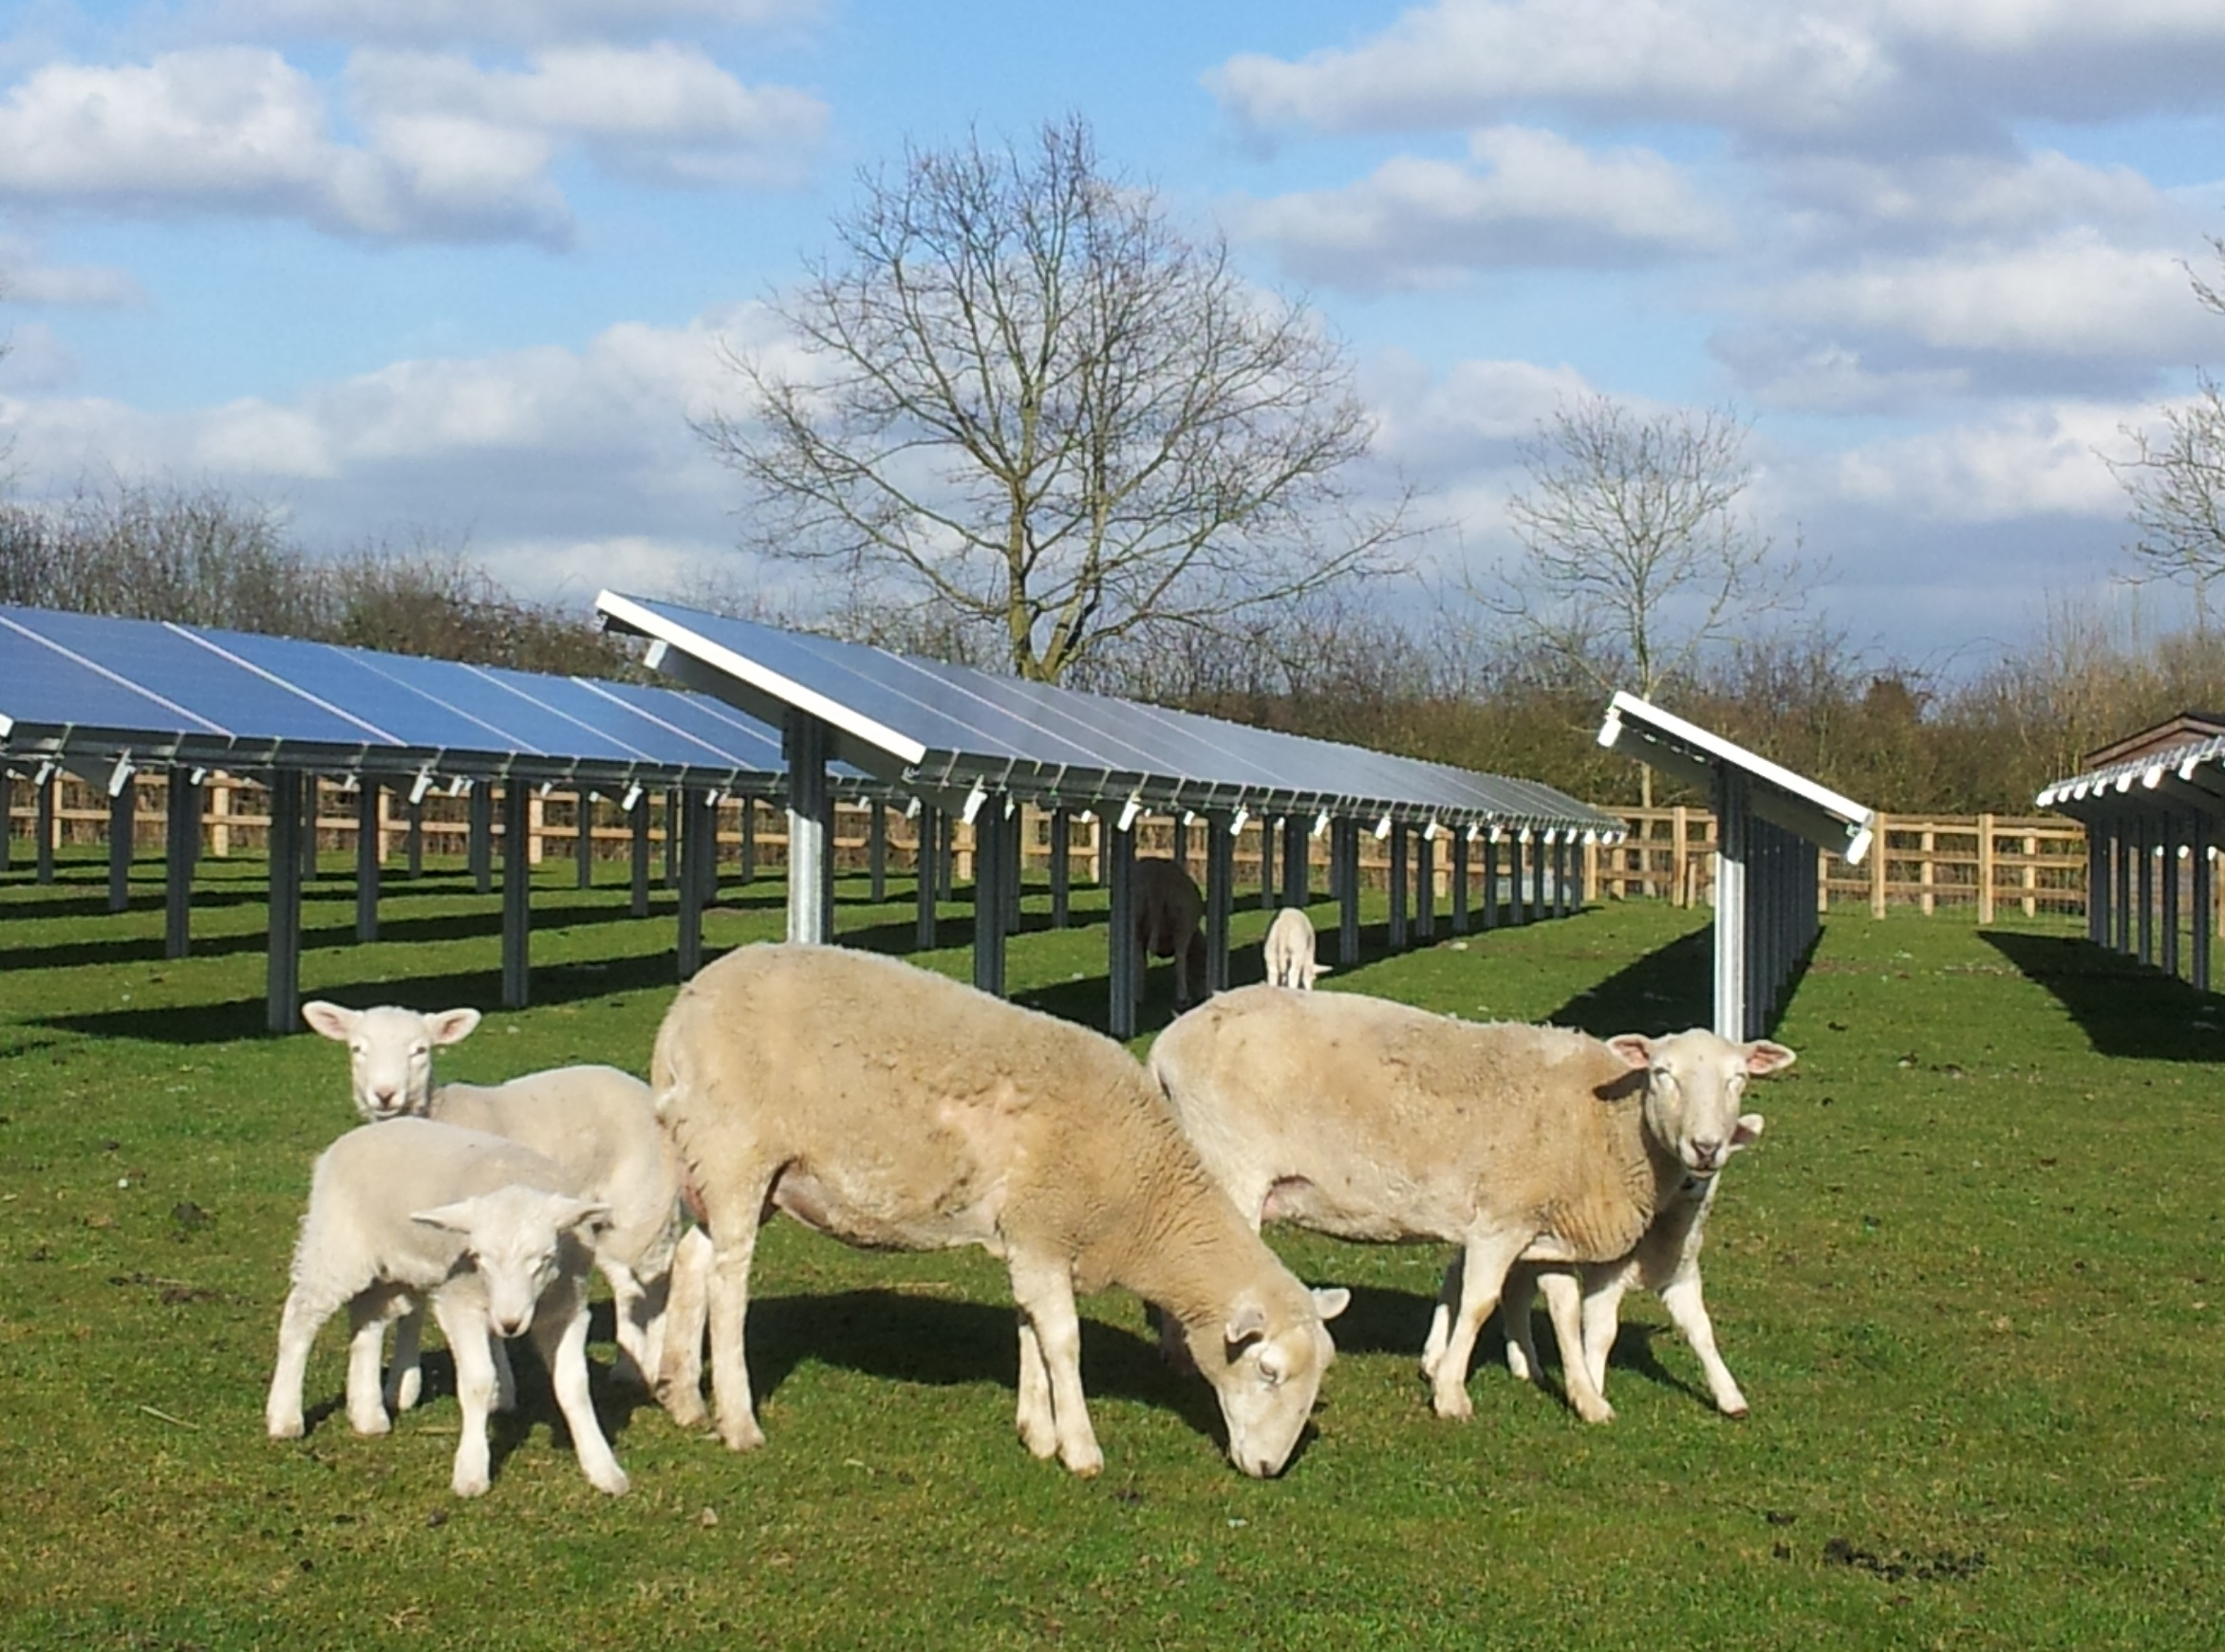
Enhanced Capital Allowances (ECA’s)
Notes:
Wind turbines and solar panels producing energy can qualify for capital allowances, including in most cases AIA.
However, certain other energy saving assets, including a solar heating system, can qualify for Enhanced Capital Allowances (ECA).
ECA’s allow a claim of 100% of the cost of the asset in the year of acquisition. This is over and above the AIA, so it can be worth a significant amount to the business.
As always, there are certain exclusions, and the conditions for qualifying costs is quite strict, so care is needed to check that the exact model being purchased by the client qualifies for the claim.
Why the sheep? This brings us on to another very important consideration for your clients – Entrepreneur’s Relief.

Slide 22
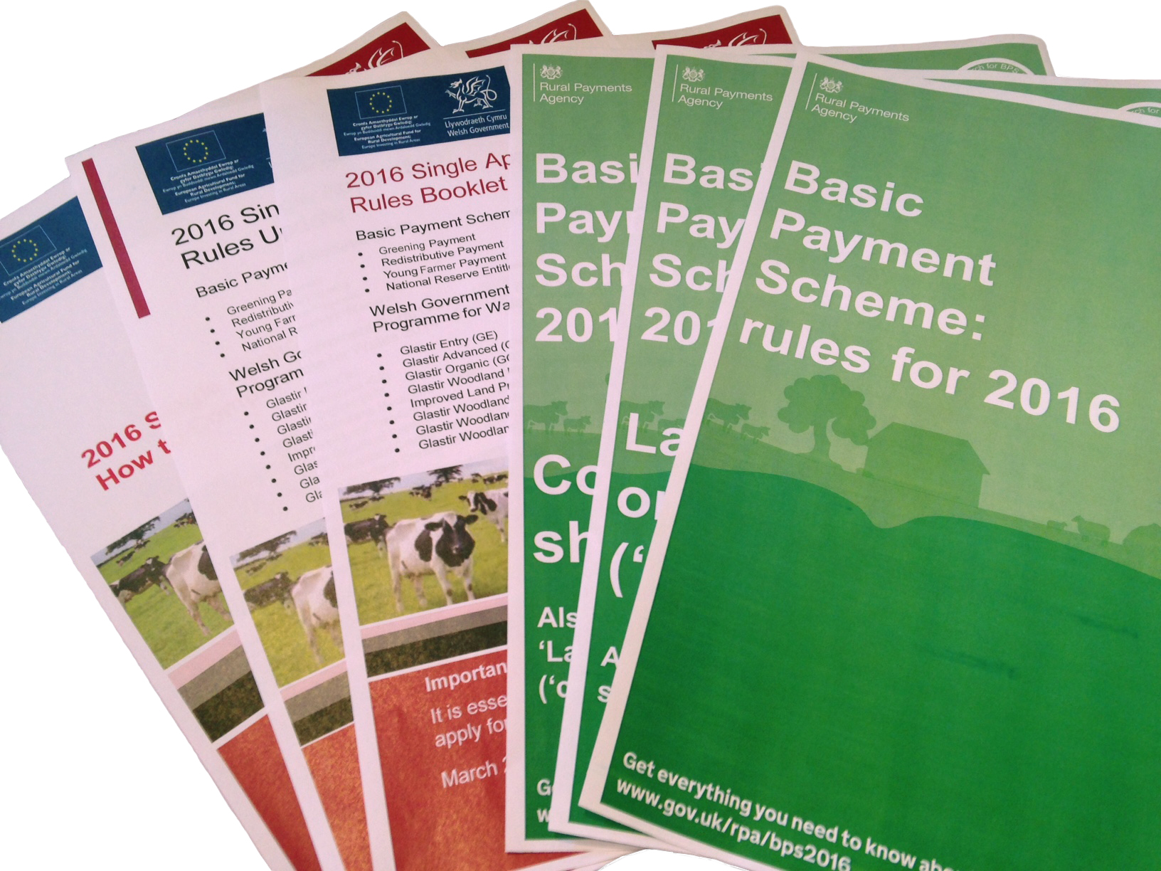

Slide 23
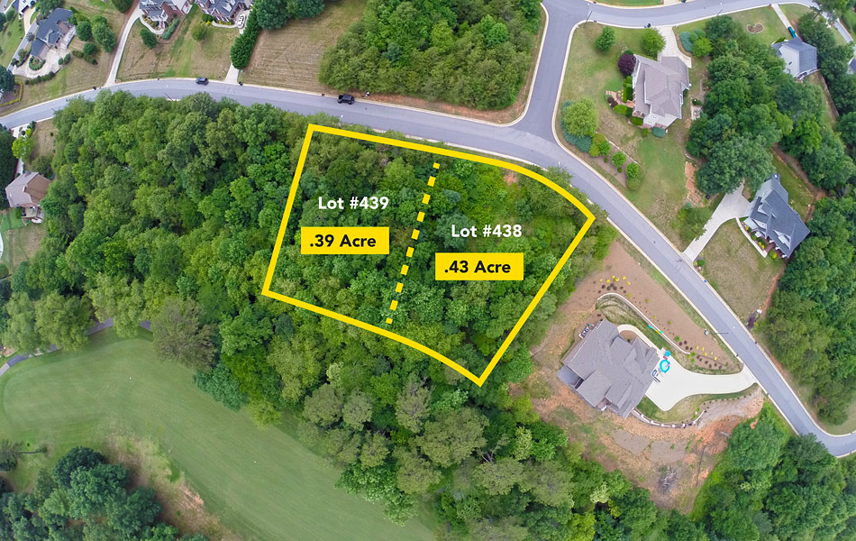
Entrepreneurs Relief – is there a ‘material disposal’?
Notes:
Many of you will be aware of Entrepreneurs Relief – the rate of tax available on certain capital gains on assets used in a business. These gains are taxable at only 10% rather than normal 10% rising to 20% (formerly 18% to 28%). What is key for ER is that there is a ‘material disposal’
To raise cashflow, it is common for many of our farming clients to look to sell off part of their land in plots for housing.
Unfortunately, sales of individual plots have been successfully argued by HMRC in the courts as not constituting a ‘material disposal’ where they are only part of the total land owned by the business, and do not represent a significant part of that land. Roughly speaking, ‘significant’ is 20% or more.
Similarly, assets which have not been used in the business for a certain period, including those for which the owner has paid himself a rent, will not qualify. The assets must be used in a trade – they cannot be ‘investment assets’
These are all important considerations when any of your clients is considering retirement, or even just looking to sell off part of their business.

Slide 24
Entrepreneurs Relief - Questions to be asked
Questions to be asked
Is there a material disposal? | Yes
Has the asset been used in the trade? | Yes
Has it always been used in the trade? | Yes
Has the owner paid himself a rent for the use of the asset? | Yes
Was this rent less than the market value? | Yes
Entrepreneur’s relief available? | Probably…
Is there a material disposal?
Yes
Has the asset been used in the trade?
Yes
Has is always been used in the trade?
Yes
Has the owner paid himself a rent for the use of the asset?
Yes
Was this rent less than the market value?
Yes
Entrepreneur’s relief available?
Possibly…

Slide 25
Holdover Relief
Available for trading assets gifted, or
Assets which are immediately chargeable to IHT
Has the effect of reducing the tax base cost of the recipient
Donor only pays CGT on the ‘actual gain’ (proceeds > cost)
If no actual proceeds, then no taxable gain

Slide 26
Rollover Relief
Available for gains on assets used by the taxpayer in:
His trade
A trade carried on by her personal company – payment of a rent from a personal company does not preclude rollover relief being available
Can roll-over the gain into new asset acquired
1 year before disposal
3 years after disposal
Full proceeds must be reinvested
If less, the gain equal to proceeds not reinvested is chargeable immediately

Slide 27
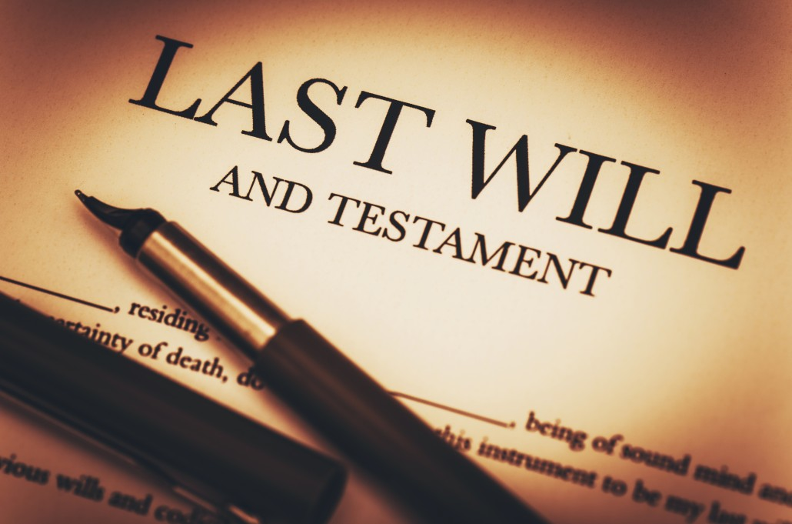
Notes:
One other capital tax which must be considered is Inheritance Tax, or IHT.
Thankfully, there is a specific IHT relief available to most farmers, called Agricultural Property Relief. The effect of APR is that the value of the trading assets, including land and buildings, are not included in the deceased’s estate for IHT purposes.
Assets which qualify for APR include farmland, woodland, and associated buildings. In addition, a farm’s main farmhouse will qualify so long as it is reasonable in size compared to the farming activity being carried on from it.
APR applies not only on the death of the farmer, but can apply on the transfer of farming assets gifted during the farmer’s lifetime. Transfers during the lifetime are called potentially exempt transfers (or PET’s for short).
A PET occurs anytime value is transferred during the farmer’s lifetime – such as bringing in a new partner to the business (unless there is consideration for bringing in the partner).
APR only applies to the agricultural value of the property, i.e. the value if it could only be used for agriculture.

Slide 28
However, tax relief is only the start of it!
Current Scottish succession law is designed to protect your family from being ‘disinherited’.
This means that, regardless of your will, your spouse and children will have a ‘legal rights’ claim over the moveable portion of your estate.
A farm land and buildings held in a partnership’s name, or within a company, is considered ‘moveable’ rather than heritable.
What does this mean for you…?

Slide 29
Consider this example
Assume you own a farm worth £1,500,000 in the name of your partnership, and you have a will leaving everything to your spouse.
The partnership is owned 75:25 between you and your spouse. Your children have no share in the farm, and do not wish to continue working in the farm.
You might assume that the whole of your 75% share in the farm is passed directly to your spouse on your death? After all, this is what you desire in your will.
Unfortunately, this is not the case.

Slide 30
Consider this example (cont.)
Your spouse keeps his 25% share in the farm upon your death.
Thereafter, the legal rights claims would be as follows:
Spouse is entitled to further 1/3 share of the farm – the 75% which you own. £375,000
Your children are then entitled to another 1/3 of your share of the farm - £375,000 split evenly between them.
The remaining share will then pass to your spouse in accordance with your will.
If no will was in place, your children’s share could be substantially higher!
Potentially quite a costly death! How would you raise the funds to pay this out?

Slide 31
What we recommend
To prevent a costly disruption to your trade:
Remove the farm land and buildings from the partnership/company
If finance is involved, banks should be ok with this so long as there is a guarantee as security over their debt
However, consider the LBTT cost of any movements out of a company
Ensure you have an accurate, up-to-date will in place
Intestacy is rarely beneficial to the continuation of the business
If your children are sufficiently provided for, they might be less likely to invoke their legal rights claim!
If appropriate, consider taking out life insurance for the value of the legal rights claim which your children would have

Slide 32
Notes:
From 1 April 2015 a new tax was introduced in Scotland – ‘woo hoo, new tax!’ I hear you cry.
Land and Buildings Transaction Tax was the first tax to be introduced by the Scottish Parliament in 300 years. This was largely a positive move, which brought in a new graduated tax system on the sale of land and buildings in Scotland, replacing the old ‘slab’ structure employed by ‘stamp duty land tax’.
How is this relevant to our clients? LBTT is payable upon the transfer of all transfers of land and buildings, where chargeable consideration is involved. A farmer looking to incorporate – LBTT must be considered. A farmer looking to transfer farm assets to their son – LBTT must be considered.

Slide 33
LBTT rates – Residential
Purchase price | Residential | Plus ADS
£nil - £40,000 | 0% | 0%
£40,001 - £145,000 | 0% | 3%
£145,001 - £250,000 | 2% | 5%
£250,001 - £325,000 | 5% | 8%
£325,001 - £750,000 | 10% | 13%
> £750,001 | 12% | 15%

Slide 34
LBTT rates – Non-Residential
Purchase price | Non-Residential
£nil - £150,000 | 0%
£150,001 - £350,000 | 3%
>£350,000 | 4.5%

Slide 35
Notes:
Tax will most likely be a key factor in your clients decision as to the business structure, the assets acquired (and the timing of those purchases). However, whatever the decision, the overall commercial impact must be considered

Slide 36
Scottish Rate of Income Tax
Taking back control
…slightly
Notes:
Everyone seen the little ‘S’ next to their PAYE code?
From 6 April 2016, the Scottish parliament controls 10p in every pound of income we earn. It only applies to non-savings and non-dividend income.
What has this resulted in so far? Very little.
Holyrood have kept the Scottish income tax rates in line with the rest of the UK.

Slide 37
Scottish Rate of Income Tax – quick comparison
 | Personal Allowance (UK & Scotland) | Higher Rate Threshold (UK) | Higher Rate Threshold (Scotland) | Additional Rate Threshold (UKG Plans)
2017/18 | £11,500 | £45,000 | £43,000 | £150,000
2018/19 | £11,850 | £46,350 | £43,430 | £150,000
Holyrood has no power to raise the personal allowance
40% threshold to increase in line with CPI
Currently Scottish taxpayers pay £400 more than the rest of the UK, £440 if NIC is included. This is increasing to £584 (£642 including NIC) from 6 April 2018.
Effective tax rate of 53% on earnings between Scottish and UK higher rate bands!

Slide 38
But now there’s more (2018/19)
Earnings | Band Name | Scottish Income Tax Rate
£nil - £11,850 | Personal allowance | Nil
£11,851 - £13,850 | Starter rate | 19%
£13,851 - £24,000 | Basic rate | 20%
£24,001 - £43,430 | Intermediate rate | 21%
£43,431 - £150,000 | Higher rate | 41%
Over £150,000 | Top rate | 46%

Slide 39
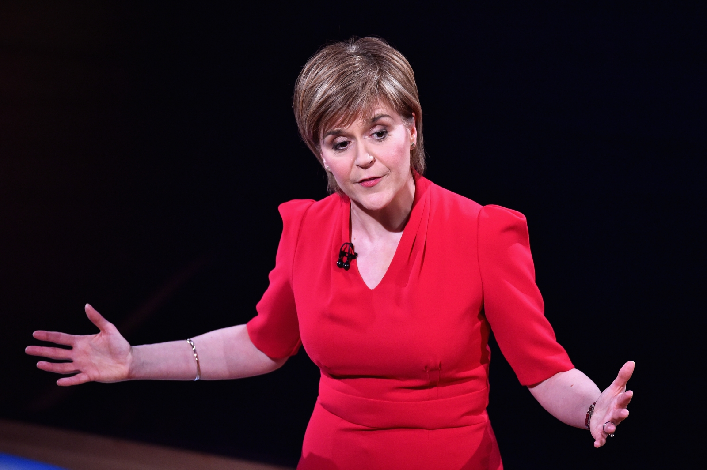
We’re going to raise this much extra!
Notes:
National Insurance hasn’t been devolved to Scotland. You might think, ‘so what?’.
For many years, the national insurance higher rate threshold has increased in line with the income tax threshold.
However, going forward, whilst the NI threshold will continue to rise in line with the UK income tax basic rate threshold, The Scottish Government plan to only increase the Scottish basic rate band in line with inflation.
What this means is, from 6 April 2017, Scottish employees earning roughly £43k per annum will pay an effective rate of 52% on the top part of their income! By 2020/21, this could result in people earning £50k per annum over £1,600 extra a year in tax and NI compare to taxpayers in England and Wales!

Slide 40
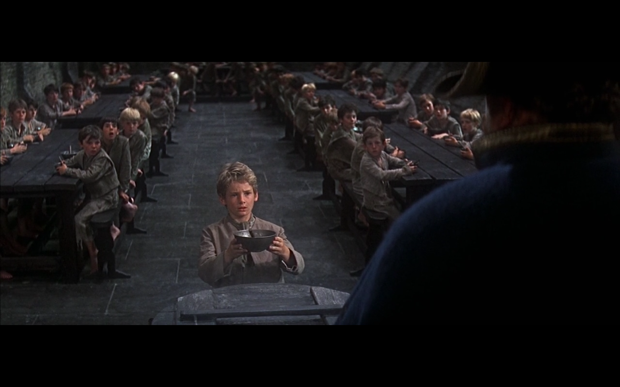
Notes:
All businessmen and women wish to extract their profits in the most tax efficient manner available.
Your unincorporated clients remain relatively simple from an income tax perspective. They are simply taxed on their share of the business’s taxable profits, after deduction of capital allowances.
For the incorporated clients, it is a little more complicated. The company subject to corporation tax on its profits. For the owners, the remuneration choice is a salary and dividends, or a mix of the two. Salaries are tax-deductible for the company, whereas dividends are paid by the company out of its post-tax profits. Both sources of income are taxable in the hands of the owner recipient.
Taking a simple example, we can see the difference in overall retained profit between an unincorporated farm and an incorporated farm. [click slide]

Slide 41
What type of remuneration?
Earnings | Salary | Dividends *
£nil - £11,850 | Nil | 0%
£11,851 - £13,850 | 19% | 7.5%*
£13,851 - £24,000 | 20% | 7.5%*
£24,001 - £43,430 | 21% | 7.5%
£43,431 - £150,000 | 41% | 32.5%
Over £150,000 | 46% | 38.1%
*Note that there currently is a 0% tax band on the first £5,000 of dividends received in the year. This is falling to £2,000 from 6 April 2018, so make sure and declare any dividends before that date!

Slide 42
What type of remuneration 2018/19 (including NIC)
Earnings | Salary | NIC | Dividends *
£nil - £8,424 | Nil | 0% | 0%
£8,425 - £11,850 | Nil | 12% | 7.5%*
£11,851 - £13,850 | 19% | 12% | 7.5%*
£13,851 - £24,000 | 20% | 12% | 7.5%*
£24,001 - £43,430 | 21% | 12% | 7.5%
£43,431 - £46,350 | 41% | 12% | 32.5%
£46,351 - £150,000 | 41% | 2% | 32.5%

Slide 43
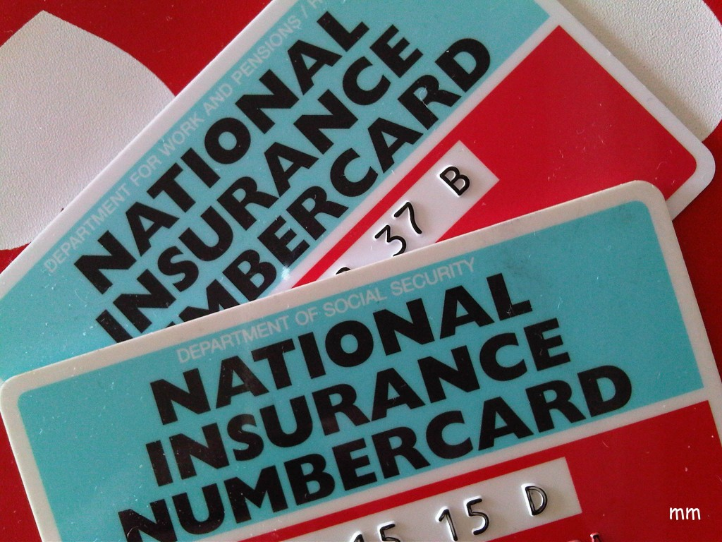
Notes:
Since 2014/15, all employers have been able to claim the Employers NI allowance. This was initially £2,000 per annum, meaning the first £2,000 of the employer NI liability did not have to be paid to HMRC. From 6 April 2016 onwards, this allowance has increased to £3,000 – representing a great saving to small businesses.
As this allowance only applies to employers, only those farms with employees will benefit from the allowance. Unincorporated farmers, with no employees, will not be eligible for the allowance.
The increase in 2016/17 was also met with a further change designed to reduce the potential for tax evasion. From that date, companies whose only employee is a director will not qualify for the allowance. Therefore, if the company has a second employee earning over the secondary NI threshold (£8,112 for 2016/17, or £156 per week) the company will continue to qualify for the allowance.

Slide 44
Notes:
Another consideration for all farms who employ staff is those of auto enrolment.
Rates, dates, exemptions and overall impact to be discussed

Slide 45
Notes:
Consideration of young family, reduction in annual income and increased availability to be discussed.

Slide 46
READY TO SUCCEED?

