Slide 1
Reading between the lines
What to look for in your accounts
Welcome
Carfraemill 13th March
New Lanark 14th March

Slide 2
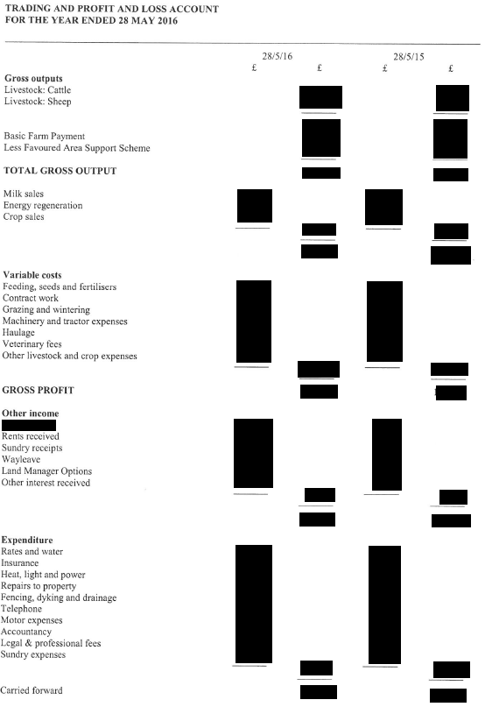

Slide 3
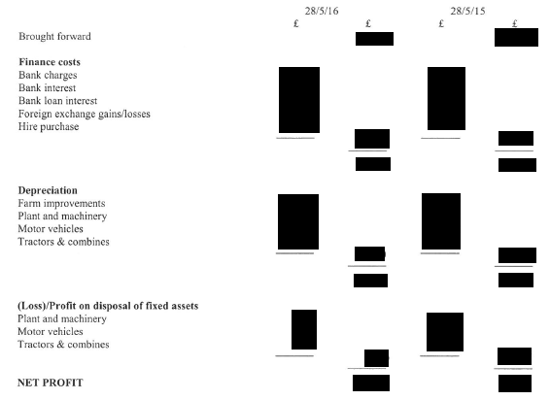

Slide 4
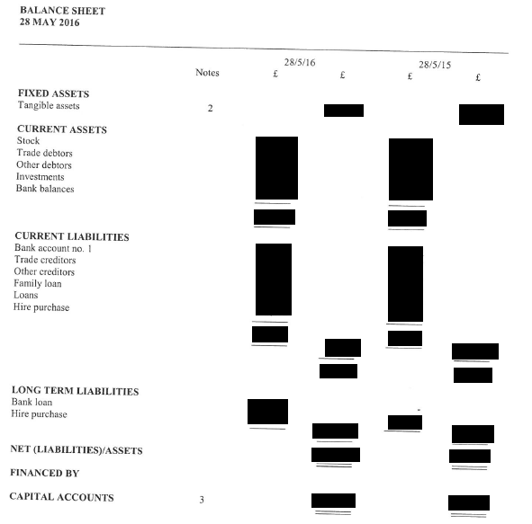

Slide 5
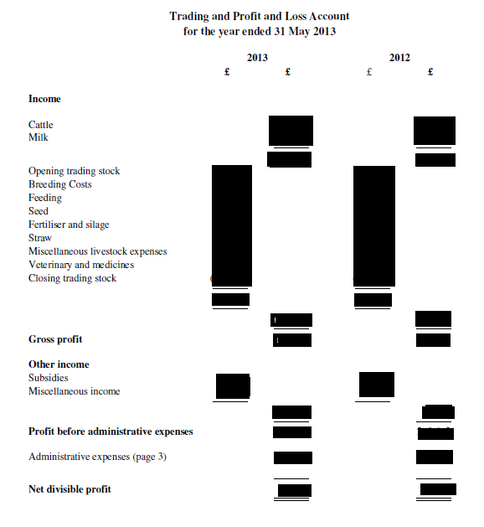

Slide 6
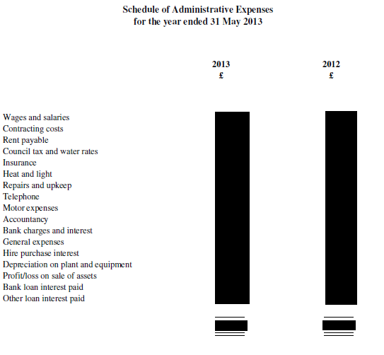

Slide 7
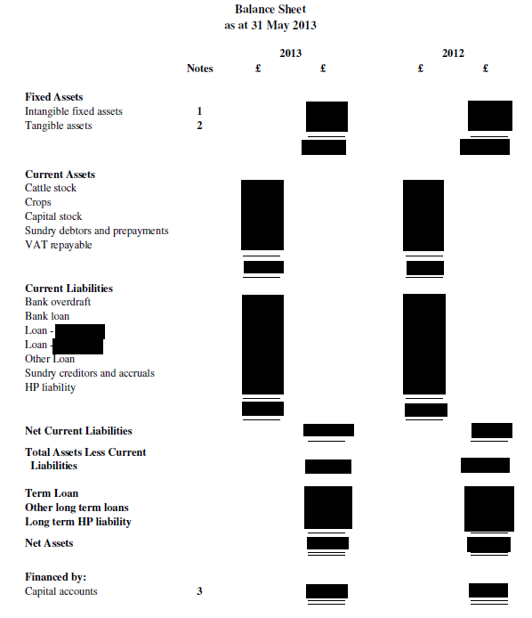

Slide 8
Gross Output Analysis

Slide 9
Owner’s Equity
% owner equity =
Net Worth(Net Assets) /Total Assets
X 100
-should be 70% for owner occupier

Slide 10
Thank You

