Slide 1
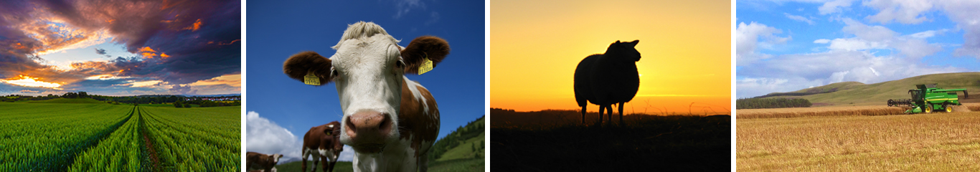
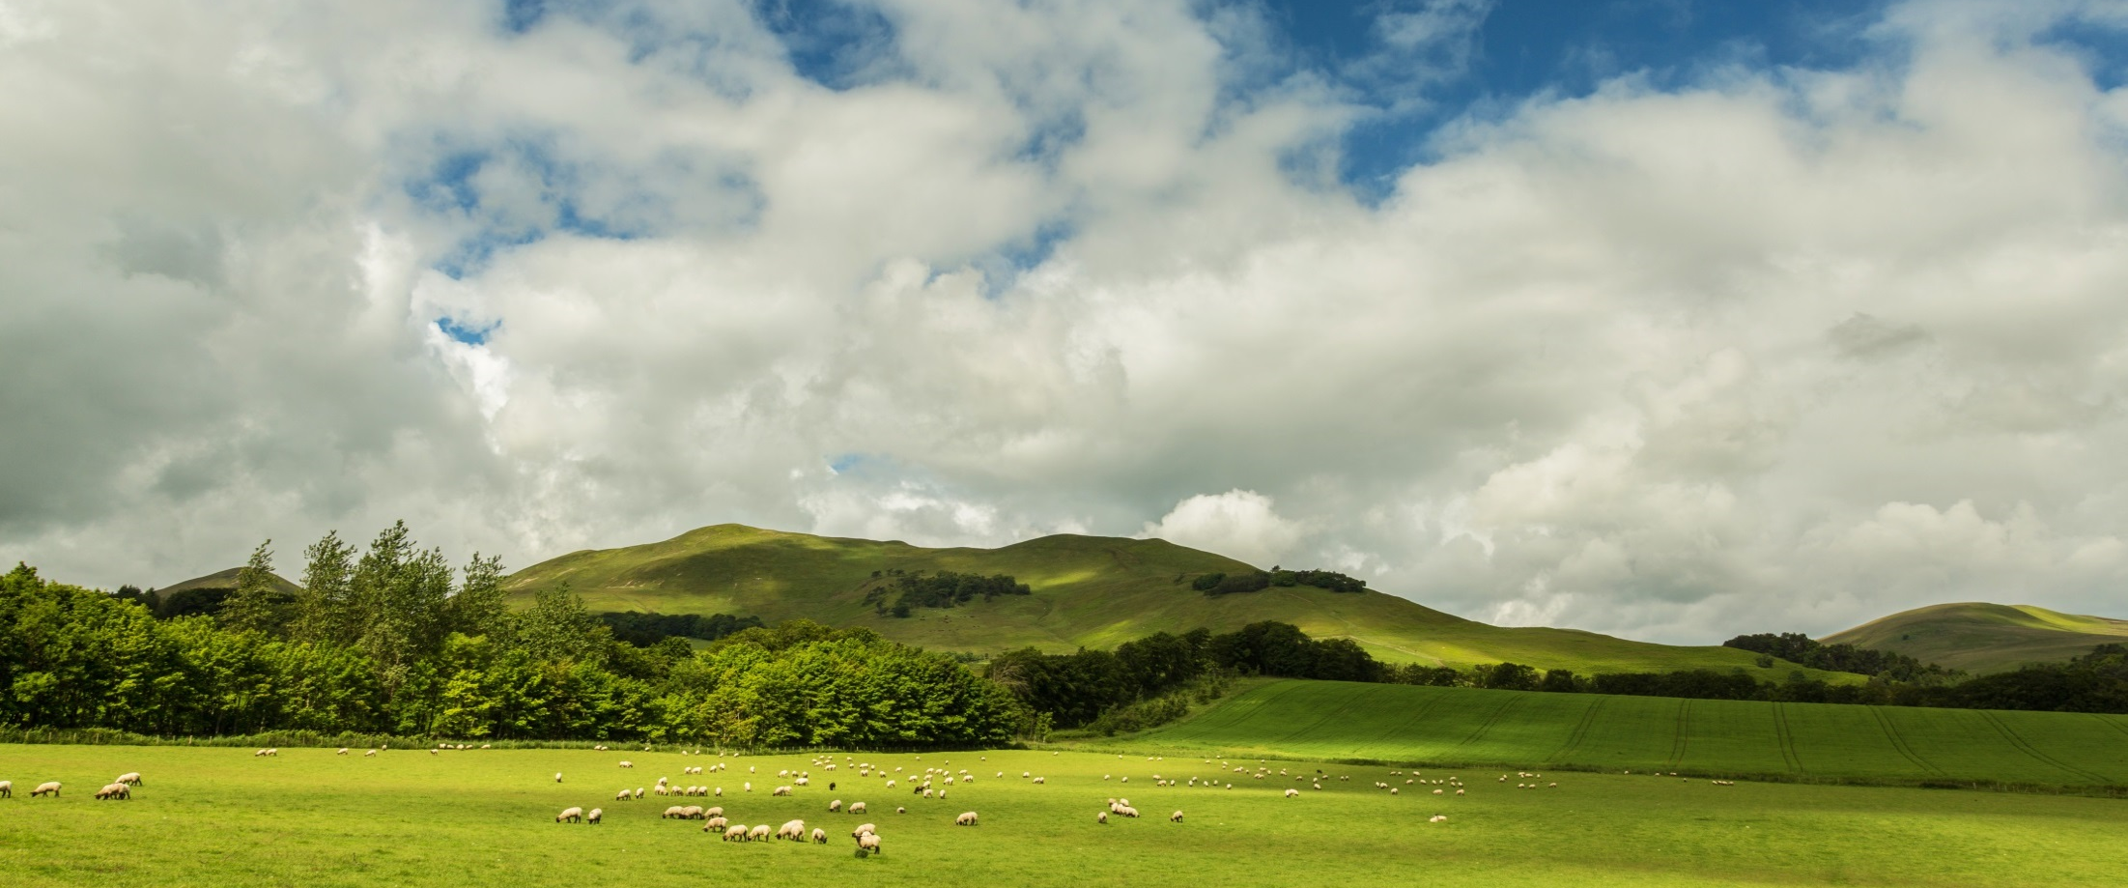

Slide 2

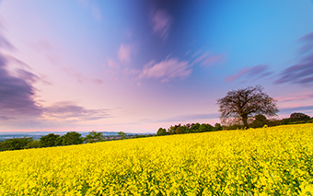
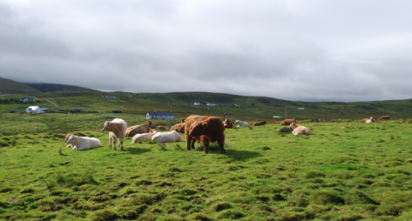
Programme:
9.30 am | Arrival
9.45 am | Introduction & Welcome
10.00 am | Stock Selection
11.30 am | Nutrition
12.3 0pm | LUNCH
1.00 pm | Paperwork & Cross Compliance
2.00 pm | Health Planning
3.00 pm | COFFEE
3.15 pm | Fencing
3.45 pm | Questions & Discussion | All
Notes:
Introduction:
Housekeeping – toilets, fire escape, fire alarm etc.
Feedback forms – these need to be completed at the end.
Introduction – who we are, what these events are about.
Plan for the day.

Slide 3
Stock Selection

Slide 4
Terminology
Cow
Heifer
  ‘stirk’
  ‘bulling’
  ‘in-calf’,
  ‘calved’.
Normally the ideal is to bull at about 15 months to calve at 2 yo.

Slide 5
Terminology
Bullock – castrated male bovine
Bull – entire male bovine

Slide 6
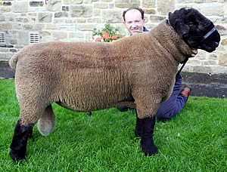
What would you call this Suffolk male sheep?
Notes:
Ram, tup, could be a shearling

Slide 7
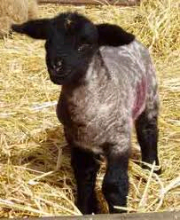
Terminology: EWE LAMB
Female lamb from time of birth until weaned
or
until the new year
Notes:
Different terms often depending on where you are in the country – can be confusing, but the headings used here are those used by the Scottish Government for record-keeping.

Slide 8
Terminology: HOGG
Female - from weaning until shorn for 1st time.

Slide 9
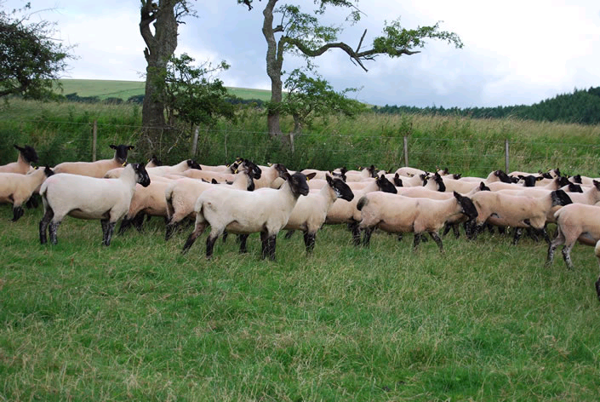
Terminology: GIMMER
Female sheep after first shearing until has first lamb (or sooked gimmer if she lambed as hogg)

Slide 10
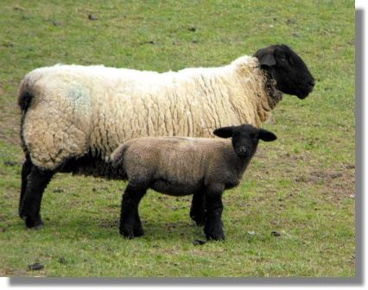
Terminology: EWE
Any female sheep that has lambed

Slide 11
Terminology: DRAFT EWE /
CAST EWE
A ewe removed from hill or upland farm to a lowground unit for further breeding
- in more favourable conditions!
Notes:
Note cast can also mean stuck on back!

Slide 12
Terminology: CULL EWE
A ewe no longer fit for breeding. Could be any age.
Reasons
  Teeth
  Udder
  Feet
  Condition
  Health
  Caesarean section

Slide 13
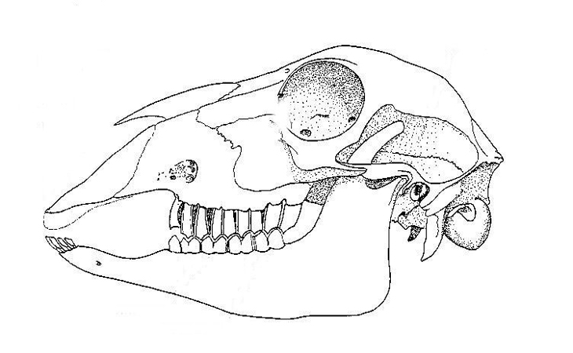
SMILE! How to tell a sheep’s age
Sheep have incisors at the front lower jaw, and a dental pad at the front upper.
At the back of the jaw are molars, top and bottom.
The age of a sheep can be determined by its teeth.

Slide 14
TEETH
Lamb - starts with 8 temporary incisor (front) milk teeth
Hogg - the centre pair of permanent teeth start to erupt at 12 months of age.
At 12-18 months old - first central pair of permanent teeth present (hogg/gimmer/wether/shearling)
At 21-24 months old - second pair present 4-tooth (gimmer/wether/tup)
At 30-36 months old - third pair present - 6-tooth (ewe/tup)
At 42-48 months old – ‘Full mouth’ - complete set of 8 permanent teeth present
Next….Breeds
Notes:
Easy way to remember is divide the number of teeth by two to give age in years, up to 8 teeth.

Slide 15
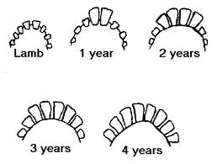
Teeth
‘

Slide 16
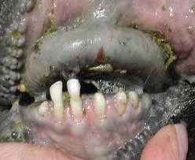
Broken mouth

Slide 17
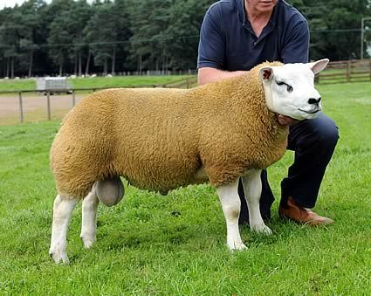
Terminology: RAM or TUP
Male - not castrated and left ‘entire’ for breeding.

Slide 18
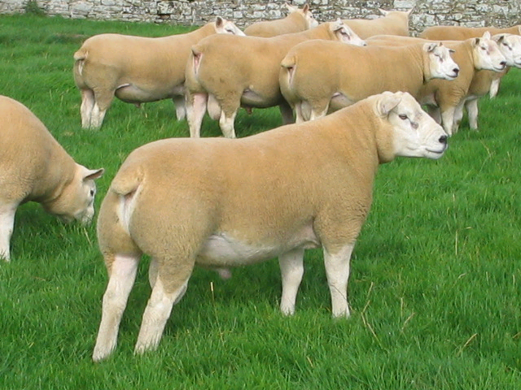
Terminology: SHEARLING
A ram or tup that has been shorn once.
Notes:
Note sometimes the term shearling is also applied to ewes, ie, gimmers.

Slide 19
Terminology: RIG
A Male that is either
Not properly castrated
With only one testicle
With arrested testicles
Notes:
Will look the same as a ram.

Slide 20
Terminology: TEASER
  A Vasectomised male kept for
  stimulating ewes into oestrus or heat
  identifying non pregnant ewes

Slide 21
Terminology: WETHER/
WEDDER/TEGS
Male lamb castrated and intended for slaughter.

Slide 22

Terminology: WETHER
HOGG
Wether - from weaning onwards
Notes:
Note both males and females might be called hoggs, but wether hoggs could be any age, whereas female hoggs change into gimmers.
Wether mutton – a favourite of Price Charles.

Slide 23
Terminology: STORE/FINISHING/FAT LAMB
Store- lamb put up for sale in the Autumn
Finishing- lamb that is being fattened
Fattening- same as finishing
Notes:
Store - Term used to describe lambs put up for sale in the Autumn from any farm but usually hill and upland units where finishing difficult
Can be sold onto a finishing farm or bought to tidy up grain stubbles or grass field, then sold on.
Store Hill lambs < > 16 - 25 kgs
Store Upland lambs < > 25 - 35 kgs

Slide 24
Stock Selection
  What type of stock?
  What breed of stock?
  Where to purchase?
  What to look for in a potential purchase?
Notes:
There is no single ideal type or breed, but there is an ideal type for any given situation. Even if you already have some stock, it’s always good to look about for other breeds that might suit your requirements better, and help you to adapt as your enterprise grows.
In the UK most breeds of livestock were designed for a particular purpose/management system. If you understand a little about what the purpose was, it will give you an idea about the suitability for what you want to do.
Today’s most popular commercial breeds have been developed to do very specific things, e.g. producing a chop or steak that fits in a standard packet, without too much fat, in as quick a time as possible. If you are trying to make a living then this is clearly critical, and since the supermarkets are trying to provide exactly what the customer wants, this appears to be what we want our farmers to do.

Slide 25
What do you want?
Cattle and/or Sheep?
Type?
Breed?

Slide 26
Cattle and/or Sheep?
Handling facilities
Housing
Type of land
Objective

Slide 27
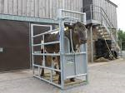

Handling
Cattle handling systems bigger, heavier, £+
Cattle generally more likely to need winter housing
More important to have practical skill when handling cattle, especially if handling system more basic
Cattle better grazers of very rough overgrown vegetation
Sheep much smaller – less poaching
Sheep better complement to horses?
Notes:
Cattle handling is a H&S issue as well as welfare.
Need to have adequate handling system, even for small number of stock. A skilled stockman may be able to get by with more basic facilities (e.g. and use a halter to restrain cattle) but this not for beginners.
Cattle better on rough overgrown land
A basic system of a crush and a few cattle hurdles for a small number of cattle could be £1,500. The equivalent for sheep (4 hurdles) is less than £100.

Slide 28
Housing
Cattle more likely to need winter housing
Cattle housing/equipment needs to be more robust
A 12’ x 12’ loosebox (i.e. horse stable size) would house 3 – 4 young cattle (200 – 350 kg), 2 cows + calves, or 10 – 14 sheep.
Consider fencing – very different requirements (sheep wriggle out, cattle bringe over/through!)

Slide 29
Type of Land
Rough grazing may benefit from cattle grazing
Wetter land could be ‘poached’ – cattle bigger so greater poaching risk. Risk greatest if supplementary feeding outside, e.g. ring feeders.
Pollution risk?

Slide 30
What Type of Stock?
Meat
Milk
Wool
Pedigree/Showing
Habitat Management
Lawn-mowing!
Pets
Notes:
One of the most important things is to identify what you want your stock to do.

Slide 31
What Breed of Stock
Once you’ve identified the type of stock, i.e. hardy sheep, milky cows, etc
  Look at different breeds
  What catches your eye?
  Speak to producers – do others keep them in the same system as you intend? What is their experience?
Breeds are largely influenced by Environment and Purpose

Slide 32
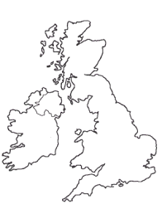
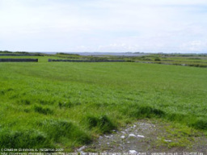
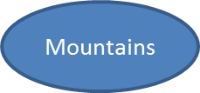
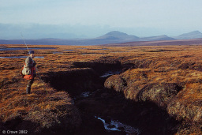
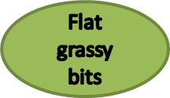

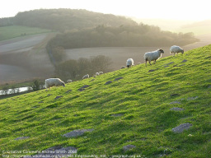
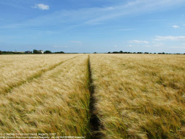

A little history…
‘Environment’
Mountains
Flat grassy bits
Notes:
There is a breed for just about every situation imaginable. Helps to understand a bit about how they evolved.

Slide 33
A little history…
‘Purpose’
WOOL
Mountains
MILK
Flat grassy bits
MEAT
Notes:
Wool – a certain amount is needed to keep the animal warm, but historically wool was a highly valuable material (pre-cotton from America/synthetic fibres) so selected for wool. Drove medieval wars, the Highland Clearances and big influence on historic international policy. Sheep were big business. Only really when imports from far east started coming through in middle of 20th Century did it start to dry up.
Milk – for most of history milk was produced from dual-purpose cattle – rear a calf and provide milk for the family/local community. Dairying as we know it probably only took off with the advent of the railways – transport was always an issue. Feed was expensive and forage quality, particularly in winter, poor by today’s standards – so needed to be fairly hardy. Compromises.
Meat – In the times before modern production systems there was always a compromise between having reasonably hardy cattle, cattle which could be handled (i.e. smaller). Also no EBVs!

Slide 34


Horses for Courses
Small & hardy
Bigger, less compromise
Notes:
In the flat fertilie lowlands, you decide what you want the animal to do (e.g. milk, meat, long lustrous wool etc) and breed accordingly. However in the upland areas the stock need to be smaller and more hardy, and there are more compromises. This is probably why the specialists of the livestock world (e.g. a Wensleydale) come from sunnier climes, whilst in harsh environments the stock are more likely to look similar – small and woolly/hairy!

Slide 35
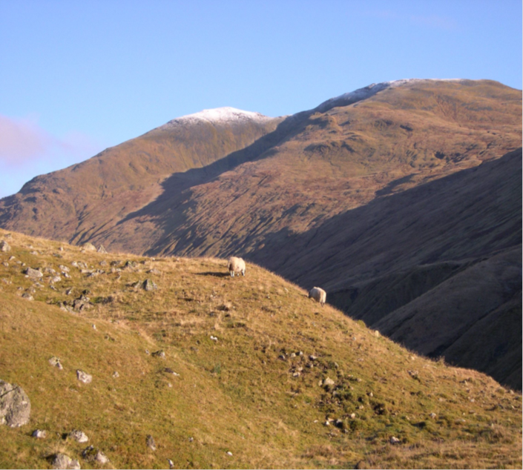
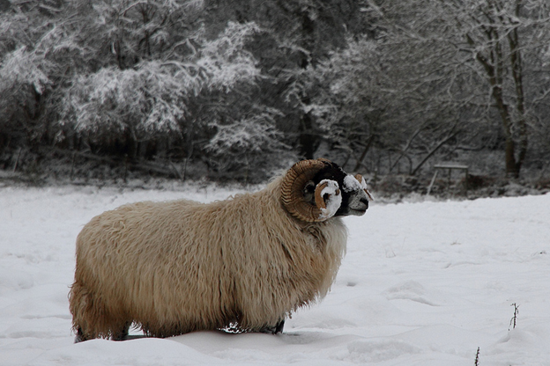
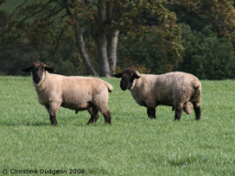
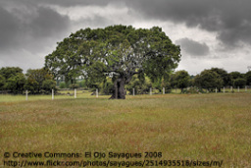
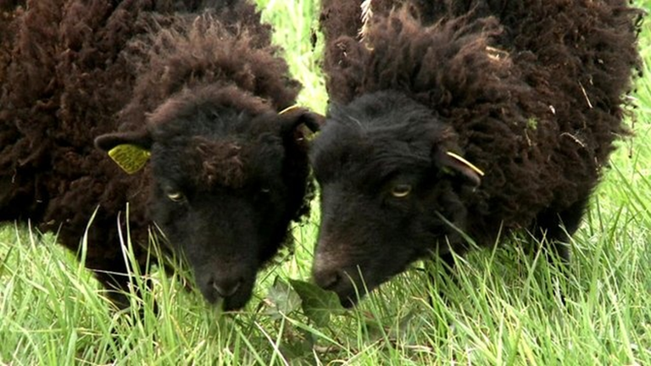
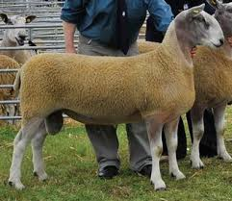
Horses for Courses
Small & hardy
Bigger, less compromise

Slide 36
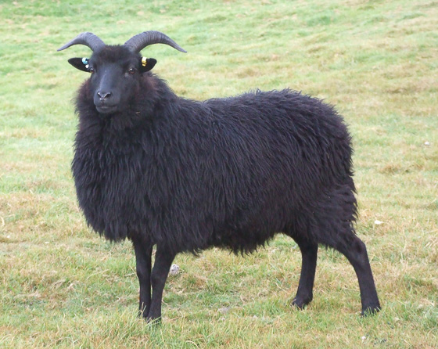
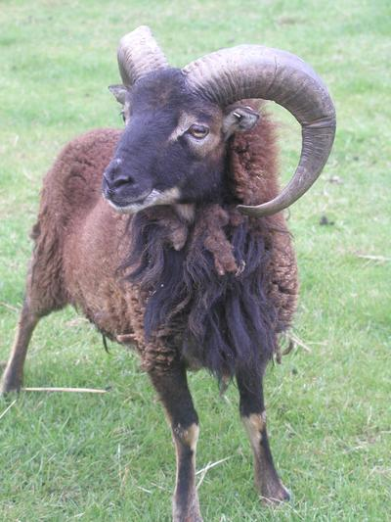

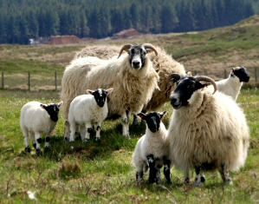
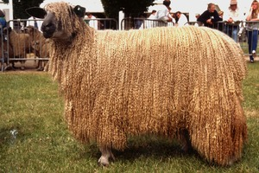
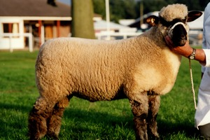

Native Sheep
Shetland
Small & hardy
Cheviot
Hebridean
Soay
Blackface
Herdwick
Kerry Hill
Welsh Mountain
Leicester
Bigger, less compromise
Lleyn
Oxford Down
Suffolk
Hampshire Down
Notes:
So this is why, even though there is great variety in our hill sheep breeds, they all tend to be fairly small.

Slide 37
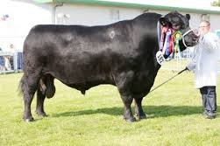
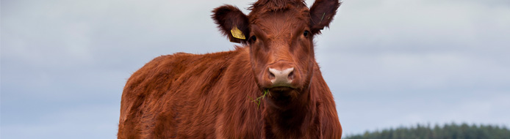
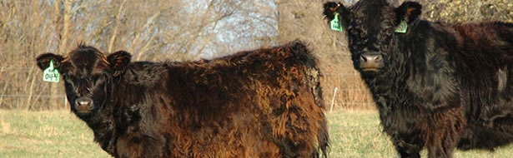
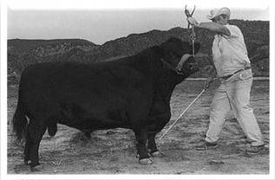
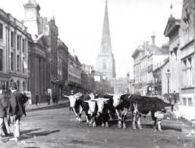
Native Cattle
Shetland
Highland
Aberdeen Angus
Luing
Galloway
Shorthorn
Dexter
Lincoln Red
Hereford
White Park
Devon
Notes:
Cattle have a similar pattern, but not quite so noticeable because they were more likely to be housed in winter (you can’t milk a cow or get her to pull your cart to market if she’s miles away on a mountain).

Slide 38
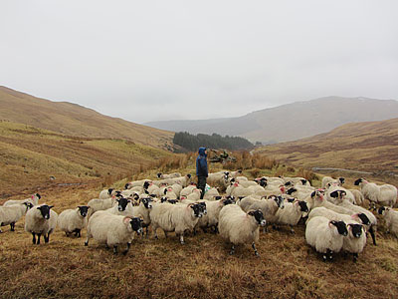
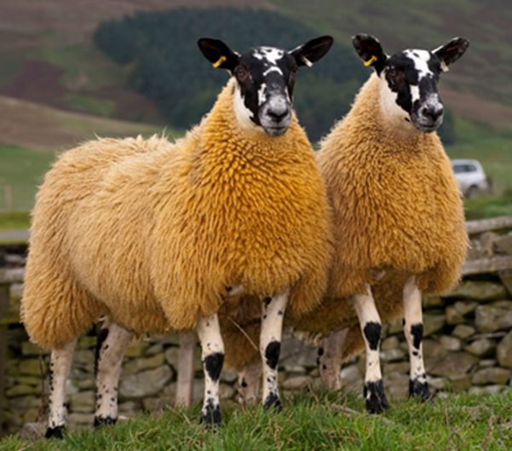
Cross Breeds
Useful ‘blend’ of attributes
  E.g milk, maternal ability, hardiness
Hybrid vigour
Scotch Mule Ewe: Blackface x Bluefaced Leicester
Notes:
Some common sheep aren’t breeds at all. The ‘Mule’ is a good example. The ‘Mule’ is the most common sheep in the UK, and they have their own societies. However they aren’t a breed. They are a crossbreed.
They don’t tend to breed ‘true’, i.e. you get much inconsistency when you cross them back together, some look like a BFL, and some like a BF.

Slide 39
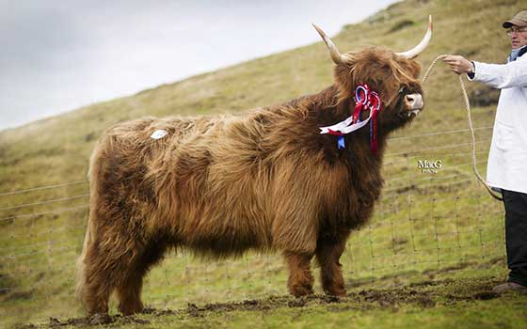
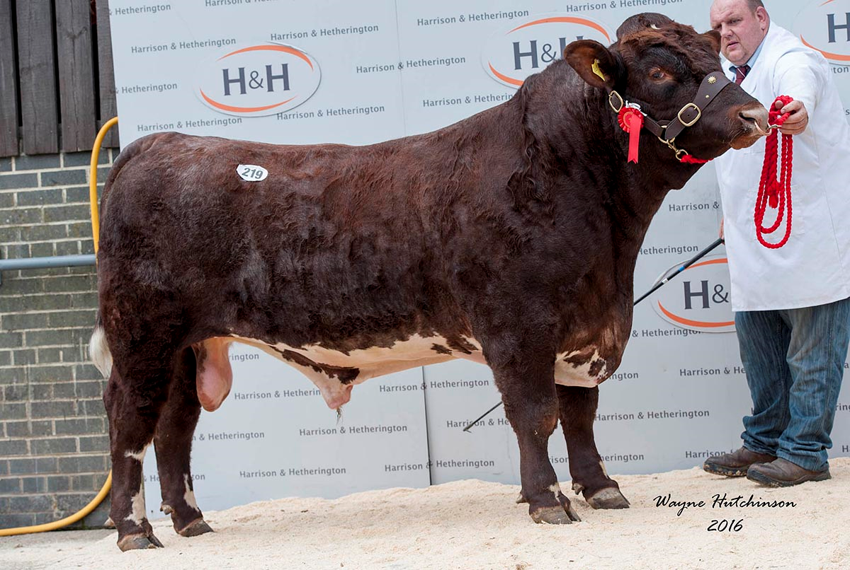
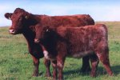


Luing Cattle
Luing cattle – a ‘new breed’ (1940’s)
Historically Highland x Beef Shorthorn
F1 crosses very consistent – breed in own right.
Notes:
Luing cattle started off as a crossbreed, but when you cross them with each other they bred fairly true, and a new breed was born.

Slide 40
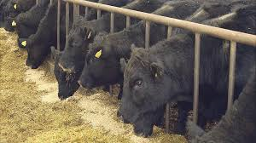
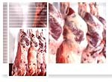
Large-scale production needs different attributes, the ‘values’ of the whole supply chain are different:
  Consistency
  Efficiency
  Uniformity
‘Commercial’ breeds are tailored to the needs of this supply chain:
  18 kg lamb carcase
  Leaner carcase – mass market
  Relatively large cattle carcase
  Early maturation

Slide 41
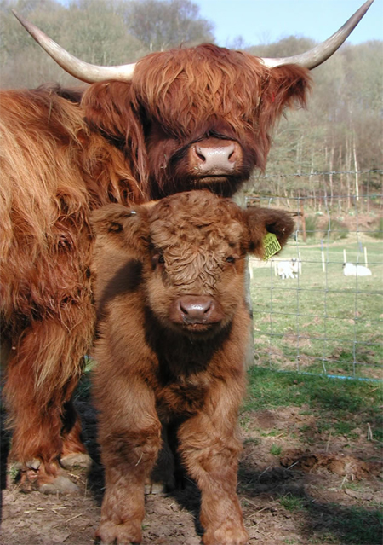

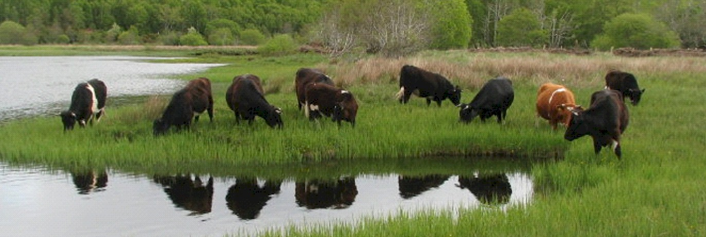
Why would you go for
Traditional v popular commercial?
Smaller number of stock
Specialist/niche markets
Interest
Support native/rare breeds
Size
Temperament
Shetland Cattle Grazing SSSI

Slide 42
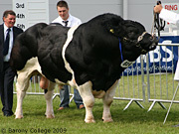
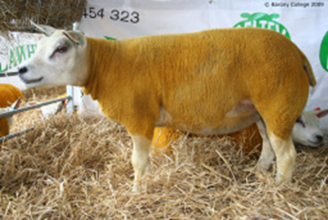
Terminal Sires
Terminal sire is a breed designed to produce the end product (meat normally). Normally his daughters aren’t bred from, except for pedigree/purebred.
E.g. British Blue or Beltex

Slide 43
‘Correct’ Breeding Females
‘Correct’ normally means having good mouth and udder, i.e. no reason why they shouldn’t be able to rear a calf/lamb.
Check ewes – practical exercise
  Mouth?
  Udder?
  Sound?

Slide 44
Where to buy stock?
Privately
  Contact for more info, make appointment, go and see, agree price. Breed societies good places to look for producers.
Livestock Markets
  View on the day of the sale at the market, bid at the sale (normally in £’s but some pedigree sales in guineas - £1= £1.05).

Slide 45
Buying From Market
Contact market day or two before hand – is there a catalogue?
Go to the sale at least an hour before it starts.
Go into the office, explain you are a new purchaser. Ask office staff to point out the auctioneer. Introduce yourself to the auctioneer and tell him what stock you are interested in.
Look at the stock you are interested in. Ask vendor questions. Handle sheep.
Notes:
Get the catalogue and do some basic research. Check

Slide 46
Buying From Market
Use the catalogue to do some basic research
  Look at the sale report for the previous year
  Google the vendor
  Inside info – ask a friend/neighbour for any pointers
  Ask your consultant for advice

Slide 47
Buyer Beware
Inspect stock, ask questions, find out more about the vendor:
  Check ewes are ‘correct’ – mouths/udders
  Are stock in good condition?
  Do they look healthy?
  What is their temperament like?
  What do the rest of the vendor’s stock look like? Does the farm appear well kept?

Slide 48
Haulage
Before the sale find out how you plan to get your purchases home.
Market will have a list of hauliers – explain the approximate number and type of stock you’re looking for, and where you need them to go. Get a mobile number so you can track them down on the day.
After the sale pay for stock at office – normally get a receipt (for you) and a ‘pass’ – give this to the haulier.

Slide 49
Haulage
If you have your own livestock transport check if you should have a Certificate of Competence (more animals than you+passengers, over 65km in distance). SAC do this at Barony - £80 – simple test.
If you passed your driving test after 1 Jan 1997 you may need to sit D+E trailer test.
Check Welfare Code of Practice for specific info about transporting animals.

Slide 50


Slide 51
Nutrition & Feeding

Slide 52
Key Requirements
Energy – ‘maintenance’, growth, lactation, pregnancy etc.
Protein – building blocks
Minerals
Water
Fibre/roughage
Notes:
In common with all animals, including us, it’s important that cattle and sheep have sufficient energy, i.e. basic calories, as well as protein to grow and repair. They also need vitamins/minerals and water. Ruminants are particularly dependent on fibre however because of how they have evolved to eat vegetation.

Slide 53
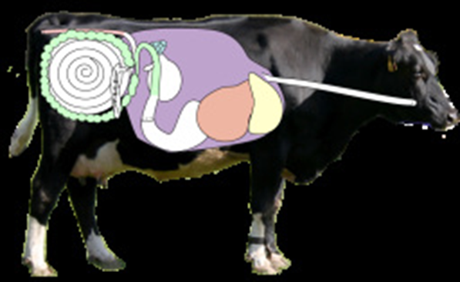
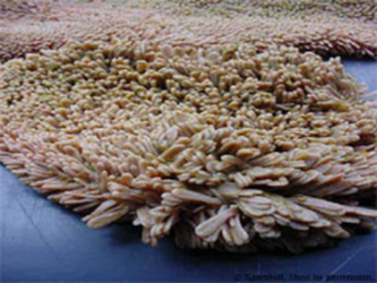
Ruminants
Sheep and cattle are ruminants
  4 stomachs
    Rumen
    Reticulum
    Omasum
    Abomasum
Notes:
The rumen is the biggest stomach. In the ruminant the rumen is essentially a bio-digester, using bugs to break down fibre. The bugs themselves, and the products of their work, are what the animal digests and gets most of it’s energy from.

Slide 54
Objectives of Ruminant Nutrition
Feeding the rumen bugs
Maintaining rumen pH (not acidic)
Notes:
DUP supplementation really only critical for late pregnancy/lactation.

Slide 55
What do Rumen Bugs Like?
Fibre + + +
  Different types/sources, long and jaggy
Sugar
  Ideally from sugary forage, e.g. young grass
Starch
  In small quantities or else risk of acidosis
Protein
  High quality, low quality
Notes:
The rumen evolved to eat roughage and fibre. In evolutionary terms young sweet grass was a source of high energy food. Grain didn’t feature!
The rumen bugs break down protein to get the nitrogen they need to multiply – but they can also use other sources of nitrogen, e.g. urea. Some protein isn’t broken down by rumen bugs and is available for ‘true’ digestion – soya/protected proteins

Slide 56
Acidosis
Risks – starchy diets, insufficient fibre
Starch is very quick-release energy – digestive system can’t keep up, ferments instead, lowers pH and makes rumen acidic.
Symptoms: reduced appetite, scour, cud-balls…potentially death.

Slide 57
Language of Nutrition:
Dry Matter
%DM: Dry Matter
  Is the proportion of the feed which is not water.
  Allows us to compare feeds meaningfully.
Notes:
Useful just to run over they key terms used when talking about diets/feeds.
Dry matter – what proportion is actually water. Ever watched a cat or dog-food advert? ‘Monty Dried Cat-Food has more nutrition gram-for-gram than leading tinned cat food’. Of course it does – it’s dried! Dried cat food typically 30% protein, tinned 7.5% protein – same stuff!

Slide 58
Language of Nutrition:
Dry Matter
  1)1 kg silage @ 20% DM has 200g material
  2)1kg silage @ 50% DM has 500g material
  1tonne = £25
  1) 12 p/kg
  2) 5 p/kg

Slide 59
Language of Nutrition:
ME
Metabolisable Energy (ME)
MJ/kg DM
How much energy is in a food.
Allows us to work out how much feed is required.
A 70 kg ewe needs about 8 MJ energy for maintenance. She would need to eat about 1 kg of dry matter @ 8 ME.
Notes:
When working out feed requirements really accurately they’ll always be slightly ‘off’ because of the energy needed to digest different feeds. So the animal might need 8 MJ of energy, but if she is eating a feed that needs a lot of digesting, her energy requirement will actually be slightly higher.

Slide 60
Language of Nutrition:
CP
Crude Protein (CP)
% of DM
How much total protein is in a food.
Doesn’t reflect how much is ‘by-pass’ protein.
Silage @ 11% CP has 110g/kg
Notes:
When working out feed requirements really accurately they’ll always be slightly ‘off’ because of the energy needed to digest different feeds. So the animal might need 8 MJ of energy, but if she is eating a feed that needs a lot of digesting, her energy requirement will actually be slightly higher.

Slide 61
Grass!
Grass and derived forages (hay, silage, haylage) are the best feeds for ruminants.

Slide 62
Grazed Grass
How many stock you can have depends on:
  Area
  Quality
  Housing
Rules of thumb:
  2 – 4 ewes/acre
  0.75 beef cows/acre
  (1 hectare = 2.471 acres)
Notes:
But the quality has a huge impact. Good quality improved grassland could sustain 4 ewes/acre. Mountain land might only support 0.4 ewes/acre. Most things somewhere in between.

Slide 63
Grass
Assess your sward
Get soil samples taken
Consider stocking mix
  Growing livestock need high energy/sugar
  Horses need low energy/sugar
Part 2 – more info on grassland.

Slide 64
Grass
Some stock will need restricted access to grass, particularly if it is of very good quality.

Slide 65
Conserved Grass
Grass can be conserved for the winter as:
  Hay
  Haylage
  Silage

Slide 66


Hay
Very dry (85+% DM)
Not wrapped
8 – 9 MJ/kg DM (ME)*
8 – 10% CP*
* Highly variable – analyse!
Notes:
Hay tends to be made from more mature grasses, later in the season – when the grasses become stemmy they dry out into hay more easily.
Hence lower energy/protein as more stem, less leaf.

Slide 67



Silage
Variable dry matter (15 - 40% DM)
Wrapped/sealed
Pit or Bales
10 - 13 MJ/kg DM (ME)*
10 - 15% CP*
* Highly variable – analyse!
Notes:
15% DM is quite wet – easily squeeze water out by hand. 40% is really very dry. Grey line between dry silage/haylage.
Silage can be high energy/protein because it can be cut when very lush and sugary.
Basic principle is that the sugars in the grass ferment creating acid, which ‘pickles’ the grass. Anaerobic process – need to keep bales well sealed.

Slide 68
Haylage
Variable dry matter (40 - 80% DM)
Wrapped Bales
8 - 12 MJ/kg DM (ME)*
8 - 14% CP*
* Highly variable – analyse!
Notes:
Haylage can be made from young grass (so more like silage in analysis) or be more like wrapped hay.

Slide 69
Silage/haylage
Less stable than hay – but can be stored outside
Anaerobic process – need to keep bales well sealed
Ideally don’t move bales once they’re made, i.e. stack in-situ or get delivered in small quantities

Slide 70
Forage Quality
Good hay, haylage or silage should look and smell appetising
  Not mouldy
  Not black
  Not foul-smelling
  Not heating
Notes:
If given access to ad lib forage sheep can get more energy from it than predicted because they select the most nutritious parts – cattle tend to eat it all (except for clearly bad material).

Slide 71
Forage Requirements
Sheep need good quality forage – fussier, smaller mouths, more prone to listeriosis etc
Cattle can cope with coarser forage, less picky, less susceptible to listeriosis etc.
Notes:
If given access to ad lib forage sheep can get more energy from it than predicted because they select the most nutritious parts – cattle tend to eat it all (except for clearly bad material).

Slide 72
Supplementing Forage
Maintenance/early pregnancy/mid/late lactation on good pasture – unlikely to need supplementation.
Late pregnancy/peak lactation – may need some supplementation.
  Energy
  Protein

Slide 73




Energy Supplements: Cereals
Barley
13.2MJME/kgDM
115gCP/kgDM
Oats
12MJME/kgDM
100gCP/kgDM
Notes:
I thought I would start by looking at some of the more commonly used feeds, starting with energy feeds inparticular cereals. Barley is the cereal we will come across for feeding cattle and sheep. It has an ME of just over 13 and 11.5% CP. Its high energy and good starch content make it a very useful feed. It si especially useful for intensive beef rations which are often referred to as “barley beef”. Barley, can be over fed though and if fed in large amounts at one time or introduced suddenly to a diet it can cause upsets like rumen acidosis and laminitis due to its readily fermentable carbohydrate level. Barley can be fed whole to sheep and is safer that way as over processing can also increase the likely-hood of problems arising from fast fermentation.

Slide 74


Energy Feeds High in
Digestible Fibre (Trident Feeds Ltd)
Sugar Beet Pulp 12.5MJME/kgDM; 100gCP/kgDM
Soya Hulls 11.8MJME/kgDM; 124gCP/kgDM
Notes:
Other energy feeds also commonly known as “the fibres”. The most common high energy ones are SBP, Citrus pulp and soya hulls. SBP is the by product of the sugar cane industry with some molasses added back, dried and pelleted. There are a few different types of SBP, for example imported SBP which is normally 10mm (bigger and harder than UK stuff and often low molasses), Supaflow which has an oil coating to aid the flow in feed bins on farm. Normal UK SBP is 6mm. Citrus pulp is the by-product of the juicing industry and most citrus is based on oranges but can contain some lemon, grapefruit and limes. The pulp is heated, dried and pelleted. Soya Hulls are the initial co-product of the crushing and oil extraction from soya beans. They are the outer coating of the beans which is removed before milling, oil expelling and extraction. Soya hulls are mostly pelleted. These energy feeds are all low in starch and are good for providing digestible fibre. Citrus is only normally used if SBP or Soya hulls are not available, all are very palatable.

Slide 75




Supplementing Low Protein
Silages
Wheat Distillers Dark Grains 340gCP/kgDM
Soya bean Meal 565gCP/kgDM
Barley Distillers Dark Grains 265gCP/kgDM
Rapeseed meal 400gCP/kgDM
Notes:
Soya is probably the best quality, high protein feed available imported from the US and South America, its used mostly in pig and poultry diets but also for high yielding dairy cows and late pregnancy ewe diets. It has a high level of DUP and is very palatable. Rapemeal conversely is not as palatable and has a lower ME due to its higher fibre content but it still has a place as a high protein source and is commonly used in cattle over 100kg as the main source of protein. Although it can be used as the sole source of protein some argue that other sources of protein used alongside rapemeal help performance.

Slide 76
Supplementing: What With?
Stick to compound feeds – mineralised
  Rolls/cobs
  Nuts
  Pellets
  Blends
Purpose designed feeds – correct minerals, protein, quality
  Calf mixture – higher protein, higher quality/price
  Beef cow rolls – high magnesium, lower protein, lower quality/price
  Ewe rolls – low copper, high protein, high quality/price
Notes:
Important to stick to a purpose designed feed. E.g. sheep (especially white-faced sheep) prone to copper poisoning. Sheep feeds normally avoid too much copper – but probably not cattle feeds.

Slide 77

Supplementing Sheep
Trough feeding
  Need enough space – 500 mm/ewe
  Potential foot problems – mucky ground
  Keeps feed clean
  Metal, wood, plastic
  Most feeds suitable - pellets/nuts/rolls/granules
Notes:
10’ trough enough for about 12 – 15 ewes depending on size
Metal/plastic troughs better for health – easier to clean
Need to be emptied daily.
Possibility for bird-borne diseases when birds eat spilled feed.

Slide 78
Supplementing Sheep
Ground Feeding
  Flexible for space but needs to be dry ground
  ‘Rolls’
  Pellets with a snacker type feeder
  Not so good with granules/crumb
  Can feed in straw bedding indoors
Notes:
10’ trough enough for about 12 – 15 ewes depending on size
Metal/plastic troughs better for health – easier to clean
Need to be emptied daily.
Possibility for bird-borne diseases when birds eat spilled feed.

Slide 79
Supplementing Sheep
Blocks & Tubs
  Relatively expensive but low labour
  Blocks are softer – higher intake
  Molassed tubs are lower intake
    Boost of sugars – good with forage
    Minerals
Notes:
Good to supplement animals but normally have maximum intakes so only go so far. Some tubs are mainly about minerals than energy – read the label.
Often high protein products are mainly urea based.
Do deliver minerals, but consider whether a reliable enough source – does every animal eat?

Slide 80

Supplementing Cattle
Troughs
Keep outside of pen where possible!
Notes:
Similar to sheep but troughs different size/shape.

Slide 81
Supplementing Cattle
Ground Feeding
Rolls/cobs
Notes:
Similar to sheep.

Slide 82
Supplementing Cattle
Blocks/tubs
Slightly different formulation as for sheep
Variety available – garlic, energy, minerals, magnesium etc.
Notes:
Similar to sheep.

Slide 83
Feeding in late pregnancy
Most important time for ewe nutrition
Lambs grow rapidly for last four weeks – woolly coats are very energy/protein intensive.
Huge demand for energy and protein
Lambs take up large % ewe’s body.
Watch ‘singles’ don’t get too fat, but twins/triplets get enough – ideally scan and batch by litter size.

Slide 84
Feeding in Late Pregnancy
Condition score ewes
Thin ewes/multiple-carrying ewes should get concentrate feed/more concentrate feed.
Make sure all ewes can access the trough (and come forward to feed).
Precise levels of concentrate feeding depend on silage/hay/grass quality and availability.

Slide 85
Soya
DUP (Digestible un-degradable protein/bypass protein) in late pregnancy recommended.
  Ewes – 100g soya/lamb carried/day for last 3 weeks.
  Cows – 500 g soya/day for last 3 weeks.
There are other sources, e.g. protected soya, protected rapemeal, Lifeline Crumb etc

Slide 86
Water Requirements
Ready access to clean water:
  Suckler cow + calf: 27 – 70 litres/day
  Pregnant ewe: 3 – 6 litres/day

Slide 87
Watering Stock
Automatic drinkers
Troughs – mains-fed
Buckets
  In a tyre
  Hanging from the wall
  Behind a feed barrier
  Generally the bigger the tub the better
Clean out regularly

Slide 89

Statutory
Requirements
Stock Identification
Movements of Stock
Medicine Records

Slide 90
Stock Identification - Why?
Traceability – Scottish/UK/EU law
Food safety
Biosecurity – need to know what stock are where

Slide 91

Guidance available…
Notes:
Lots of guidance on website

Slide 92
Basic Requirements
Authorities need to know Who, What, Where, When, (Why?)
Who/Where: Register with SGRPID – get a holding number/CPH number
What: Register with Animal Health – tell them if it’s cattle, sheep or both
When: Record movements with SAMU (sheep) or BCMS (cattle)
AND keep records at home – movement/medicine book
Notes:
CPH number – County, parish, holding – unique for each holding.
SGRPID – Scottish Government Rural Payments & Inspections Directorate
SAMU – Scottish Animal Movement Unit
BCMS – British Cattle Movement Service

Slide 93
Registering with SGRPID
Complete an LMF form
Be issued with a CPH number, e.g. 70/123/0012

Slide 94
Registering with Animal Health
Phone Animal Health – Register as a Keeper
  South, East and North Ayrshire, Dumfries and Galloway, Inverclyde,
  Renfewshire AHDO,
  Russell House,
  King Street,
  Ayr
  KA8 OBE 01292 291350
  City of Edinburgh, Falkirk, City of Glasgow, North and South Lanarkshire, East, Mid. and West Lothian, The Scottish Borders AHDO,
  Cotgreen Road,
  Tweedbank,
  Galashiels
  TD1 3SG 01896 758806
Notes:
They will probably want to visit you.
Animal Health will contact you for routine screening and health testing, e.g. TB testing, brucellosis testing, etc.

Slide 95
Registering with Animal Health
Animal Health will give you a herd/flock number.
They’ll probably want to visit.
They’ll need to know who your vet is.
Notes:
They will probably want to visit you.

Slide 96
Register with BCMS
Also known as CTS Online
BCMS Helpline English 0345 050 1234 Monday to Friday 8.30am to 5pm
Need your CPH number first
Notes:
CTS (Cattle Tracing System)

Slide 97
Summary
Register with SGRPID – get a CPH number (for your holding)
Register with Animal Health – get a flock/herd number (unique ID number for your stock)
Register with British Wool Marketing Board Tel: 01877 339657

Slide 98

Sheep
Tagging & Recording
ID and Traceability

Slide 99
Sheep Records
Need to record
  When sheep arrive
  When sheep leave/die
  When sheep are ear-tagged
  When sheep are replacement-tagged
  (see Holding Register)

Slide 100
Sheep Records
All sheep > 12 months old should have a pair of eartags – one of which electronic
All sheep < 12 months old should receive either a pair of eartags (as above) or a single ‘slaughter tag’ before they leave the holding of birth (or by 9 months)

Slide 101

Tagging
Recommended left ear standing behind
Notes:
Only recommended not compulsory
Best practice - many tagged in right ear

Slide 102
Tagging
After you register with Animal Health, they update the national database. Phone ear-tag supplier (i.e. local merchant) with your flock number and holding number to hand.
They will automatically issue the next numbers in the sequence, starting from 00001.
Replacement tags for bought-in sheep always red. They can either get a new number, or have an old number reprinted (uncommon – more expensive).
Your ‘own’ tags (that you tag homebred lambs with) are either yellow (slaughter) tags, or any colour except red or black.
Consider having a separate colour for each year to readily identify the age of sheep.
Tags inserted using special pliers – normally each tag manufacturer has different pliers. If borrowing pliers make sure you order the right make of tags!
Notes:
Many different manufacturers and suppliers of tags. Everyone has a preference – no right or wrong. Some have the chip in the middle of the tag, some are bigger than others, some breed societies provide a certain tag, etc.

Slide 103

Tagging - Slaughter / Store sheep
To be slaughtered before one year old
Apply a single electronic slaughter tag at 9 months old or when leaving holding of birth
Record animals - Enter date of tagging, flock number, number in batch
When moved off enter flock number and numbers moved within batch
Notes:
Highlight Batch – this is what is meant by batch recording – no individual id’s
Remember - Must not use one half of EID Double tags – penalty
One half of a double tag can be used as a Management Tag Only and matched up later
Better not to do this if not matched up later or sold on one half it is a breach
Doesn’t need to be tagged moving to holdings under a concession within 9 months
Columns 5, 6 and 7 optional
Doesn’t have to be kept in this format or in this book but easier if it is
Makes SGRPID job easier which helps inspection
Example Movement Records shown later

Slide 104

Tagging - Home bred breeding sheep
To be kept on farm beyond 12 months of age
Full EID tag (Double tag ;one electronic) at 9 months old or when leaving holding of birth
Record individually - Enter date of tagging, individual flock numbers
Notes:
Doesn’t need to be tagged when moving to holdings under a 5 mile concession within 9 months
Concessions covered later

Slide 105



Retagging - Home bred sheep
Breeding Sheep
Remove any remaining tags and apply 2 new matching yellow tags
Slaughter Sheep
Replace with an identical yellow tag
Record Replacement - date, individual flock number and original tag, reason
Notes:
All replacements must be recorded
You do not need to record the EID tags numbers when replacing historic sheep tags but better to do it if you can – you must however record the date
Do not use Red Replacement tags in home bred sheep
Guidance in Shepherd Right for all age groups and scenarios
Can buy a matching tag but easier to replace as you have to record anyway
Must record a Slaughter EID replaced by a slaughter EID
Seems pointless but that is the rules
To confuse the issue slaughter tags have an individual EID so if the tag is read by a reader you cannot distinguish between slaughter and full EID
You can distinguish between tag types on ScotEID which we will show you later

Slide 106


Retagging – bought in sheep
Breeding Sheep
Remove any remaining tags and apply 2 new matching red replacement tags
Slaughter Sheep
Replace with an red replacement tag
Record Replacement - date, individual flock number and original tag, reason
Notes:
Retagged lambs with a Red EID slaughter tag must be sold by 12 months of age cannot be upgraded even to double red EID
Reason - Slaughter tagged traceability lost cannot be upgraded to your own Full EID
If you are planning to keep them beyond 12 months as breeding stock upgrade ASAP ( if fully traceable)
Reason – if tag lost it has to be replaced by a red tag and slaughtered by 12 months

Slide 107

Recording Initial Tagging
Notes:
By using the SG holding register and following the format of the example entries, farmers can keep compliant with the regulation and reduce the chance of an SMR 8 XC penalty
Farmers can keep compliant by entering the mandatory information every time they tag sheep or goats for the first time – definitely an area of weakness found regularly at inspection

Slide 108

Continuous Register:
When a sheep arrives/leaves/dies
Notes:
By completing the continuous register the farmer will be maintaining an accurate register as well as meeting the requirement to record on and off movement records
Although optional, maintaining a running total and updating at accurate gathers keeps the records up to date and makes the annual inventory submission more straightforward

Slide 109

Recording Replacement
Tagging
Notes:
Farmers are failing to maintain a record of replacement ID – ie they are not recording the information when they retag sheep.
This falls into the categories of farmers having no replacement tag record at all, or partial / incomplete records

Slide 110
Recommendations
Retagging sheep all ages
Make sure any tag replacements are recorded
Make sure you have a stock of red EID tags on farm
Tags should be replaced within 28 days of discovery. SGRPID Inspections.
Any red tagged slaughter sheep must be slaughtered by 12 months
  CANNOT be upgraded
Notes:
If you do anything write it down then copy to main records
If no replacement record within the last year and tags missing at inspection a breach will automatically apply. SGRPID will assume tags have not been replaced within 28 days of discovery or not recorded

Slide 111

Tagging Tips
Use tags sequentially - UK050123 400114 – 00213
Don’t throw away damaged tags
– keep a note of them
Tag before moving (before 9 months old)

Slide 112
Sheep Tagging – Common Errors
SGRPID inspections.
Slaughter tagged sheep not upgraded to full EID by 12 months of age. (Not allowed > 12 mths).
Sheep of an age requiring tagged - never tagged
Excessive number of sheep with missing ear tags
Failure to use red replacement tags for re-identifying purchased sheep
Notes:
All these are all penalty offences

Slide 113
Recording ON Movements
Animals moving on, over 12 months old, should have a pair of tags.
You should record in your book (or separate sheet referenced at the back) the individual ID number of each animal.
ScotEID – a facility that can be used in support.

Slide 114


Deaths
Record as they happen
Death of animals yet to identified must be recorded
Notes:
Don’t record on the day they were picked up – they don’t believe you!
Remember the rules for burial – must be marked on map if in a remote area
Should only be if collection is not available
Make sure deaths are recorded – no deaths don’t believe you
Month and year is enough

Slide 115

Inventory - compulsory
Notes:
Must be returned – although not a cross compliance breach
Must be accurate and be shown in your records
If not returned – increases a chance of inspection
At inspection they work back to see if records match inventory
Each BRN one form
Every Holding including concessionary ones and seasonal/wintering where you are registered as the keeper must be entered

Slide 116
Movements - General
Make sure haulier information is complete
Standstill period 13 days for sheep.
  Exemptions:
  Movement to slaughterhouse
  Breeding rams (same applies for bulls)
Separation facilities ….
  Must be approved by SGRPID
Holding must be registered with Animal Health
Notes:
Information can be available in any form SAMU’s etc but easier for SGRPID if all in one place

Slide 117
Updating Holding Register
On/Off holding 48 hours
First Identified 48 hours
Tag replacement 48 hours
Annual Inventory 1st December *
(part of December Census but must be returned at the latest 1st February)

Slide 118



Movements
Must be reported within 3 days to SAMU
- Unless moved through a Scottish Market or Scottish Abattoir
- Or under a concession
Can use the Movement Document
  Retain slips for 3 years
Can be by email or fax

Slide 119
Acronyms
SAMU – Scottish Animal Movement Unit
  The official register
ScotEID
  Not the official register – you can use it to support your records

Slide 120
Records - compulsory
Replacement tag record
Record of tagging
Record deaths (commonly missing)
Continuous records
SAMUs – Movement Documents
Keep for 3 years
Notes:
Records that must be kept

Slide 121



Cattle Guidance
Tagging & Recording

Slide 122


Use the correct books!
Can be downloaded as excel spreadsheets from SG website

Slide 123

Tagging - Basics
Born after 1 July 2000
  All numeric eartag in each ear

Slide 124
Tagging
After you register with Animal Health, they update the national database. When you call an ear-tag supplier (i.e. local merchant) have your flock number and holding number to hand.
Cattle tags are in the format UK123456 100001, 200002,etc (check digit goes to 7 then starts again at 1).
They will automatically issue the next numbers in the sequence, starting from 100001.
Unlike replacement sheep tags (which issue a new number), cattle replacement tags get the same number. Have it to hand when you order.
Tags inserted using special pliers – normally each tag manufacturer has different pliers. If borrowing pliers make sure you order the right make of tags!
Notes:
Many different manufacturers and suppliers of tags. Everyone has a preference – no right or wrong. Some have the chip in the middle of the tag, some are bigger than others, some breed societies provide a certain tag, etc.

Slide 125
Tagging
Primary tags
  Big yellow plastic tags
Secondary tags
  Either the same as above or a small yellow plastic tag/metal tag.
Tags need to be officially printed – you cannot make your own statutory tags.
You can have a hand-written ‘management tag’ but needs to be in addition to statutory.

Slide 126
When to tag
Beef Cattle
  Both tags within 20 days of birth or before it moves off the holding of birth
Dairy Cattle
  At least one tag fitted within 36 hours of birth. Up to 20 days to fit the second tag. Both tags must be fitted before leaving birth holding within 20 days

Slide 127
Replacing tags
Animals born or imported after 1 January 1998 must have tags replaced with the same number
Lost or illegible tags must be replaced on the animal, no later than 28 days after the loss is noticed

Slide 128
Passports
Must apply within 7 days of the animal being tagged
Must be applied for within a maximum of 27 days from the date of birth
Can use software, CTS Online or pre printed application form

Slide 129

CTS Online
Notes:
CTS online contains all the details for the cattle you currently have on your holding, animals you have registered, moved on or off your holding and any on farm deaths
If you want to improve your compliance then check the problem summary screens, take a download of cattle expected to be on your holding and carry out your own cattle audit – that is basically all that RPID are doing at a CII anyway.
You can provide feedback to BCMS on any updates required to your cattle, so it is straightforward to keep your animals details up to date.
You can also use the BCMS helpline to speak to BCMS personel

Slide 130

Cattle Records – use books
Notes:
The herd register contains example entries and if you follow the same format will help ensure that your records are up to date in the event of a cattle ID inspection
Records can be kept electronically or paper formats
A regular problem found is farmers using their management tag information for the dams and cross referencing to the official ID – this can lead to transposition errors etc. To cut down on errors they should ensure official identifiers are entered in the records

Slide 131
Records must be completed by:-
On/off movements – within 36 hours
Birth (dairy) – 7 days
Birth (non-dairy) – 30 days
Death – 7 days
Replacement tag – 36 hours
Movements must be notified to BCMS within 3 days

Slide 132
Movements - General
Make sure haulier information is complete on moves off otherwise breach
Standstill period 13 days for cattle
  Exemptions (see pack)
Separation
  Must be approved by SGRPID
Holding must be registered with Animal Health
Notes:
Information can be available in any form SAMU’s etc but easier for SGRPID if all in one place

Slide 133
On farm burial
On farm burial of fallen stock is banned.
Use a registered fallen stock carrier – (they will make sure that stock > 4 yo are tested for BSE).
Deal with companies individually, or join National Fallen Stock Company (NFSCo) to use Direct Debit.

Slide 134
Medicine Records
Buying Medicines:
The Veterinary Medicines Regulations 2013 (as amended) :
Documentation (inc proof of purchase) on the acquisition of a veterinary medicinal product and the records relating to the product for at least five years following the administration or other disposal of the product (even if you no longer have the animal):
  the name of the product and the batch number;
  the date of acquisition;
  the quantity acquired; and
  the name and address of the supplier.

Slide 135
Medicine Records
Using Medicines:
At the time of administration the keeper must record:
the name of the product;
the date of administration;
the quantity administered;
the withdrawal period; and
the identification of the animals treated.
Vet should give you this information where they administer a medicine.
A keeper who disposes of any or all of the veterinary medicinal product other than by treating an animal must record, the date of disposal, the quantity of product involved and how and where it was disposed of.
Notes:
There is no specific format required however it is required that the record be made as soon as practicable after administration.
The records described above can be kept either; on paper or as a computerised record. If kept on a computer an inspector may require the records to be produced in a form in which they may be taken away.

Slide 136
Example Medicine Book
Date of purchase/ acquisition | Name & address of supplier of veterinary medicine | Name of Product | Quantity | Batch number | Withdrawal period | Date, quantity & route of disposal if not administered

Slide 137
Example Medicine Book
Date of adminis- tration | Name of veterinary medicinal product | Batch No. | Identification of the animals treated | Qty adminis- tered | Date treatment finished | Date withdrawal period ended Meat / Milk |  | Reason for treatment | Name of person who administered medicine

Slide 139
Health

Slide 140
Step 1
Buy healthy stock!
  Accredited stock (‘health schemes’)
  Non-TB areas
  Vaccinated?
  Check mouths
  Not itchy
  Check udders/testicles

Slide 141

Health Schemes
BVD (Bovine Virus Diarrhoea)
IBR (Infection Bovine Rhinotracheitis)
Johnes
Leptospirosis
Notes:
BVD – diarrhoea
IBR – lung disease
Lepto – infertility/abortion
Johnes – similar to Crohns

Slide 142

Health Schemes
MV (Maedi Visna)
CLA (Caseous Lymphadenitis)
EAE (Enzootic Abortion of Ewes)
Scrapie
Notes:
MV – virus, pneumonia/wasting
CLA – lung abscenses
EAE – infectious abortion
Scrapie – wasting conditions

Slide 143
Bovine TB
Not part of a Health Scheme – Compulsory
Scotland ‘OTF’ – Officially TB Free
Routine Testing at Abattoirs
Infrequent but routine testing on farm
More frequent testing if buy-in from non OTF areas.
Shoudn’t be able to buy from actively infected herds – ‘TB2’ – movement restricted.

Slide 144
BVD
Bovine Virus Diarrhoea
Screen every year. Free or not-free of BVD.
Get individual advice from vet.
  Blood sampling
  Tissue test tags
‘PI’: Persistently Infected. Cows that are infected in pregancy likely to have a PI calf – major source of infection.

Slide 145
Vaccination
Sheep
  Heptavac/Ovivac/Covexin; Footvax; Scabivax; Enzovax; Toxovax
Cattle
  Rispoval IBR; Rotavec; Bovilis-BVD; Covexin; Rispoval RS/PI3; Bovipast
Ask your vet what YOU need
to vaccinate for!
Notes:
Heptavac/Ovivac/Covexin – clostridial diseases (5, 7, 8-in 1)
Footvax – foot rot – doesn’t do much for Scald
Scabivax – orf
Enzovax/toxovac – EAE/toxoplasmosisT

Slide 146


Worms
.

Slide 147
Worming
Stomach/gut worms (sheep and cattle); Lung worms (cattle)
Normally mostly affecting young animals – older animals develop immunity.
Worms can develop resistance to products – increasing problem in UK. Worm only when necessary. Take veterinary advice on which particular wormer for your circumstances.
Rotate wormers – not just the name!
Notes:
Extent of problem

Slide 148
Worms/Liver Fluke
Sheep pick up worms from pasture – these can be transferred from animal to animal.
FEC’s can be done to test for worms/fluke.
Fluke generally on wetter ground but increasingly prevalent.
Symptoms: Ill thrift, scour, sudden death (nematodirus/fluke).
FEC’s and routine dosing – speak to your vet.

Slide 149


Normal Liver

Slide 150


Acute Fluke
Notes:
Fluke are little burrowing parasites with backward pointing teeth and they eat their way through the animal’s liver.
Painful. Deadly in sheep, less so in cattle.

Slide 151

Acute Fluke

Slide 152

Acute Fluke

Slide 153

Subacute Fluke

Slide 154

SAC Consulting DSC Chill 31/10/12
Notes:
2012 a bad year for liver fluke!

Slide 155


Chronic disease
Sheep and cattle (cattle are more resistant than sheep, so don’t tend to die suddenly from the baby flukes, more likely the big adult ones)
May present as sudden deaths
Loss of condition
Anaemia
Bottle jaw
Scouring (diarrhoea)
Adult fluke in the liver

Slide 156

Chronic Fluke

Slide 157

Severe Chronic Fluke

Slide 158


External Parasites
Scab
  Notifiable disease
  Mite – causes itching
  Wool loss, itching
  Easily transmitted between sheep
  Treated with injectable and/or dipping
  MUST notify vet if suspect scab.

Slide 159
Lameness in Sheep
Very common
Scald
Footrot
CODD
Shelley Hoof
Abscess
Granuloma

Slide 160







Happy Feet?

Slide 161



Foot rot
Perspective: How would we like it?

Slide 162
Flystrike
Very common
Flies lay eggs on wet soiled fleece
Maggots
Prevention better than cure
Distinct smell

Slide 163




Orf
Scabby lesions, mouth, nose, udder, genitals
Difficult/impractical to treat
Major welfare issue
Vaccination
Zoonotic!

Slide 164







Behaviour and exercise intolerance
Or……….

Slide 165
Twin Lamb Disease
Pregnancy Toxaemia
Lack of energy in diet – ketosis
Late pregnancy
Drowsy sheep, nervous signs, recumbant
Feed molasses, glucose injection, energy drink
Check ration
Look out for others.

Slide 166
Hypocalcaemia
Milk fever
Similar signs to twin-lamb but almost always after lambing.
Calcium + glucose injection under skin
Monitor carefully – protect lambs

Slide 167
Mastitis
Usually after lambing
  Soon after lambing (find before they go out)
  Later on in lactation
  Look out for lame sheep

Slide 168
Listeriosis
Bacteria infects the brain
Nervous system symptoms – circling, chewing
Mouldy silage

Slide 169
Abortion in Sheep
Enzootic Abortion of Ewes (EAE) – zoonotic i.e. can be passed to pregnant women. Pregnant women should not handle pregnant ewes (or even the clothes of those who have).
Toxoplasmosi
Listeriosis
Campylobacter
Take aborted lambs (and placenta) to vet lab.

Slide 170
Shepherd’s Calendar
January:
Scan ewes, condition score ewes
House triplets/lean twins
Hoggs/gimmers first dose Heptavac
Fluke dose
February:
House twins and singles
Hoggs/gimmers 2nd dose Heptavac, other ewes Heptavac booster (+ tups)

Slide 171
Shepherd’s Calendar
March:
Lambing!
[Fluke dose]
Start feeding soya – 100g/day/lamb carried
April:
Lambing
May:
Lambs first dose Ovivac
Lambs worm dose

Slide 172
Shepherd’s Calendar
June:
Lambs second dose Ovivac
Lambs worm dose
Weigh lambs – draw fat lambs
July:
Lambs worm dose
Weigh lambs – draw fat lambs
Shearing + fly control pour-on

Slide 173
Shepherd’s Calendar
August:
Weigh lambs – draw fat lambs. Wean lambs.
Gimmers/hoggs – Enzovax/Toxovax
Mineral bolus ewes (if necessary)
September:
Crutch ewes & gimmers
Fluke dose everything expecting to stay
Dectomax or dip
Fertility test tups

Slide 174
Shepherd’s Calendar
October:
Tups out
November:
Tups in after 51 days
Fluke dose
December:
Condition score

