Slide 1
Liver Fluke
Heather Stevenson
SAC Veterinary Services
Dumfries

Slide 2
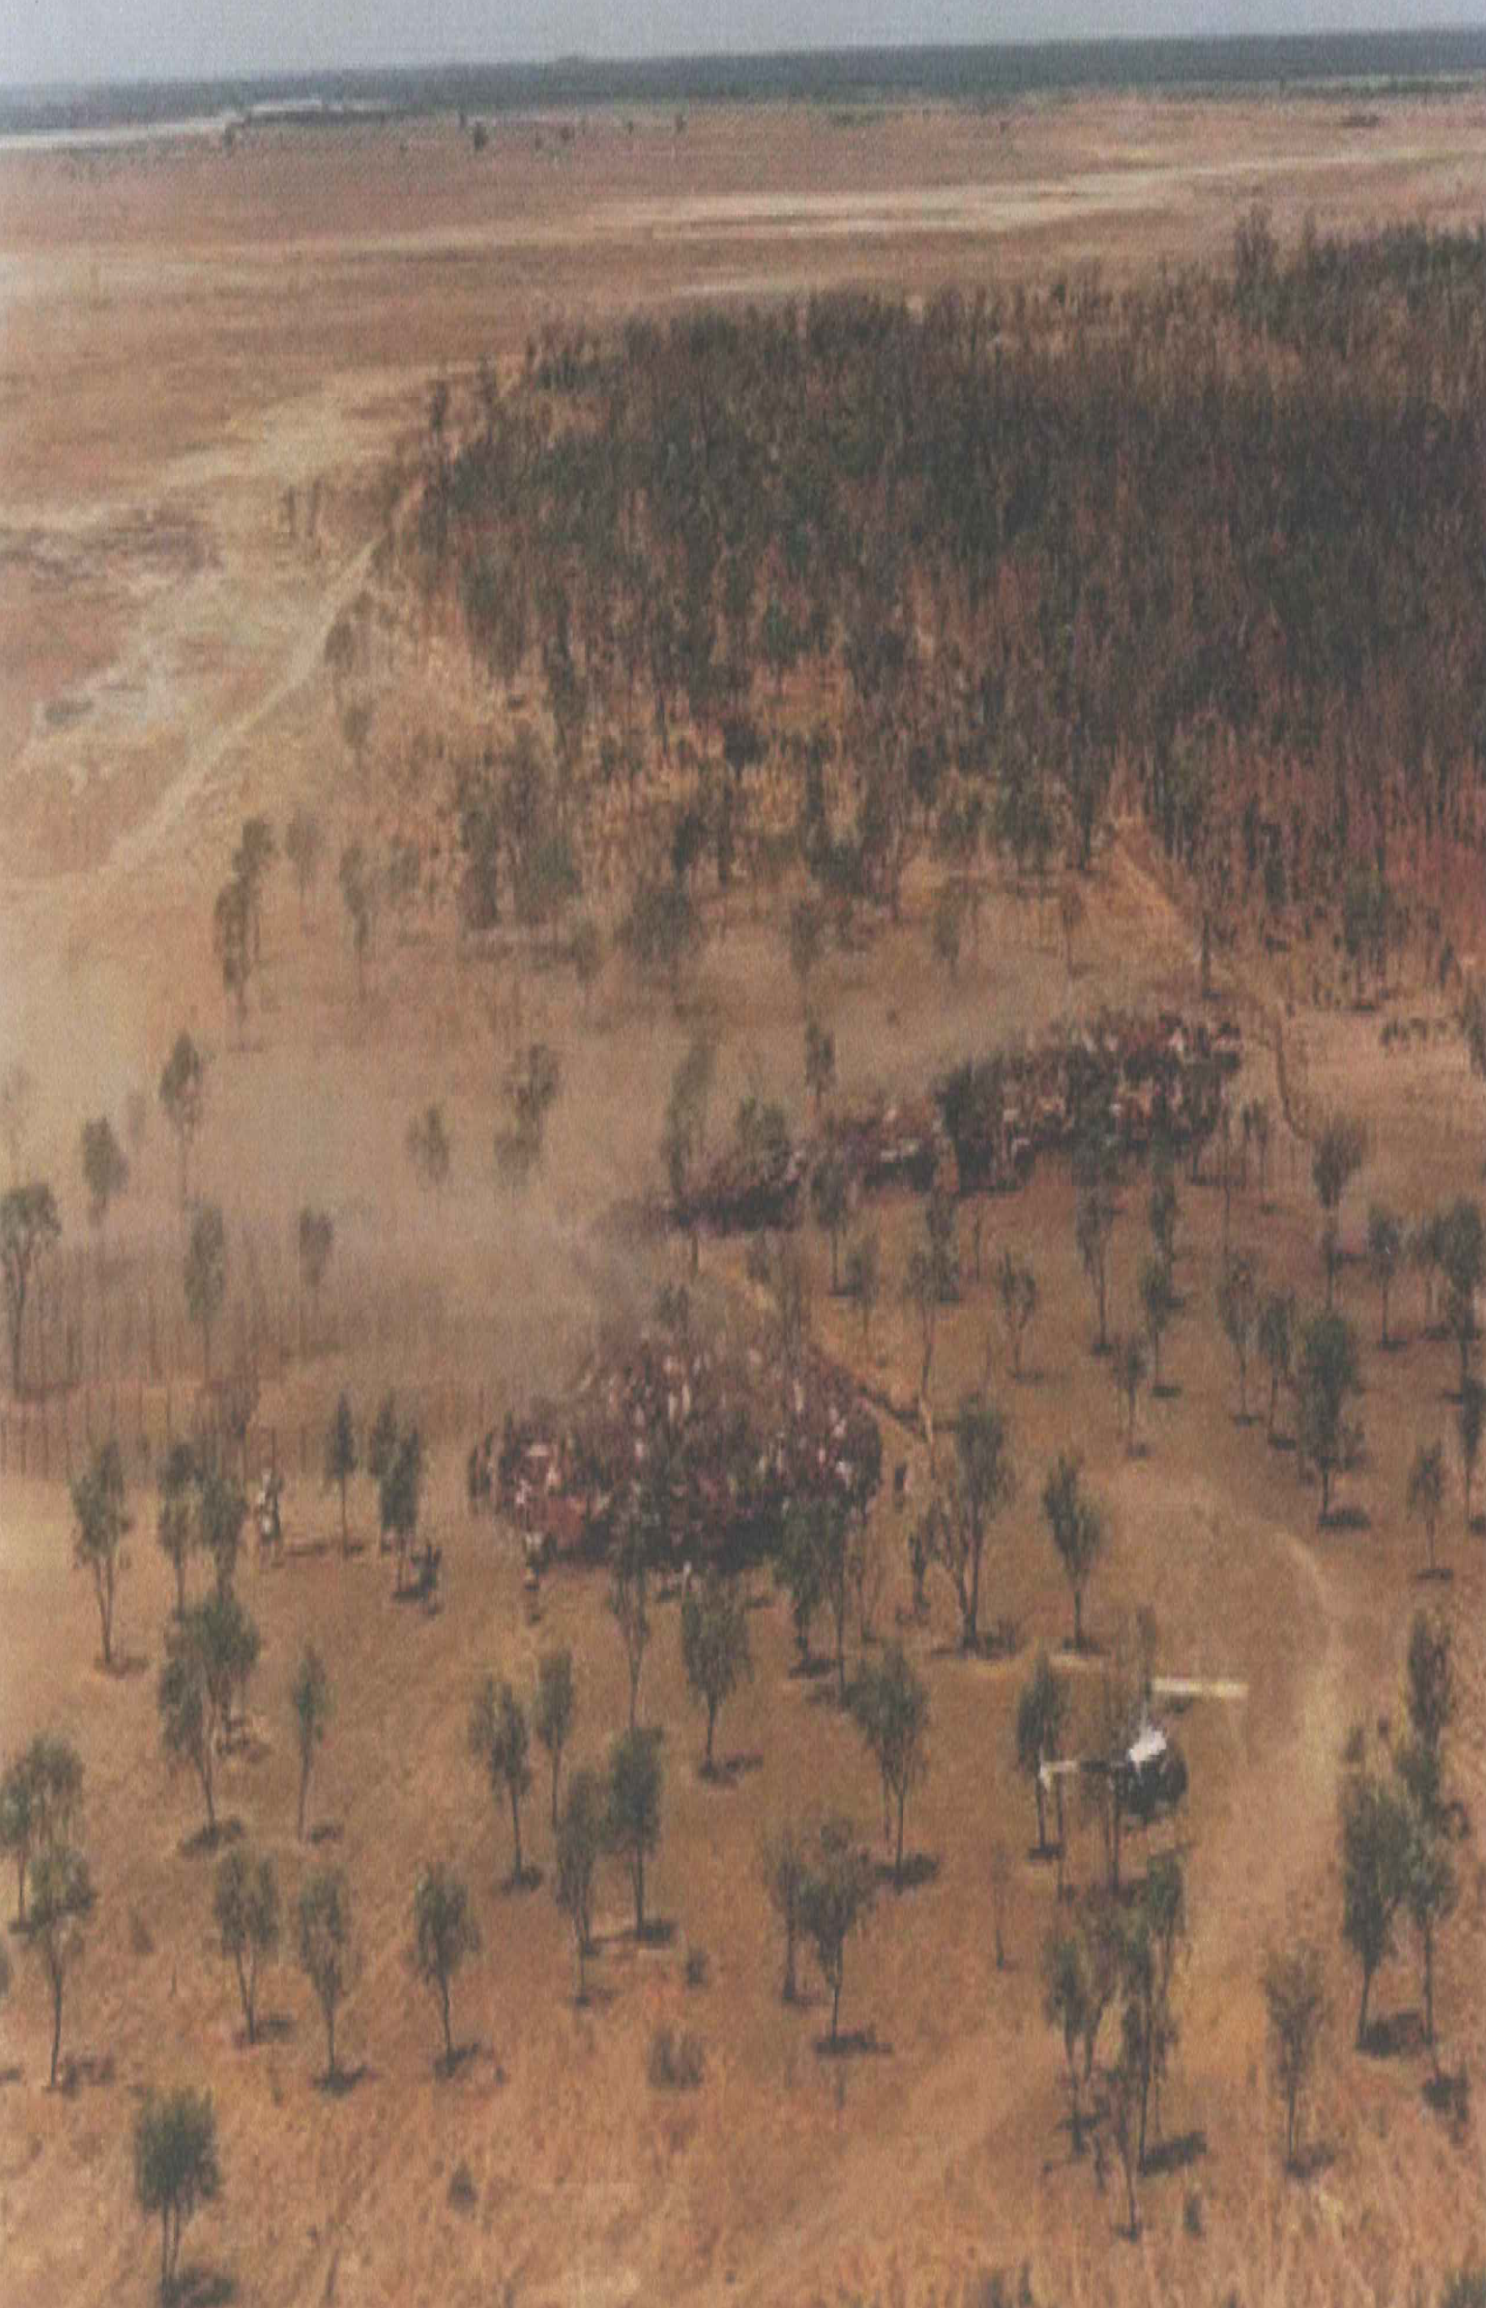
Picture: Dieter Palmer

Slide 3
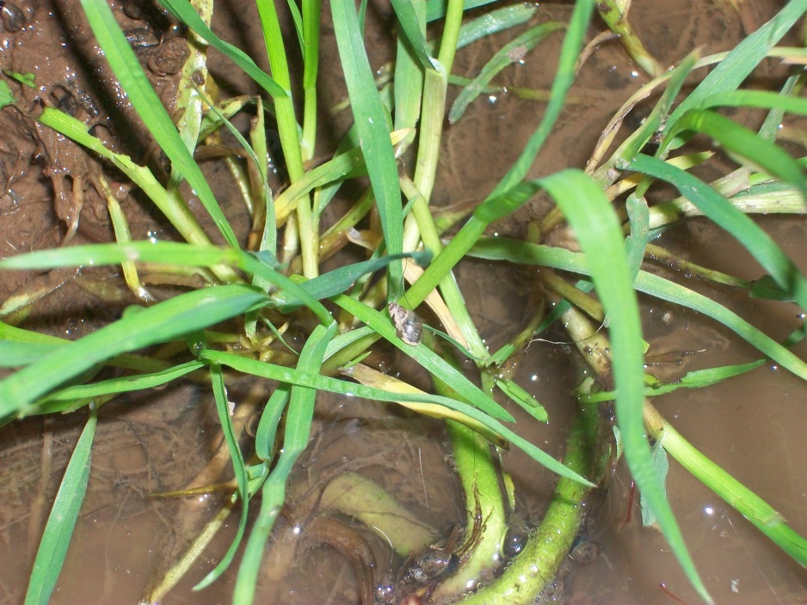
Fluke requirements
Snails
Water
Temperatures >10ºC
Sheep, cattle, deer, rabbits, horses, man

Slide 4
Fluke Lifecycle
MAY
E
JULY
S
WILDLIFE
SEPTEMBER
GRASS
OCTOBER
LIVER
DECEMBER
DECEMBER ON
E

Slide 5
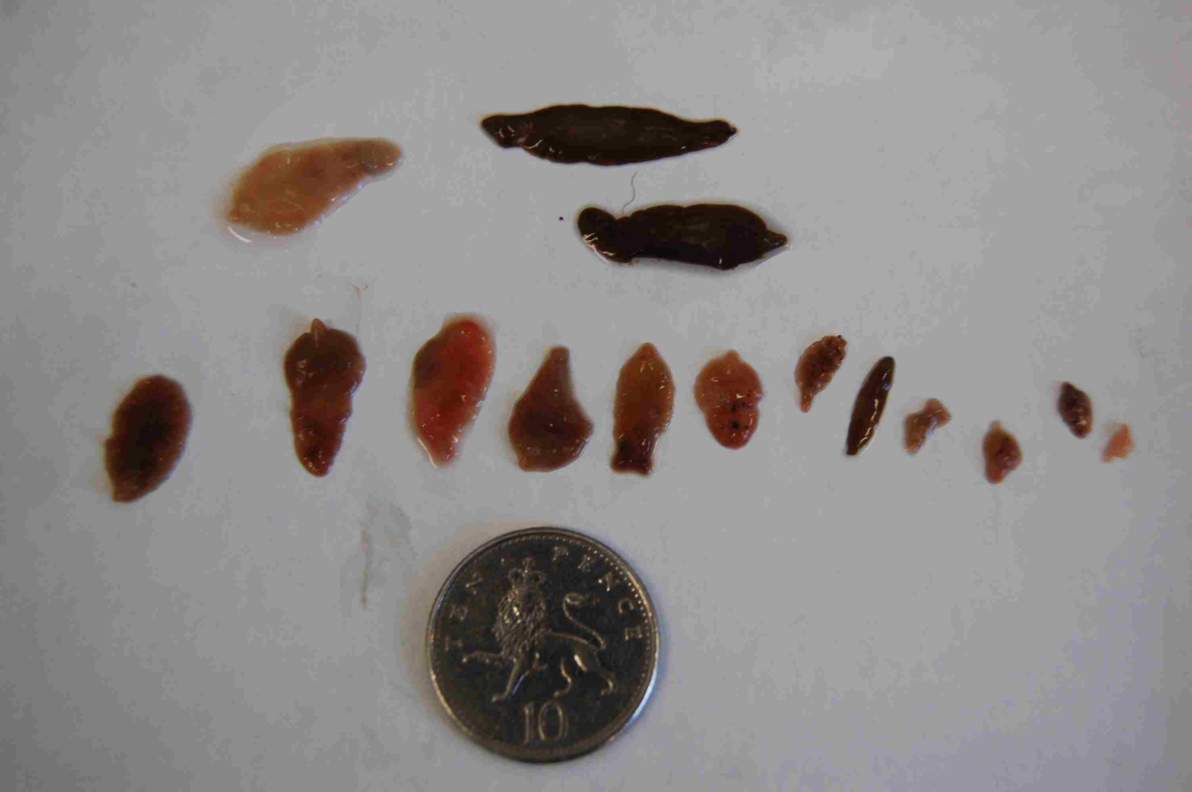
Immature and Adult Fluke

Slide 6
Liver Fluke Disease
SUB ACUTE
ACUTE
LIVER
CHRONIC

Slide 7
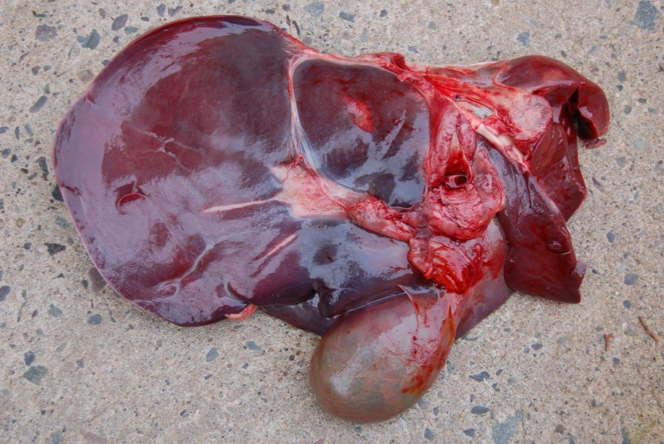
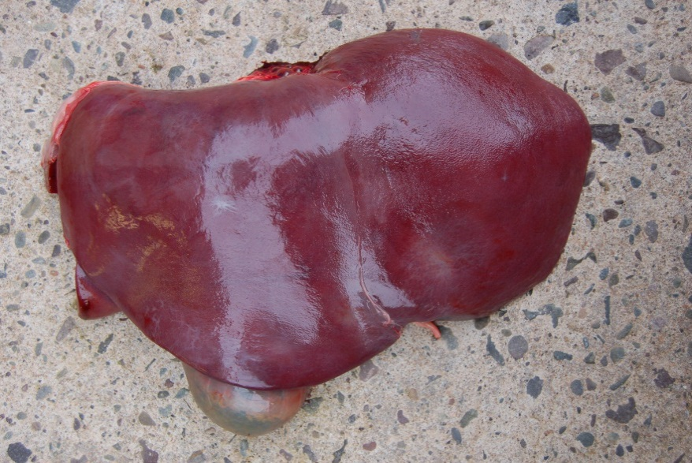
Normal Liver

Slide 8
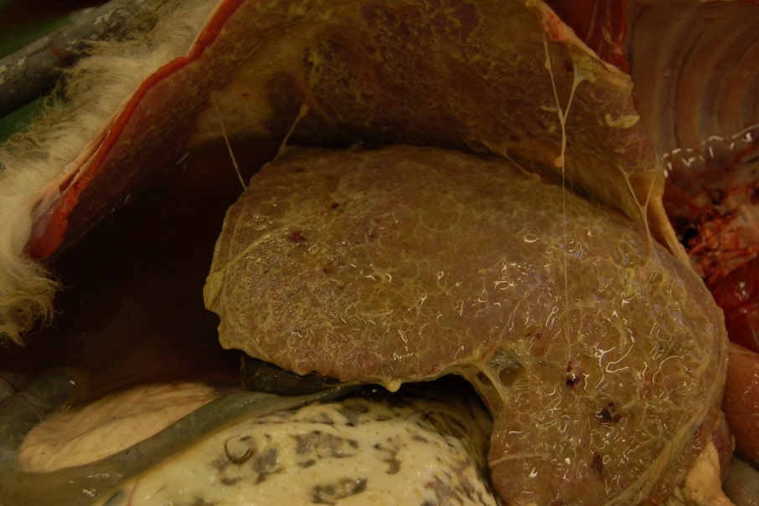
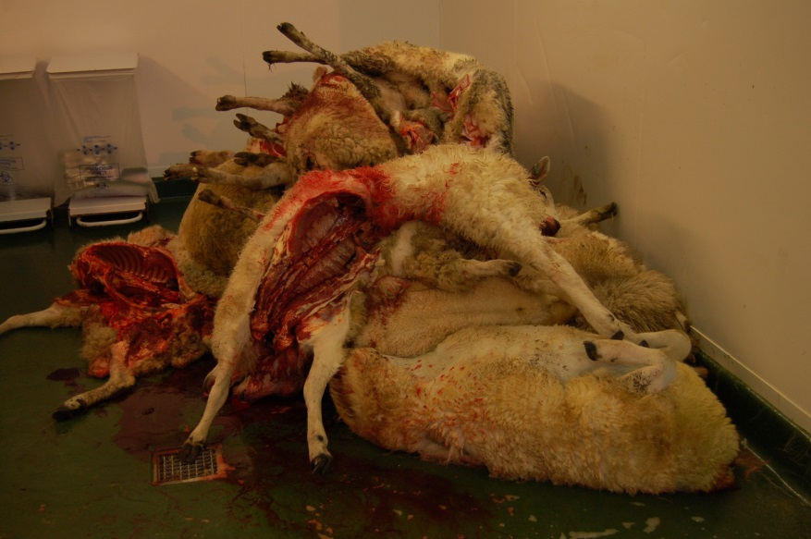
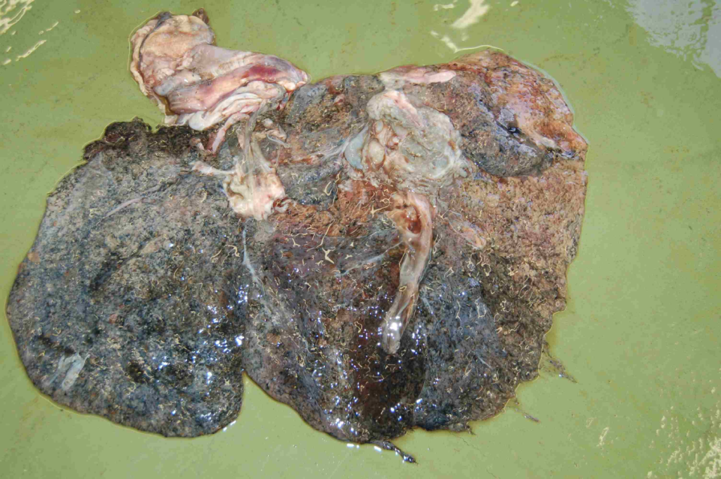
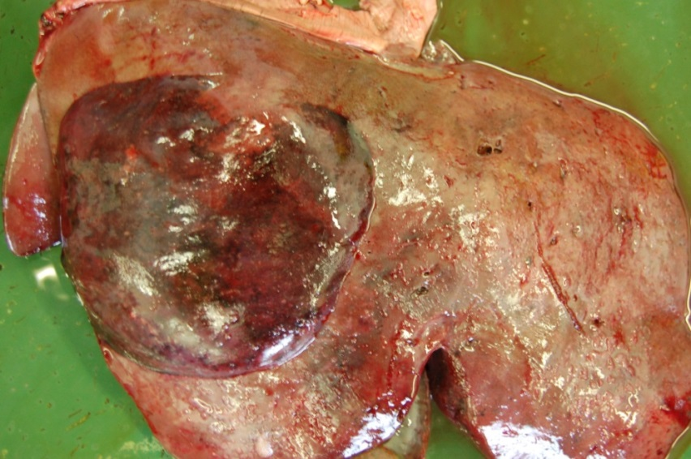
Acute/Subacute Fluke

Slide 9
Fluke Lifecycle
MAY
E
JULY
S
WILDLIFE
SEPTEMBER
GRASS
OCTOBER
LIVER
DECEMBER
DECEMBER ON
E

Slide 10
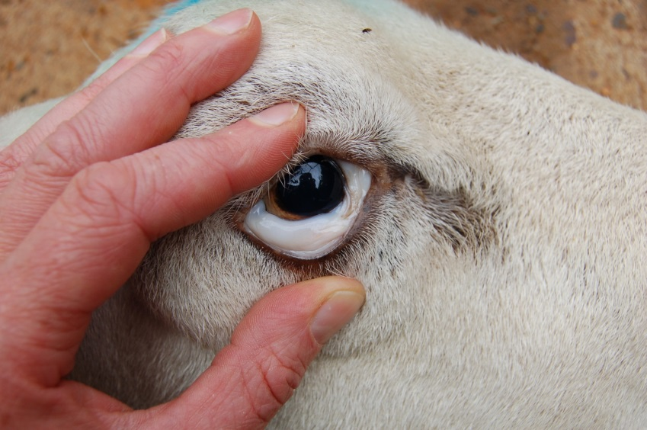
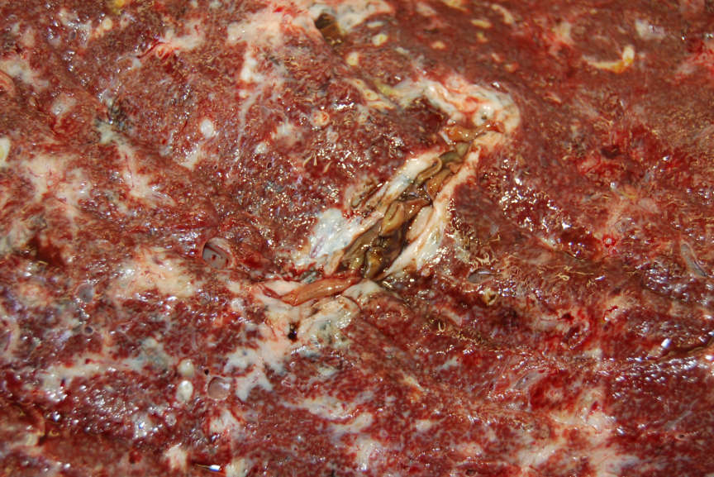
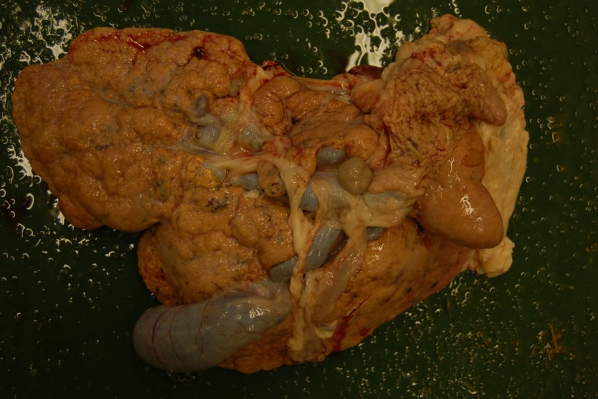
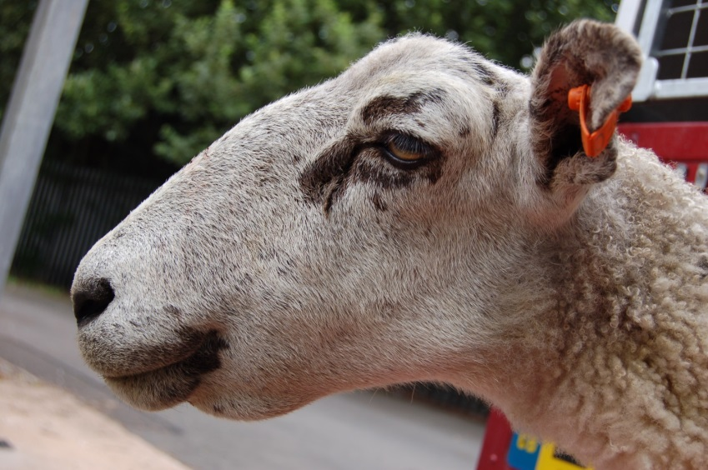
Chronic Fluke

Slide 11
Fluke Lifecycle
MAY
E
JULY
S
WILDLIFE
SEPTEMBER
GRASS
OCTOBER
LIVER
DECEMBER
DECEMBER ON
E

Slide 12
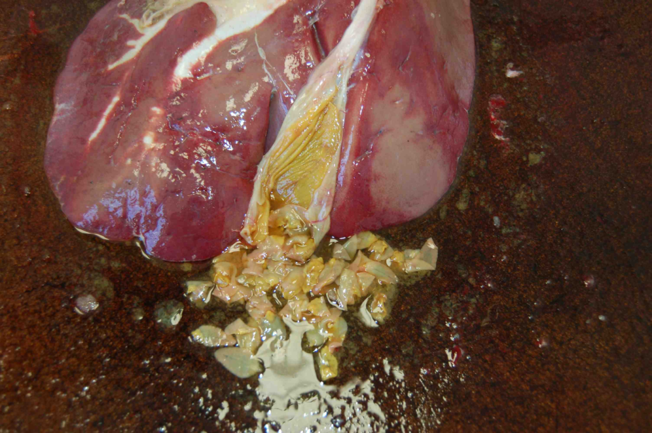
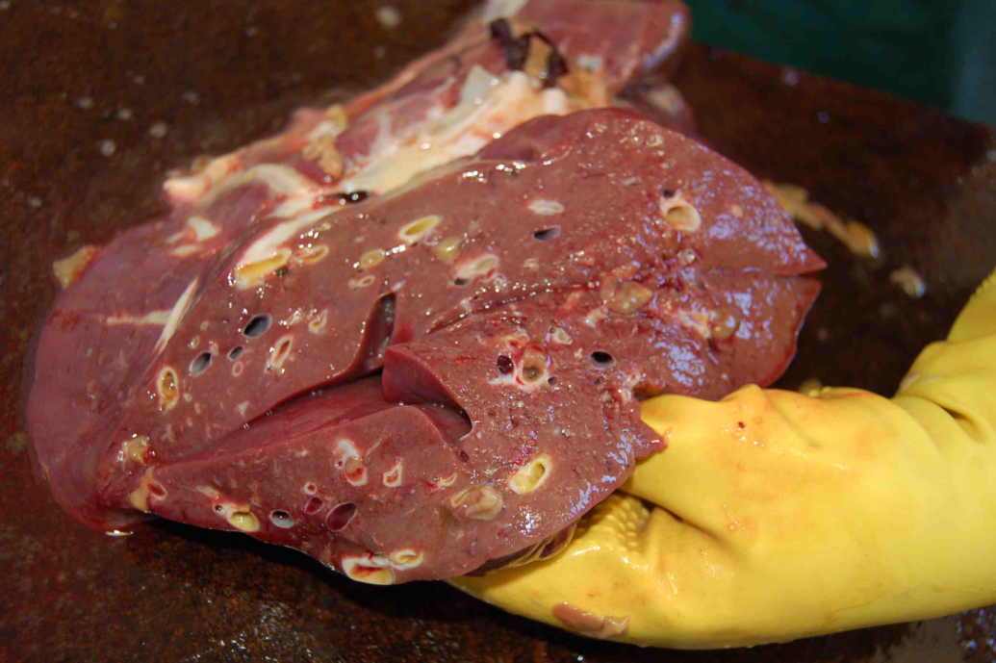
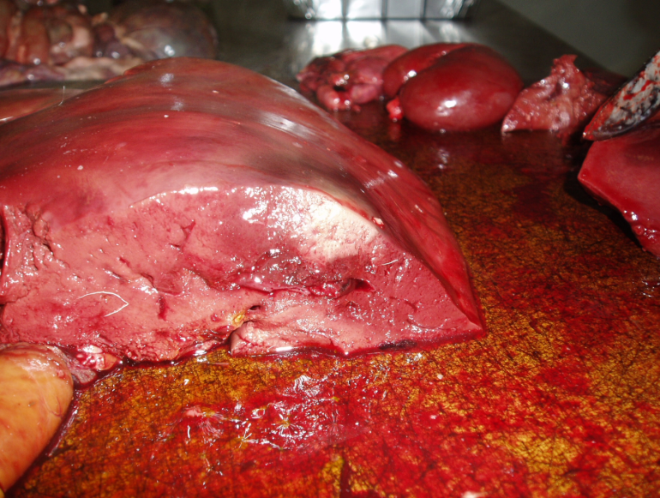
Chronic Fluke (Subclinical)

Slide 13
Other problems
High barren rates and abortions
Deaths due to clostridial disease
Deaths when handled for treatment
Deaths due to liver failure after successful treatment
Metabolic disease
Acute fluke deaths of sheep wintering on dairy farm
TREATMENT FAILURES

Slide 14
Other losses
Reduction in milk yields
Increased deaths of young lambs
Poor lamb growth rates
Poor store cattle weights
Increased time for cattle to finish (+8%)
Death of suckled calves due to chronic fluke
Downer suckler cows
Liver condemnation at abattoirs
Treatment costs including time

Slide 15
Dairy Losses
Reduced growth rates.
Delayed puberty.
Reduced milk yield.
Reduced milk fat.
Increased days calving to conception.
Increased number of services.
Increased calving interval.
Increase in cases of milk fever and downer cows.

Slide 16
Fluke Lifecycle
MAY
E
JULY
S
WILDLIFE
SEPTEMBER
GRASS
OCTOBER
LIVER
DECEMBER
DECEMBER ON
E

Slide 17
Fluke egg

Slide 18
Test Timeline
Weeks after infection
2
PCR
Liver enzymes (blood)
4
Blood/milk antibodies
6
8
Coproantigen
10
Fluke egg count
12

Slide 19
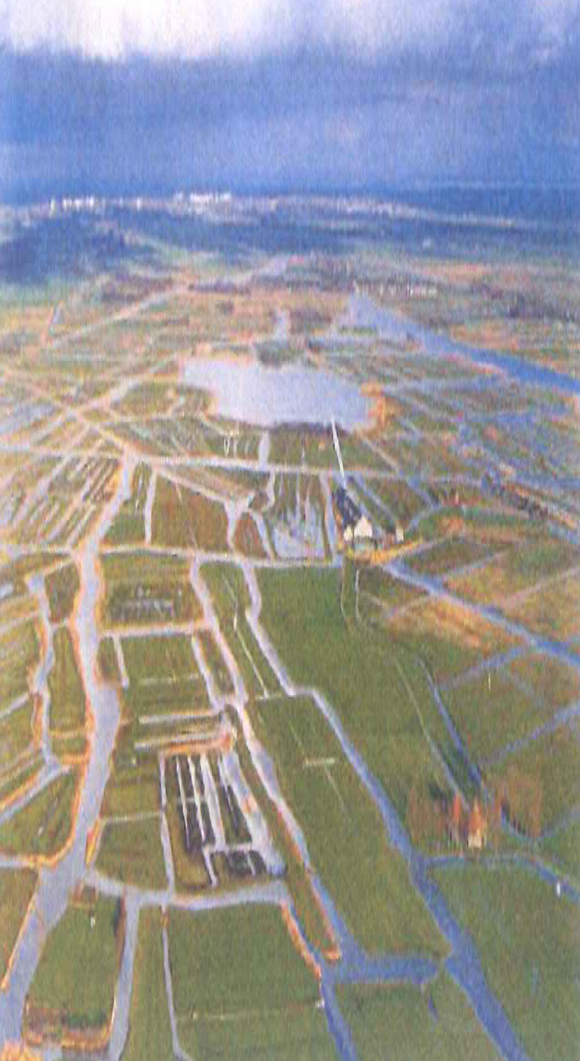
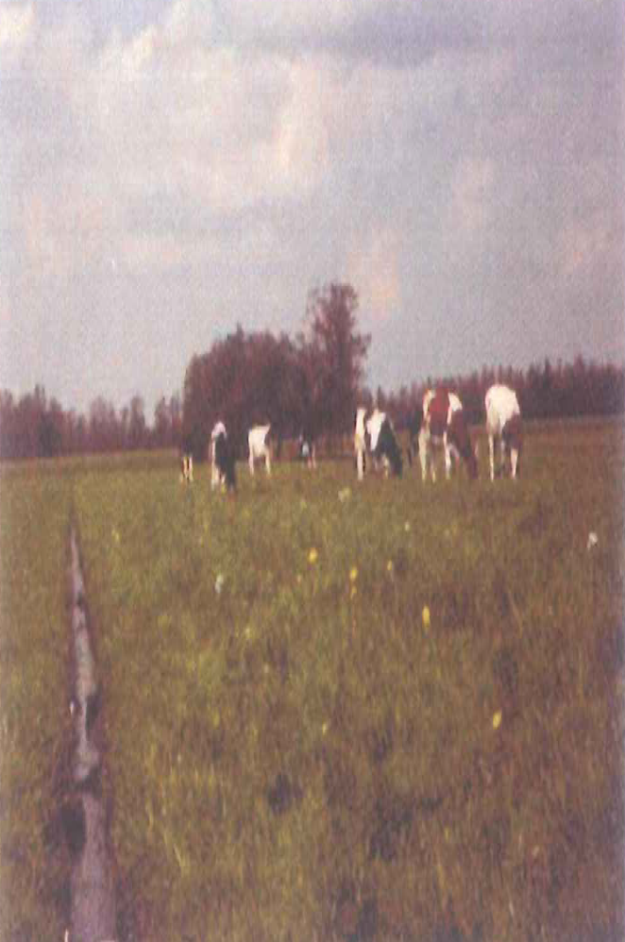
Pictures: Lammert Moll

Slide 20
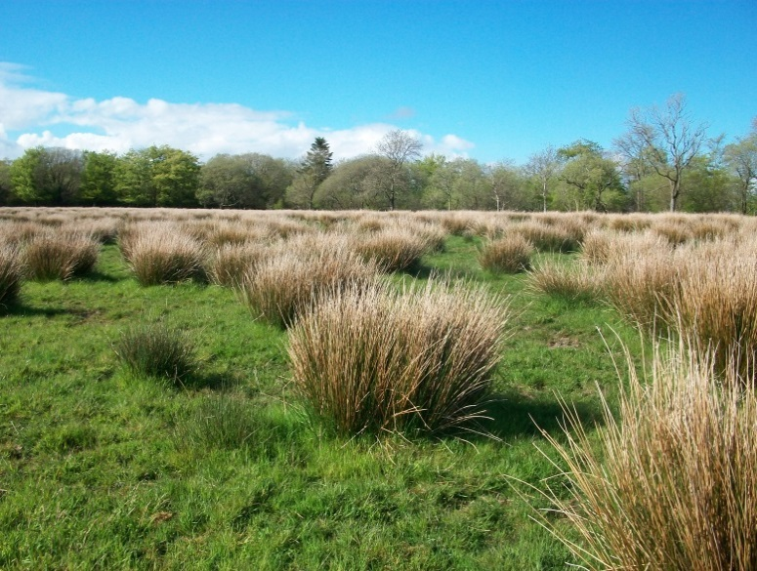
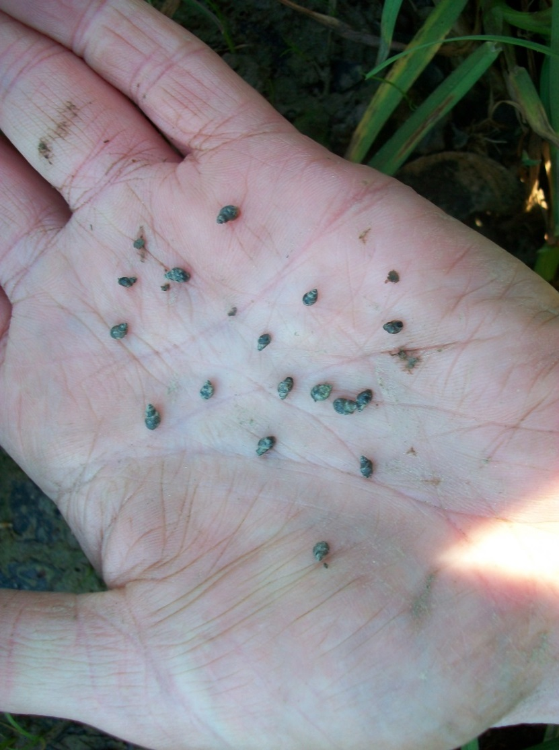
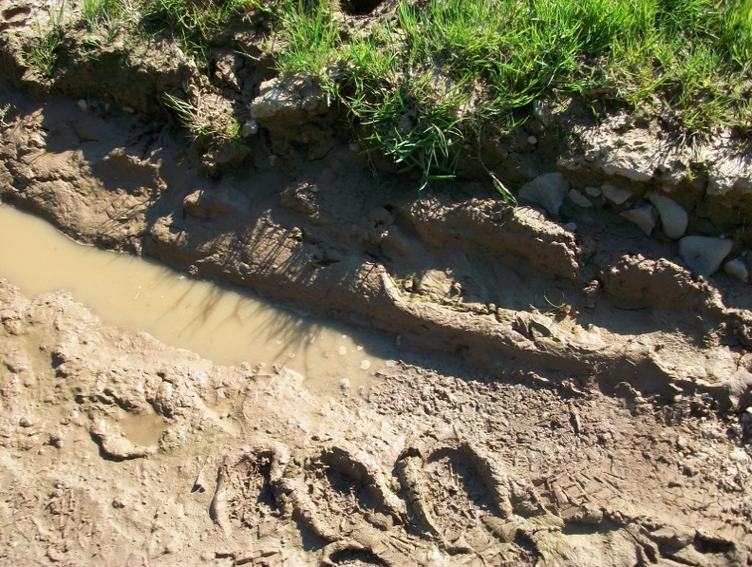
Snail Habitats

Slide 21
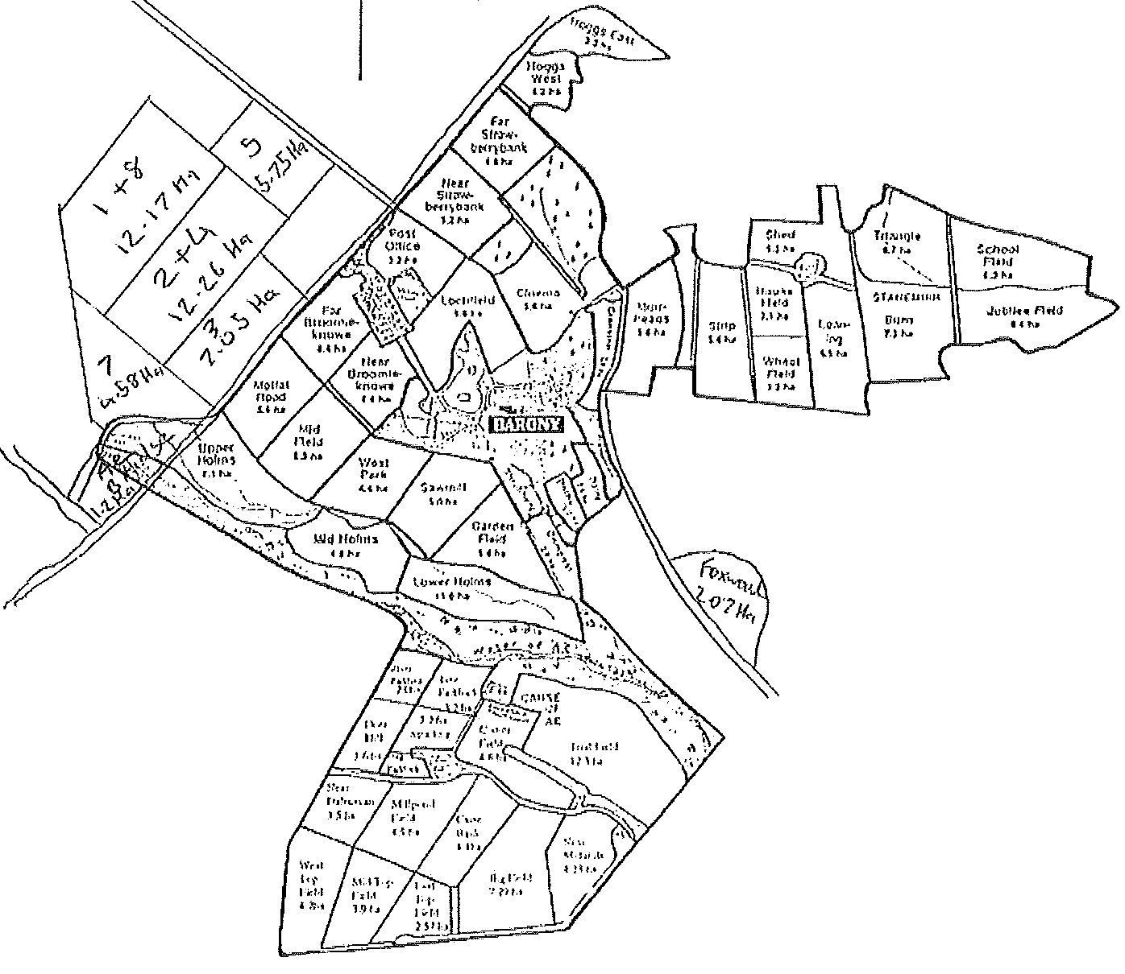
Barony Field Map
*
*
*
*
X
*
*
*
*

Slide 22
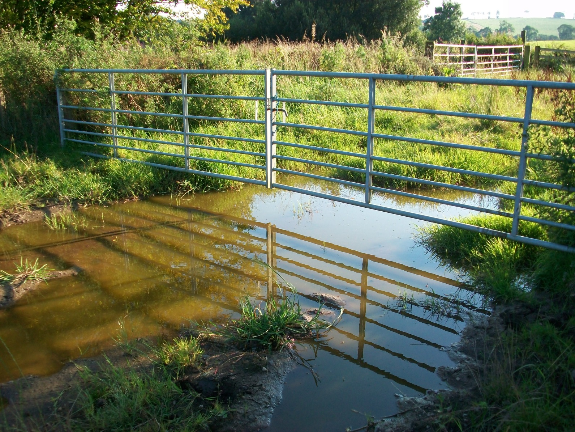
Loch Field

Slide 23
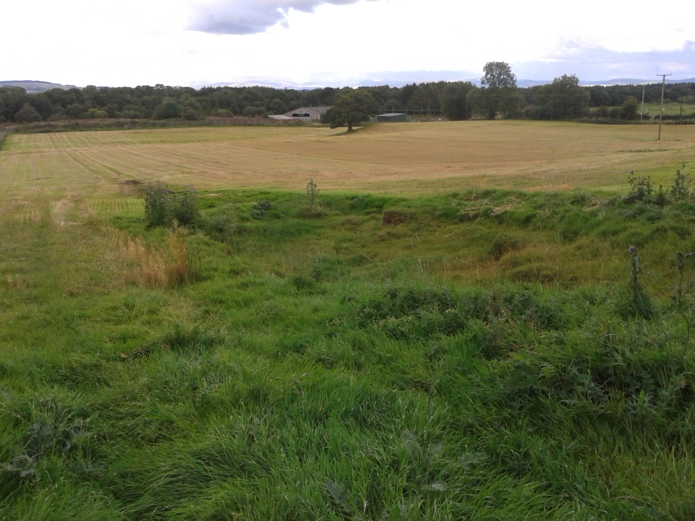
Steading Field

Slide 24
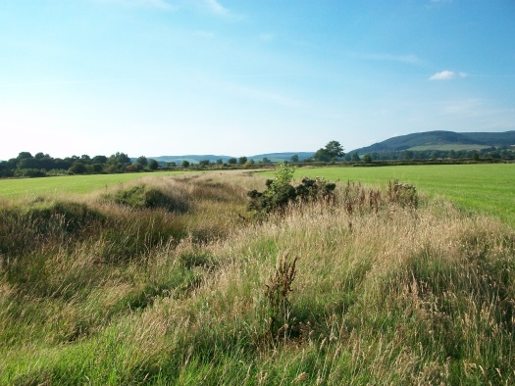
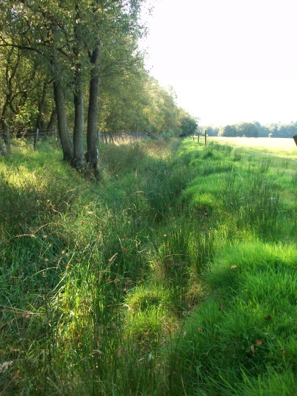
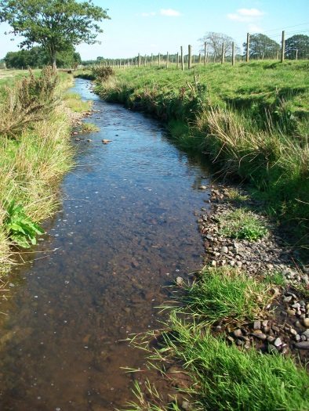
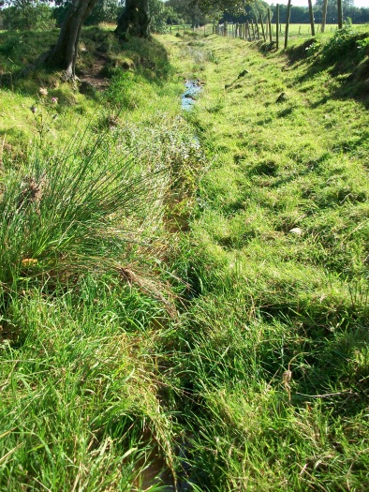
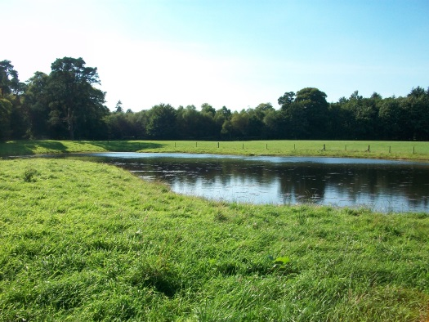
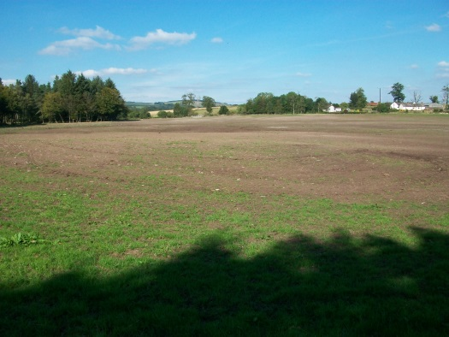
Barony Fields

Slide 25
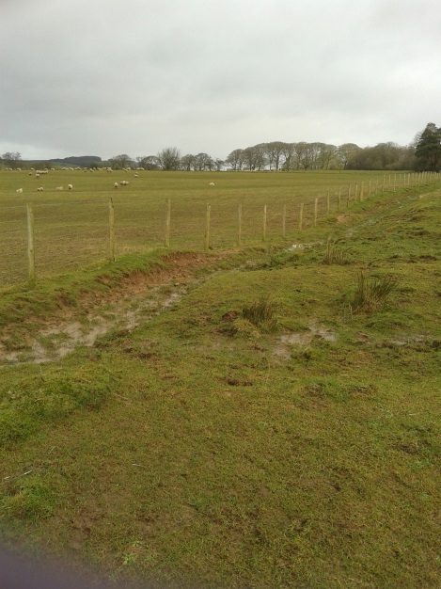
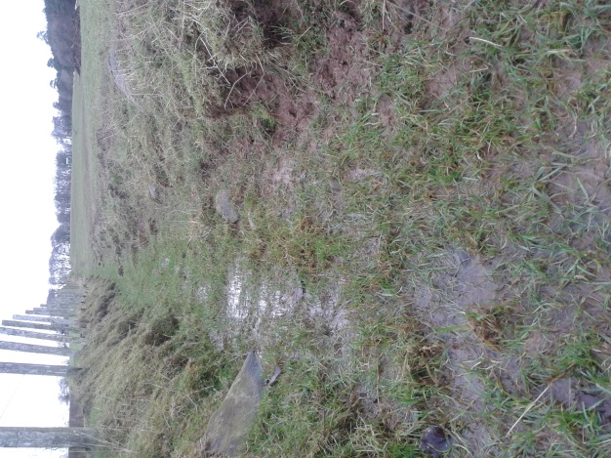
Good Snail Habitats

Slide 26
Mid September
All sheep on farm last fluked in January.
Cows/calves usually housed mid November.
Lambs should all be fat in less than 6 weeks.
Summer rainfall slightly above average.
(Cows and calves, ewes, purchased gimmers, fat lambs.)

Slide 27
Barony Field Map
*
*
*
*
X
*
*
Hoggs
*
*
In calf heifers

Slide 28
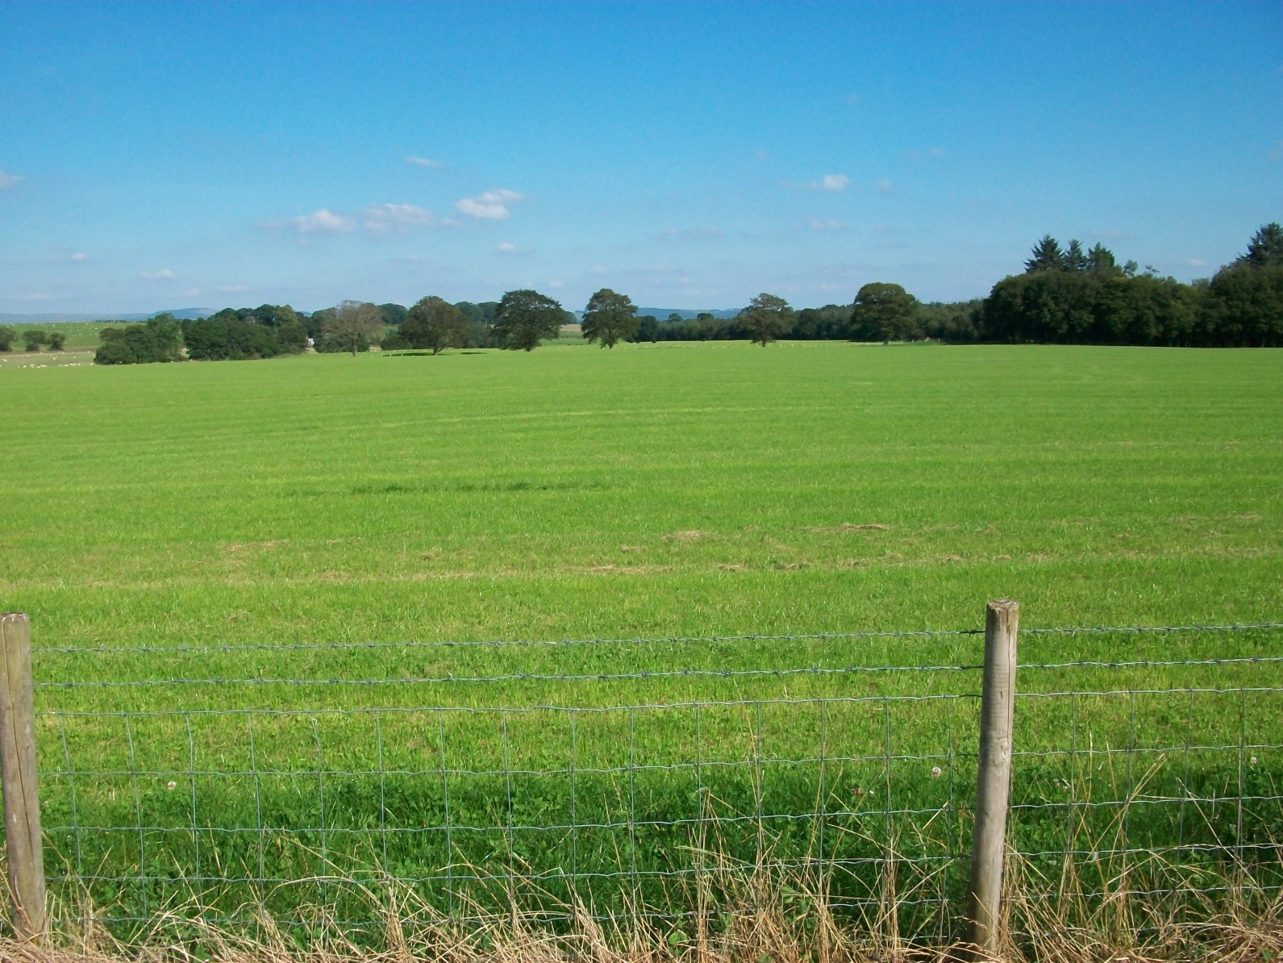
Jubilee Field - Hoggs

Slide 29
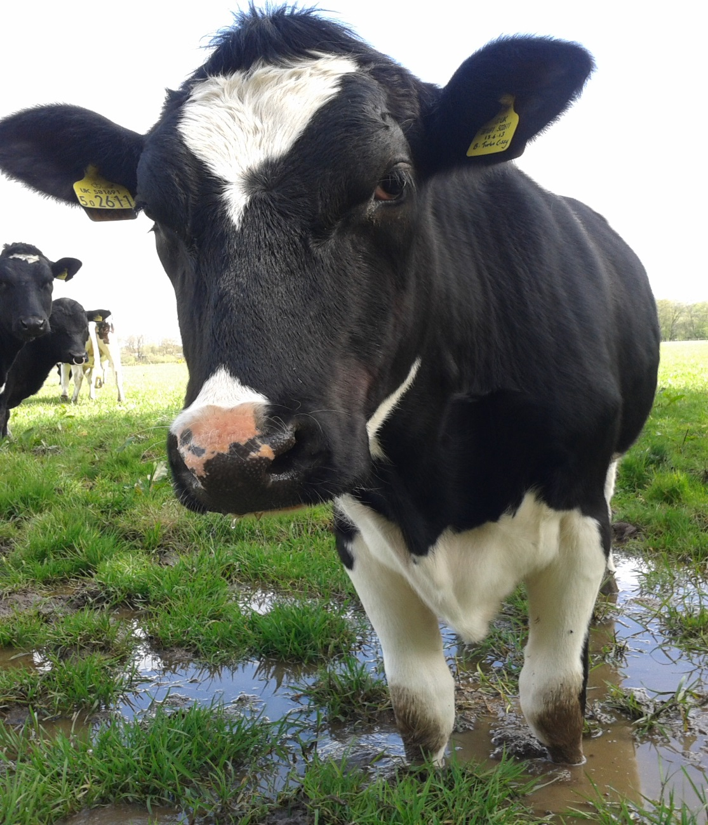
Trial Field – In Calf Heifers

Slide 30
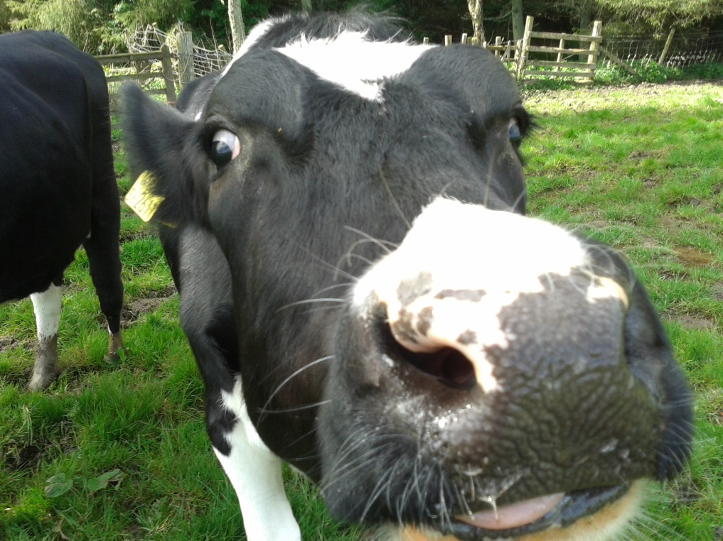
Blood Antibody Results (21/11/14)
Heifers – 100% positive.
Hoggs – 20% positive.

Slide 31
Bulk Tank Fluke Antibody Test
Result estimates the percentage of the milking cows with antibodies to fluke.
This does not prove active infection.
Bought in animals could skew the result.
Antibody levels can drop over time.
Tend to be highest following recent infection – a few weeks after housing is a good time to test.

Slide 32
Bulk Tank Milk Antibody Results
Date | Result (%)
17/9/13 | 420
30/4/14 | 223
21/8/14 | 168
1/10/14 | 209
13/11/14 | 366
Housed from mid October.
Heifer and bulk tank results suggest re-infection in the few weeks before housing.

Slide 33
Fluke Lifecycle
MAY
E
JULY
S
WILDLIFE
SEPTEMBER
GRASS
OCTOBER
LIVER
DECEMBER
DECEMBER ON
E

Slide 34
Choice of product

Slide 35
Choice of product
Products vary in their ability to kill fluke
Time of year
Age of fluke present in liver
Withdrawal period
Method of administration
Is a worming dose also required?
What has been used in the past?
Did it work?

Slide 36
Drug Activity
LIVER

Slide 37
Drug Activity
TRICLABENDAZOLE
LIVER

Slide 38
Drug Activity
TRICLABENDAZOLE
LIVER
CLOSANTEL
NITROXYNIL

Slide 39
Drug Activity
TRICLABENDAZOLE
LIVER
CLOSANTEL
NITROXYNIL
CLORSULON
ALBENDAZOLE
OXYCLOZANIDE

Slide 40
Drug Activity
TRICLABENDAZOLE
LIVER
OCTOBER TO JAN/FEB.

Slide 41
Drug Activity
TRICLABENDAZOLE
LIVER
OCTOBER TO JAN/FEB.
CLOSANTEL
NITROXYNIL
OCTOBER TO JAN/FEB.

Slide 42
Drug Activity
TRICLABENDAZOLE
LIVER
OCTOBER TO JAN/FEB.
CLOSANTEL
NITROXYNIL
OCTOBER TO JAN/FEB.
CLORSULON
ALBENDAZOLE
OXYCLOZANIDE
MAY

Slide 43
Pick a Product
FLUKIVER
TUPS IN OCTOBER
(No resistance to Triclabendazole diagnosed.)
LEVAFAS DIAMOND
COMBINEX
CLOSAMECTIN INJECTION
SUCKLER COWS
8 WEEKS AFTER HOUSING
EWES LAMBING OUTSIDE IN MAY
FASINEX 5%
FASIMEC DUO
LONG KEEP STORE LAMBS
IN EARLY NOVEMBER
CYDECTIN TRICLAMOX POUR ON
ANIMEC SUPER
EWES IN OCTOBER
(Triclabendazole resistance diagnosed.)
ZANIL
PURCHASED GIMMERS IN
LATE SEPTEMBER
(Came from a very wet area.)
TRODAX
ALLVERM 4%
OVISPEC
DAIRY COWS AT DRYING OFF
IN FEBRUARY
(Housed mid October)
TRICLAFAS 5%
OVISPEC
TRICLAFAS 5%

Slide 44
Pick a Product
FLUKIVER
TUPS IN OCTOBER
(No resistance to Triclabendazole diagnosed.)
LEVAFAS DIAMOND
COMBINEX
CLOSAMECTIN INJECTION
SUCKLER COWS
8 WEEKS AFTER HOUSING
EWES LAMBING OUTSIDE IN MAY
FASINEX 5%
FASIMEC DUO
LONG KEEP STORE LAMBS
IN EARLY NOVEMBER
CYDECTIN TRICLAMOX POUR ON
ANIMEC SUPER
EWES IN OCTOBER
(Triclabendazole resistance diagnosed.)
ZANIL
PURCHASED GIMMERS IN
LATE SEPTEMBER
(Came from a very wet area.)
TRODAX
ALLVERM 4%
OVISPEC
DAIRY COWS AT DRYING OFF
IN FEBRUARY
(Housed mid October)
TRICLAFAS 5%
OVISPEC
TRICLAFAS 5%

Slide 45
Assess Fluke Risk
Where have they grazed particularly from August on?
What grazed these fields earlier in the year?
Sheep?
Re-seeds, silage fields?
Are there wet areas, could there be snails?
Was the summer wet or dry?
Likely date of housing?
Problems in previous years?
Any signs of ill health/poor production that could be due to fluke?

Slide 46
When To Treat?

Slide 47
When to treat?
Fluke treatments are not long acting
Sheep - October, January and late spring/early summer.
High risk years/farms – as above plus extra treatments 4-6 weeks after the October and January doses.
Extreme years on wet farms - ? Every 4 weeks in autumn, ?treat and house.

Slide 48
When to treat?
Beef cattle - treat at appropriate interval after housing (?plus at housing in high risk years/farms)
Outwintered cattle - treat winter and spring (?3 times in highest risk years)
Consider checking for fluke eggs before turn out.
Useful websites:
www.nadis.org.uk
www.scops.org.uk
www.cows.org.uk

Slide 49
Management of 864 UK Dairy Herds

Slide 50
If You Need To Treat …..
Milking herd – treat in DRY PERIOD (or minimum 60 hour milk withdrawal).
Replacement heifers – CARE WITH MILK WITHDRAWALS IN SECOND HALF OF PREGNANCY.
Youngstock – CHOOSE PRODUCT THAT WILL BE OF MOST BENEFIT AT THE TIME OF TREATMENT.
Once housed for 10-12 weeks no need to use triclabendazole products.

Slide 51
My Stock Were Treated – Why Have The Livers Been Condemned?
Re-infection
Inappropriate product used.
Incorrect timing of treatment.
Product not expected to kill 100% of fluke in the liver.
Treatment failure e.g. underdosing, product out of date.
Treatment failure – resistance.
Scarring and fibrosis of liver.
Error.

Slide 52
My Sheep Were Treated Why Are They Still Dying?
Re-infection – dosing interval too long.
Inappropriate product used.
Incorrect timing of treatment.
Treatment failure e.g. underdosing, product out of date.
Treatment failure – resistance.

Slide 53
Resistant Fluke
Resistant fluke survive being exposed to the correct dose of a drug that would normally be expected to kill them.
They pass this advantage to their offspring via their genes.
The next generation of fluke are also resistant.

Slide 54
Triclabendazole
First became available in 1984.
Resistance in Scotland first recognised around 1998.
Now reported in many countries.
How much is out there?

Slide 55
Checking For Resistance
Mark and weigh 10 sheep/cattle.
Collect individually identifiable faecal samples.
Dose accurately.
Re-sample 3 weeks later if fluke eggs counts are being carried out, 2 weeks later if coproantigen testing is being carried out.

Slide 56
Quarantine Treatment – Why Bother?
Picture: Dieter Palmer

Slide 57
Quarantine Treatment – Why Bother?
Any farm - To kill liver fluke and prevent deaths/production losses.
Farms with snail habitats but no history of liver fluke – To prevent deaths/production losses and prevent liver fluke becoming established on the farm.
Farms that already have liver fluke – To prevent deaths/production losses and prevent the introduction of liver fluke that are resistant to triclabendazole.

Slide 58
Quarantine Treatment – Why Bother?
Where have they come from?
Are they likely to be infected?
What time of year is it?
What age of fluke are most likely to be in the liver?
Have they been treated? What with and when?
Could collect samples but interpret results with care.
Treat with triclabendazole and either monitor or treat with closantel or nitroxynil 6 weeks later.
Treat with closantel or nitroxynil and repeat 6 - 7 weeks later.
If housed on arrival (and no immediate disease risk) delay treatment for 6 to 8 weeks and treat with closantel or nitroxynil.
Graze in fields with no snails for as long as possible.

Slide 59
Quarantine Treatment – Why Bother?
Extra costs and hassle.
If triclabendazole resistant liver fluke have already been confirmed locally then spread may occur via:
Movement of wildlife and straying stock.
Heavy rainfall may cause flooding across boundaries or wash snails/cysts downstream.
Snails could be transported on the feet of birds.

Slide 60
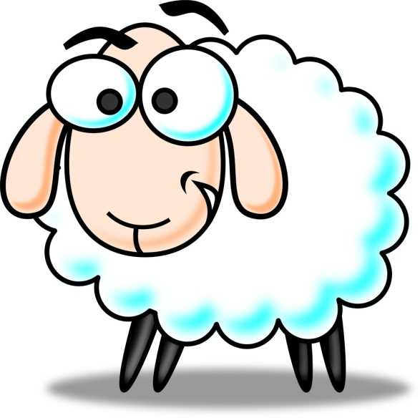
Fluke Forecasts
WHAT ABOUT
THIS YEAR?

Slide 61
Fluke Forecasts
Developed in the 50s and 60s.
Based on the knowledge that summer weather conditions influence the fluke lifecycle.
Compared meteorological data with the number of sheep deaths due to acute/subacute fluke.
Are they still accurate and relevant? Has the disease changed?

Slide 62
Reasons for Developing Fluke Forecasts
X
“to assist in a decision to use
molluscicides”
“to design grazing control”
“to assist in the recommendations for treatment and other forms
of fluke control”
✓
✓

Slide 63
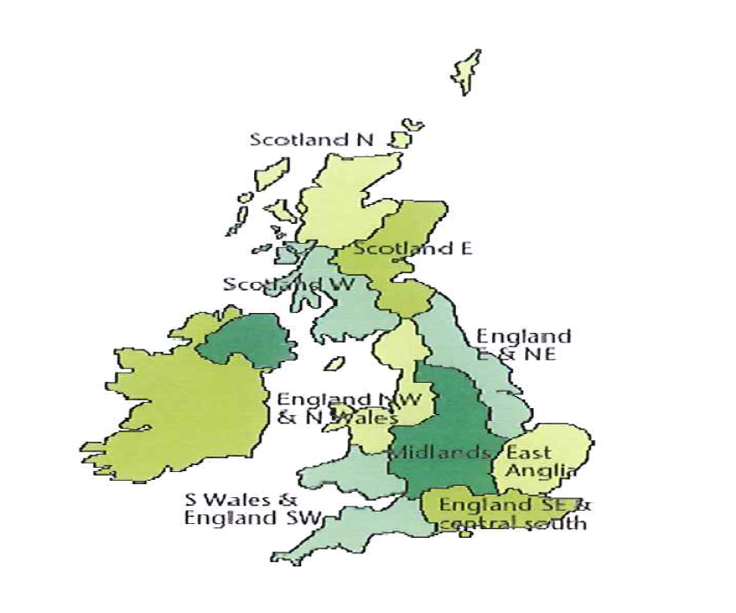
Meteorological Office Regions

Slide 64
Acute/Subacute Fluke - Ayr and Dumfries

Slide 65
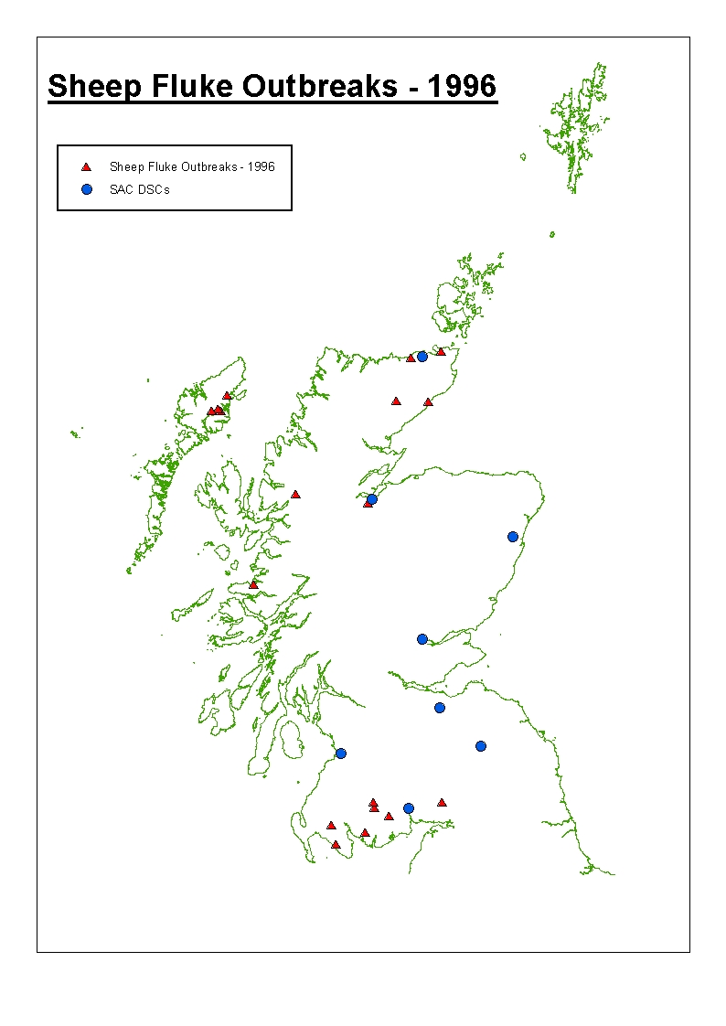
Sheep Fluke Outbreaks 1996

Slide 66
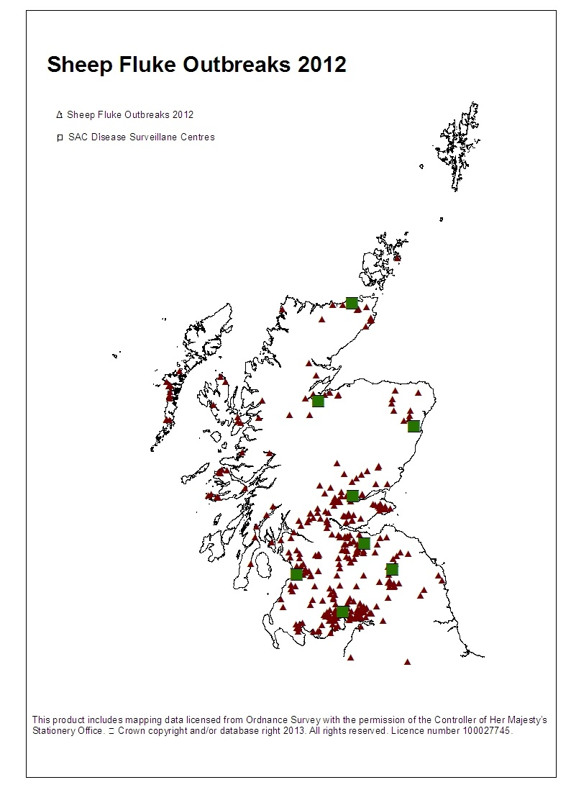
Sheep Fluke Outbreaks 2012

Slide 67
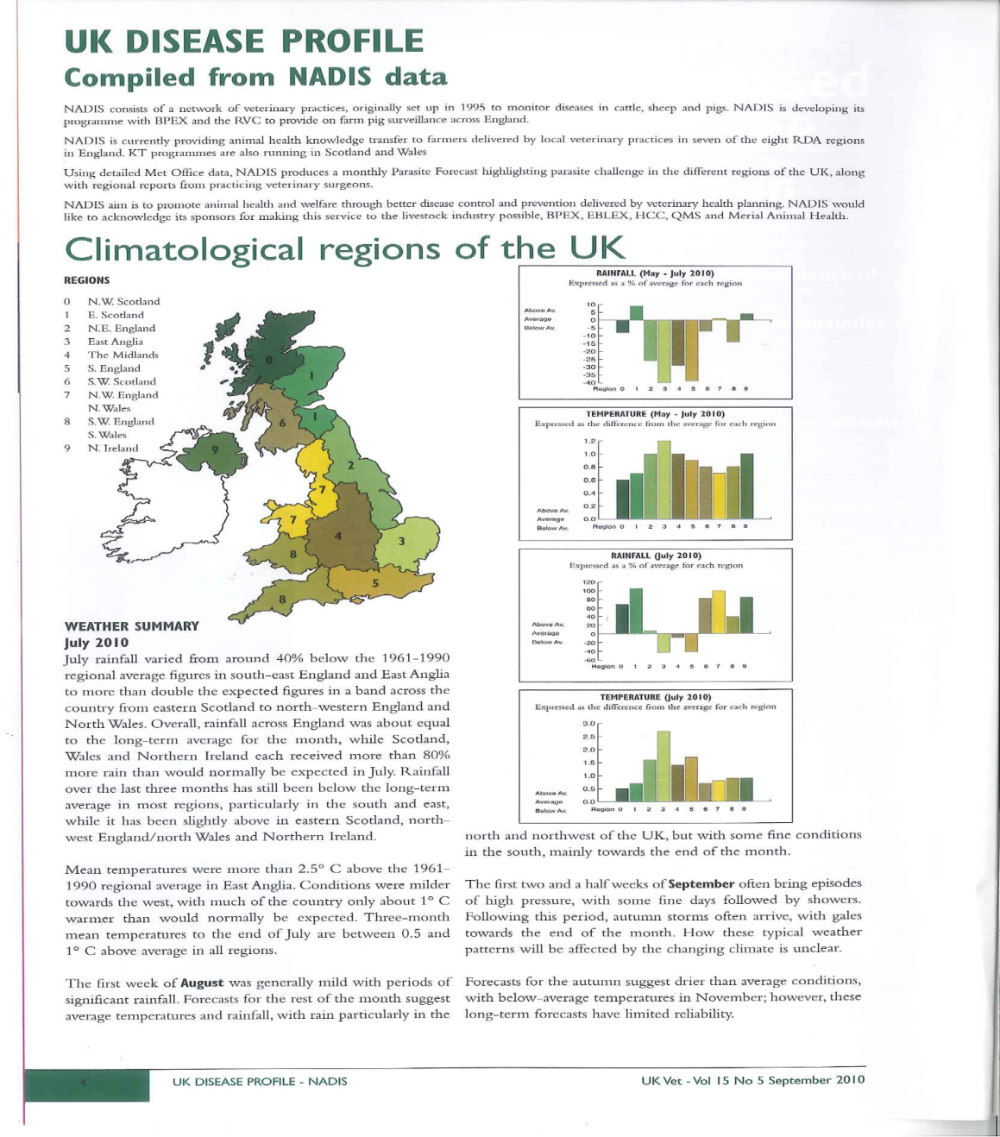
NADIS Regional Parasite Forecasts

Slide 68
Fluke Forecasts – Netherlands Snail Monitoring

Slide 69
SRUC Barony Campus Snail Nos. Mid August

Slide 70
The Future?
Met. Office climate meeting June 2013: “UK could be in the middle of a 10 to 20 year cycle of wet summers”
Predicting Impacts of Climate Change on Fasciola hepatica: Fox et al 2011 “Maps show unprecedented levels of future fasciolosis risk in parts of the UK with risk of serious epidemics by 2050”

Slide 71
The Future?
Since 2012 there is more awareness of liver fluke.
More research is being carried out.
Snail control?
New tests?
New treatments?
Vaccination?

Slide 72
Fluke Lifecycle
MAY
E
JULY
S
WILDLIFE
SEPTEMBER
GRASS
OCTOBER
LIVER
DECEMBER
DECEMBER ON
E

Slide 73
Plan Ahead To Reduce Losses
Kill adult fluke late spring/early summer.
Check that triclabendazole is working.
Assess risk by field.
Improve, manage or avoid high risk areas.
Reduce stocking density in autumn.
Check fluke forecasts.
Investigate sudden deaths or ill thrift both before and after treatment.
Treat with an appropriate product for the time of year.
Quarantine purchased stock.

Slide 74
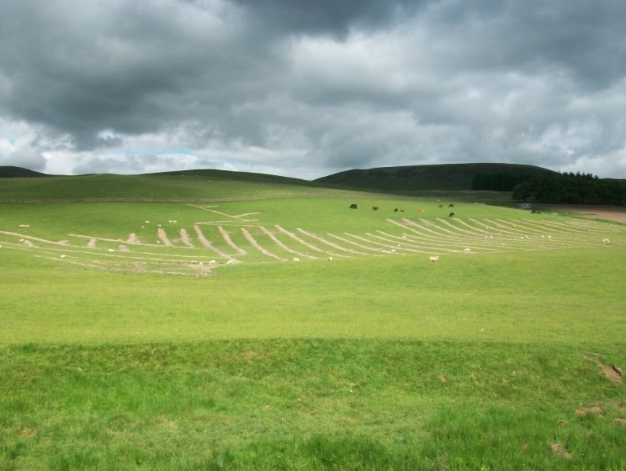
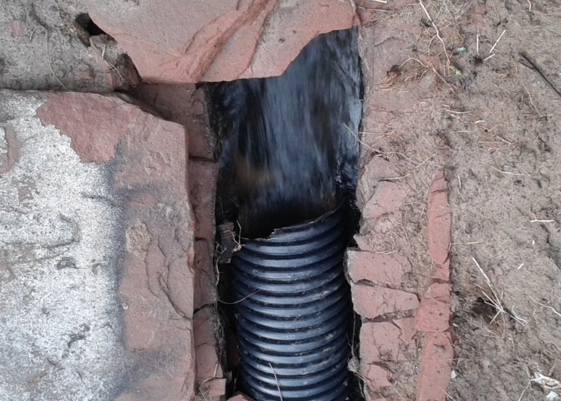
Grazing Options
Fence off snail habitats.
Improve drainage, reduce compaction.
Remove stock, especially sheep, from high risk fields as soon as possible in late summer/autumn.

Slide 75
Lambs Particularly If High Risk Year/Farm
Finish or sell as soon as possible.
Graze on lowest risk fields in autumn.
Consider grazing on brassicas/chicory.
House to finish.
Monitor weight gains.
Investigate the first death.
Monitor for infection – antibodies, fluke eggs, abattoir feedback.

Slide 76
Don’t chew the grass!
Winkelhagen et al, Emerging Infectious Diseases, 6th June 2012, http://dx.doi.org/10.3201/eid1806.111038

Slide 78
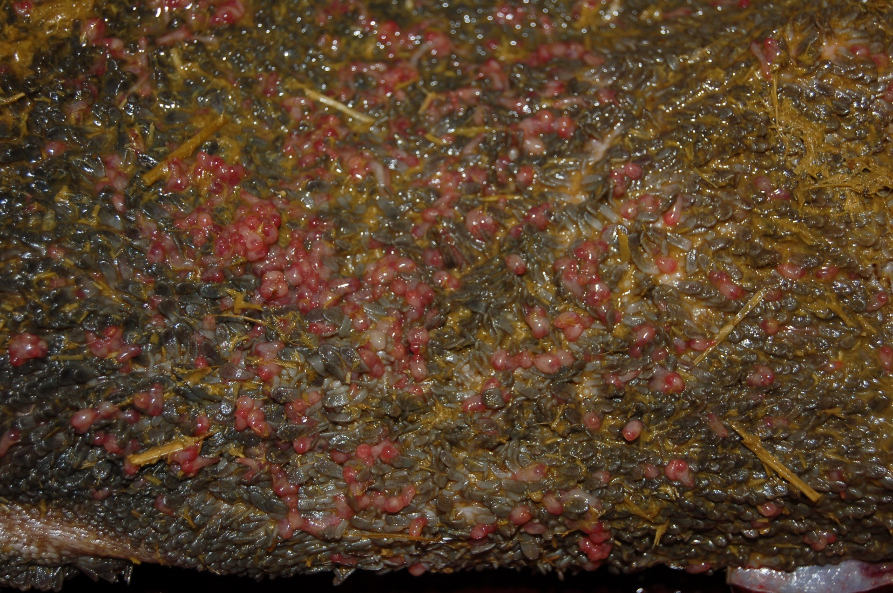
Adult Rumen Fluke

Slide 79
1st September
Milking herd, late pregnant heifers, bulling heifers, dry cows (M, PH, BH, DC).
Want to house on 20th October.
Pregnant heifers due to calve from 20th January.
Dry cows already treated for fluke.
Summer rainfall above average.
Deer common on farm.

