Slide 1
Lamb Losses
Heather Stevenson
SAC Veterinary Services
Dumfries

Slide 2
Lamb Losses in Scotland
QMS Cattle and Sheep Enterprise Profitability in Scotland 2016.
 | Hill | Upland | Lowland
No. of flocks | 49 | 55 | 12
Average Lamb Mortality (range) | 15% (12-23%) | 20% (15-20%) | 16%
Average lambs reared per 100 ewes (range) | 98 (76-116) | 149 (141-159) | 160

Slide 3
Low Lambing Percentage
Need to pin down when the losses occurred.
Issues at tupping time – BCS, tup fertility or numbers, timing.
Early losses – embryonic death – Toxoplasmosis, liver fluke, Border Disease, TBF, Selenium or Iodine deficiency.
Late losses – abortions/stillbirths – infectious causes, dystocias.
Post natal losses – weak lambs, starvation/hypothermia, infectious disease e.g. scour, pneumonia, clostridial diseases.

Slide 4
When and Why Should You Investigate Abortions?
Abortion rate should be less than 2%.
All of them?
More than 1 in a few days/week?
More than 1 in a group? e.g. gimmers, purchased stock.
Owner perception and previous flock history?
Can be the first indicator of infectious disease in a flock.
Zoonotic risk e.g. EAE, Salmonella, Campylobacter
To justify vaccination or investigate vaccine efficacy?

Slide 5
SAC Ovine Abortion Diagnoses 2015

Slide 6
Diagnosis Not Reached – Why?
No placenta.
Placenta only.
Mummified foetuses.
No foetal stomach contents.
No foetal fluids.
Very autolysed foetuses.
Non infectious cause.
Within “normal” abortion rate.
Diagnosis made in previous/subsequent submission.
No explanation.
New or unusual disease?

Slide 7
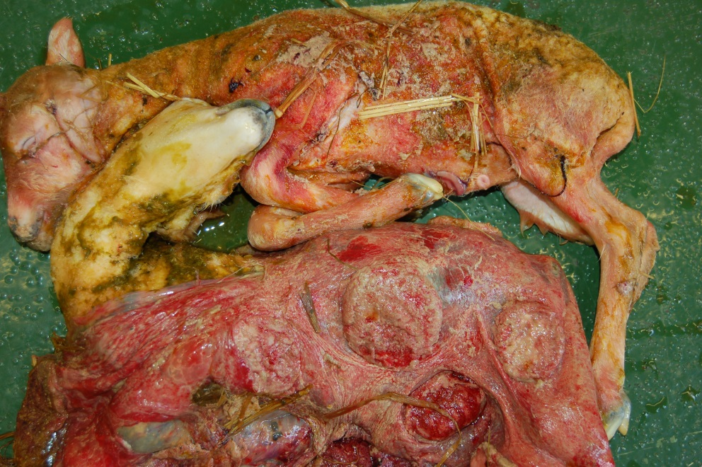
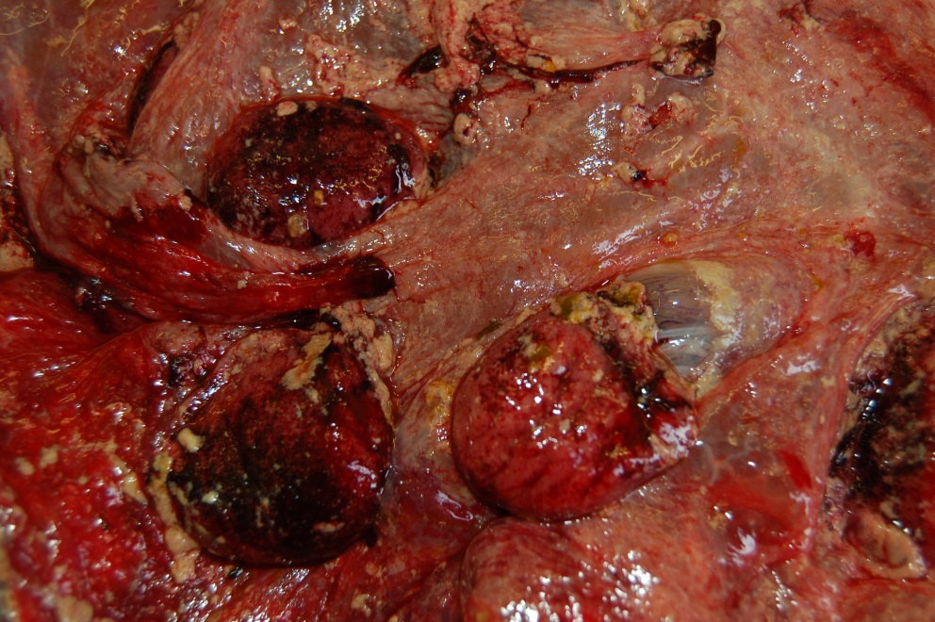
Diagnosis?

Slide 8
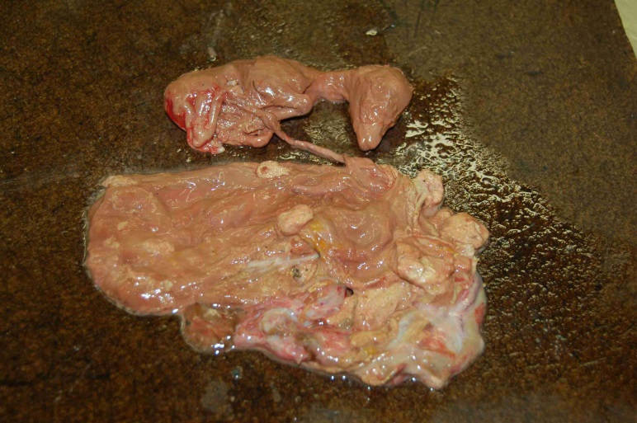
Diagnosis?

Slide 9
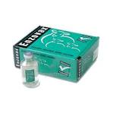
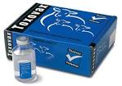
Abortion Diagnoses 2005 – 2016.
On an annual basis EAE and Toxoplasma combined account for 50% to 65.7% of diagnoses made.
Annual costs to industry: EAE £20 million
Toxoplasmosis £12 million
Nieuwhof and Bishop, Animal Science, 2005, 81, 23-29.

Slide 10
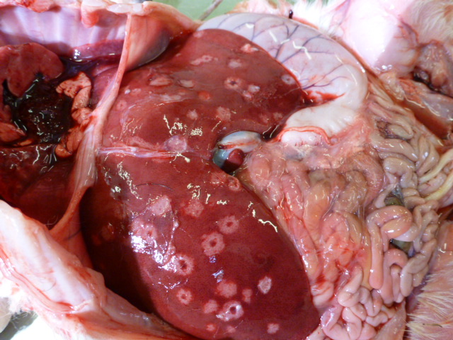
Campylobacter
Carrier ewes, birds or wildlife.
Abortion from 6 weeks pre lambing.
Zoonotic.
Reduce stocking density.
Shift troughs and turn them over.
Avoid spread to other groups of sheep.

Slide 11
Border Disease
Sheep version of BVD.
A PI ewe will always give birth to a PI lamb.
Cattle can infect sheep with BVD.
20% of outbreaks shown to be due to BVD (2003-2004).
Sheep infecting cattle with BD reported rarely.

Slide 12
Location of BVD Virus Positive Cattle

Slide 13
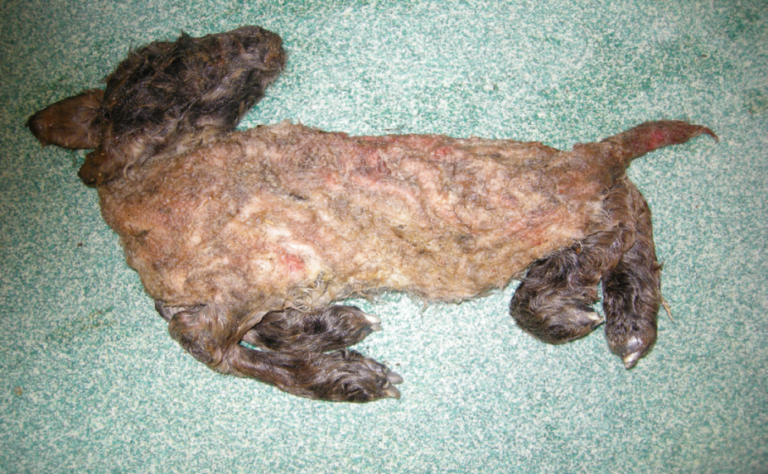
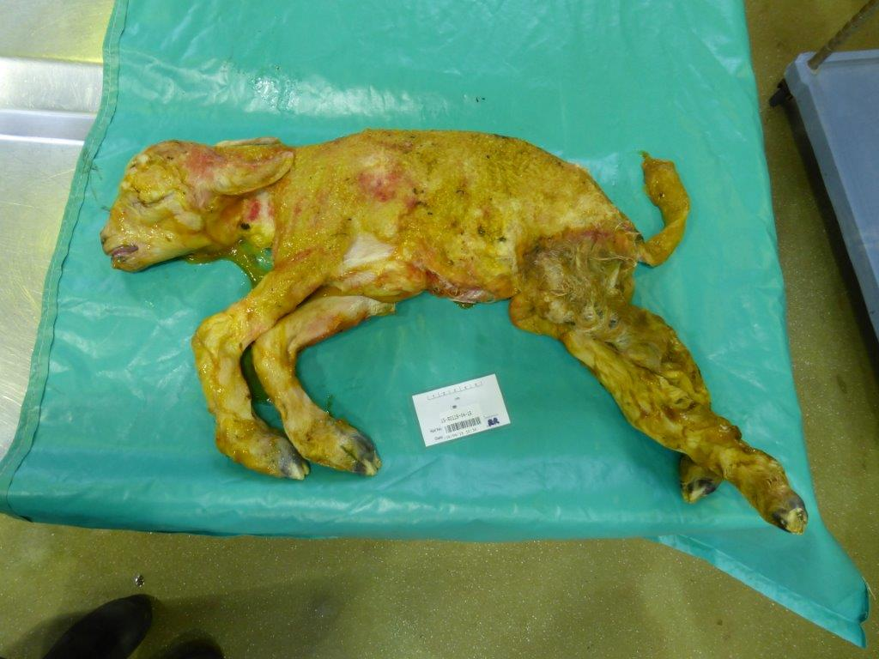
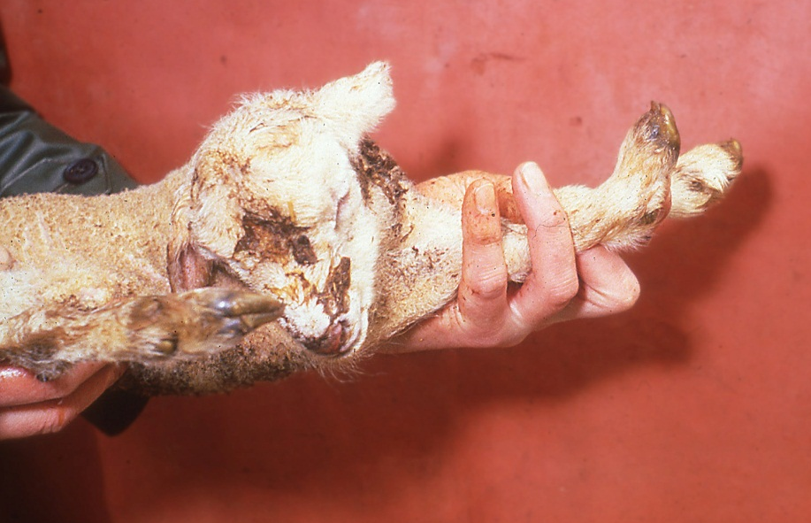
Diagnosis?
Pictures: APHA and Moredun

Slide 14
Schmallenberg Virus Update
Transmitted by midges.
No clinical signs in ewes.
Virus in the blood only for a few days.
Lamb deformities are a result of naïve ewes becoming infected during the second month of pregnancy.
Notes:
Cattle months 3-4

Slide 15
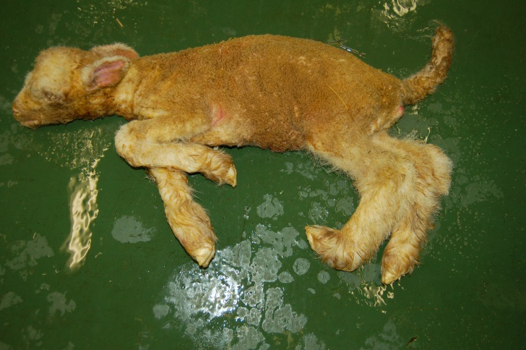
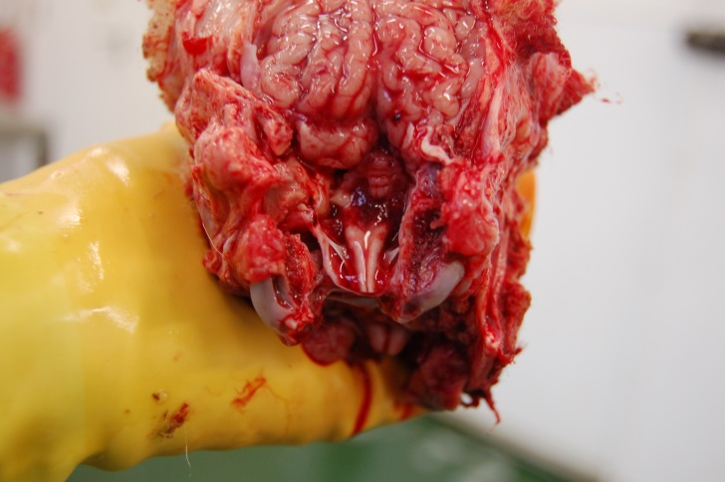
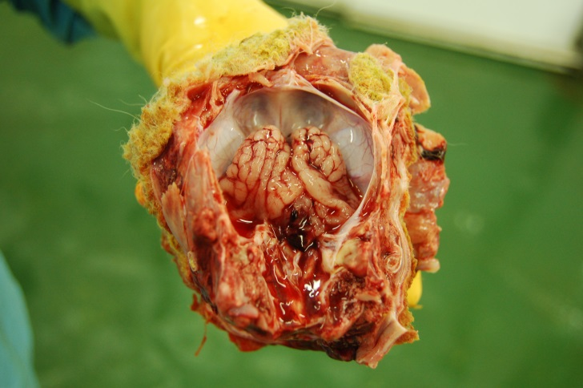
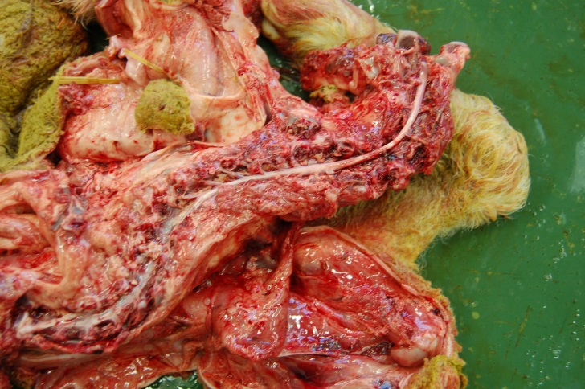
Schmallenberg Virus Update

Slide 16
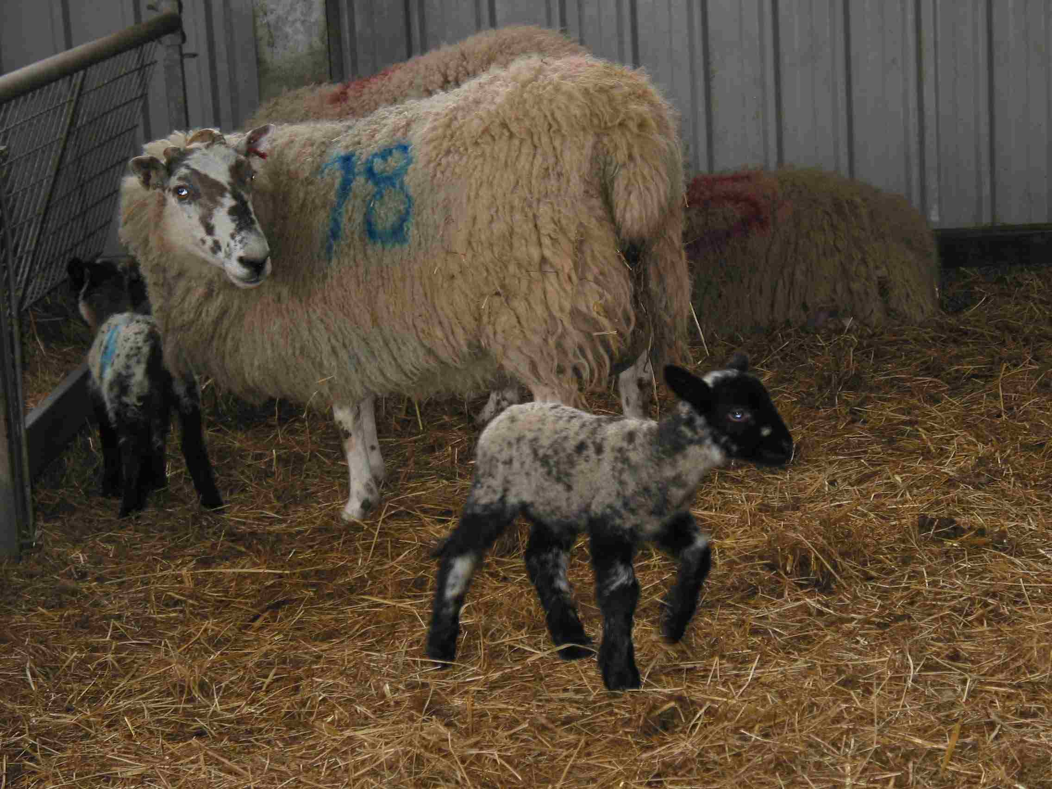
Causes of Perinatal Lamb Mortality
Accident/predation – 5%
Congenital defects – 5%
Infectious Disease – 20%
Starvation/hypothermia – 30%
Dystocia – 40%

Slide 17
Where to start?
Ewe nutrition
Ewe age
Poor colostrum
supply/quality
Viral infection
(BD, SBV)
Trace element deficiency
Triplets
Ewe Disease e.g. Johnes, fluke, metritis
Placental
insufficiency
Mastitis
Low
birthweight
Congenital deformity
Prematurity
STARVATION/HYPOTHERMIA
Insufficient/delayed colostrum intake
Infectious agent
Poor management/ supervision
Bad weather
Poor udder/
teat conformation
Dystocia
Poor mothering
High birthweight
Infectious disease
Genetics

Slide 18
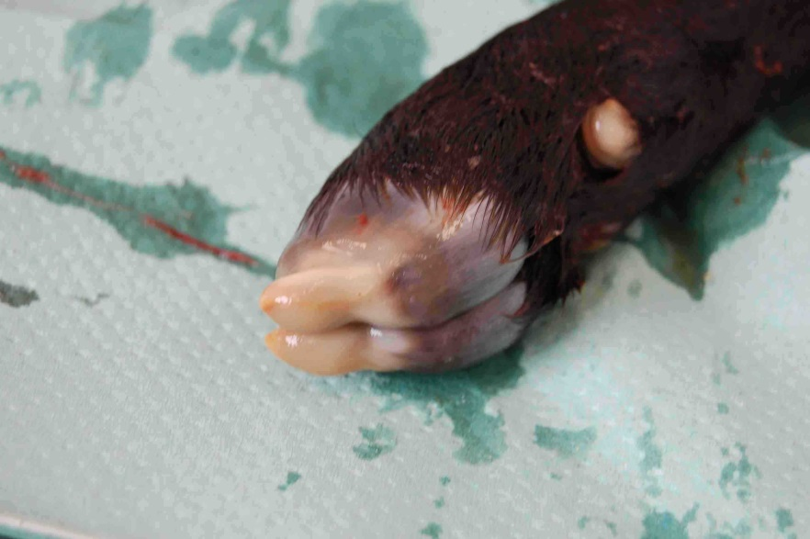
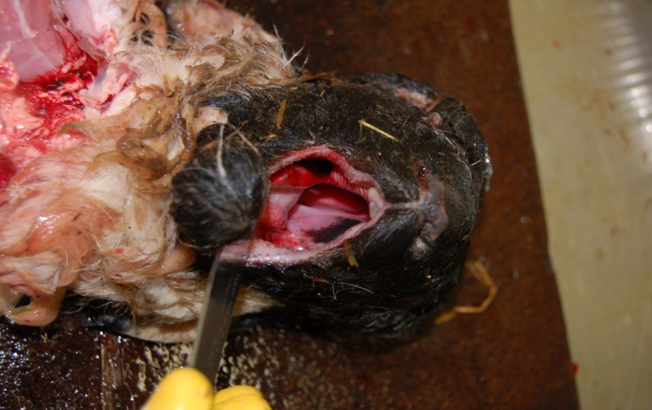
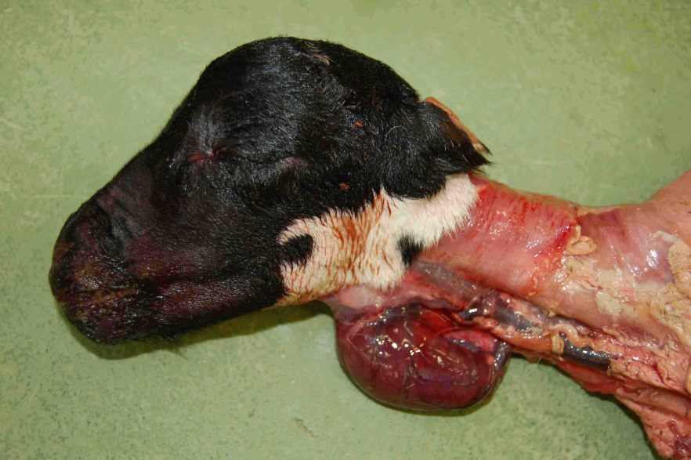
External Examination
Bodyweight
Has it walked?
Has it been ringed/tagged?
Navel ill, swollen joints.
Injuries, bloating, anaemia.
Normal fleece, ticks.
Meconium/faecal staining.
Check for deformity e.g cleft palate

Slide 19
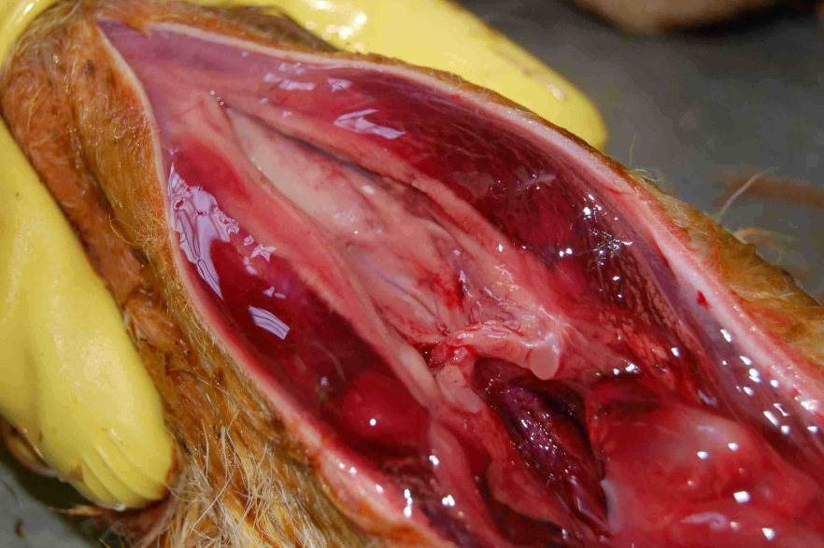
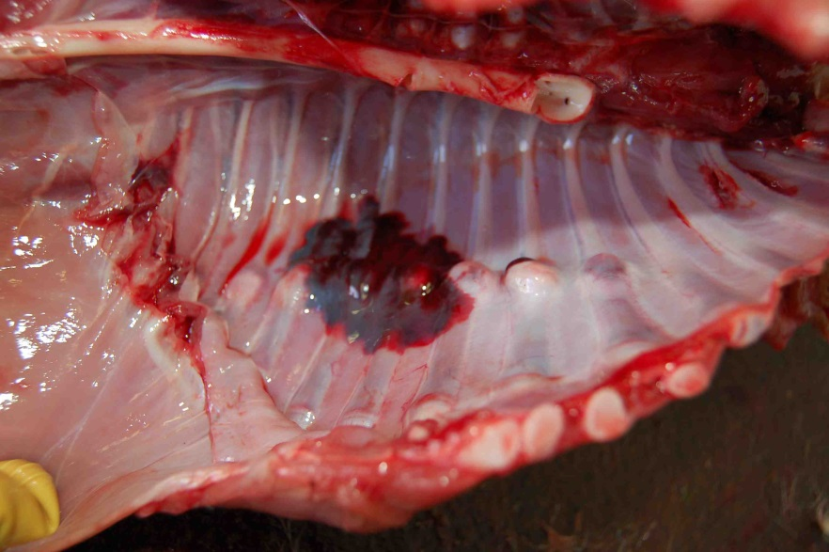
Are There Signs Of Dystocia/Trauma?
Swollen head/tongue, meconium staining.
Subcutaneous oedema head, shoulders, hind quarters.
Fractured ribs, limbs.
Free blood in abdomen from ruptured liver/navel.
Haemorrhages within carcase.
Brain congestion, haemorrhages.
Has it breathed? – inflated lungs are pink and float in water.

Slide 20
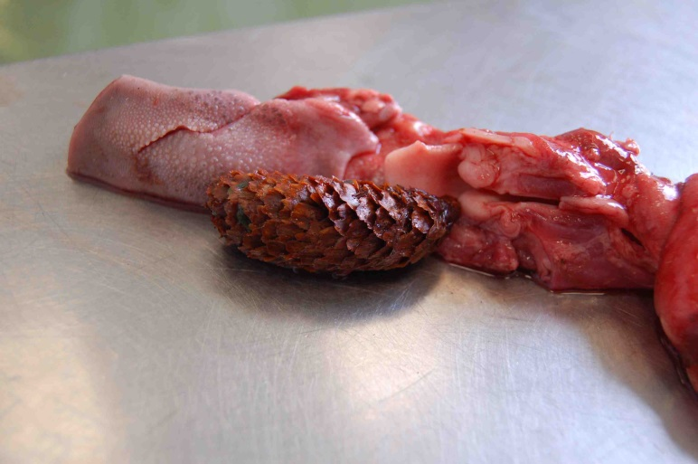
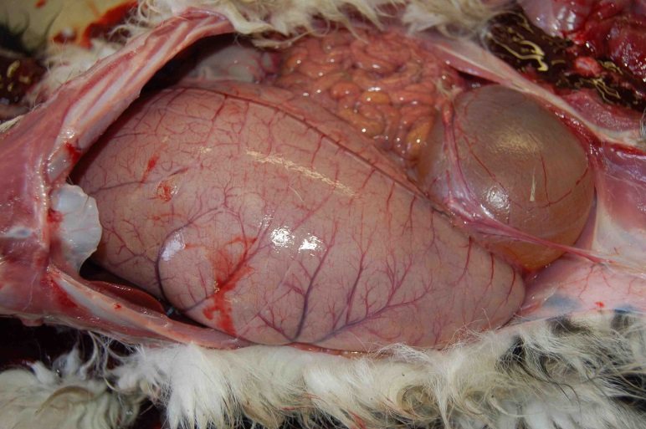
Sudden Death (Found Dead)
Clostridial disease.
Septicaemia (e.g. Watery mouth,
Pasteurellosis).
Trauma/accident.
Abdominal catastrophe e.g. abomasal bloat, intestinal torsion.
(Starvation/hypothermia).

Slide 21
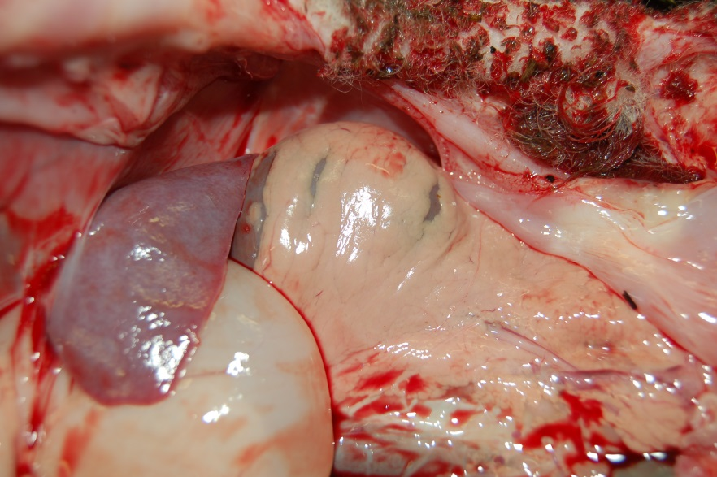
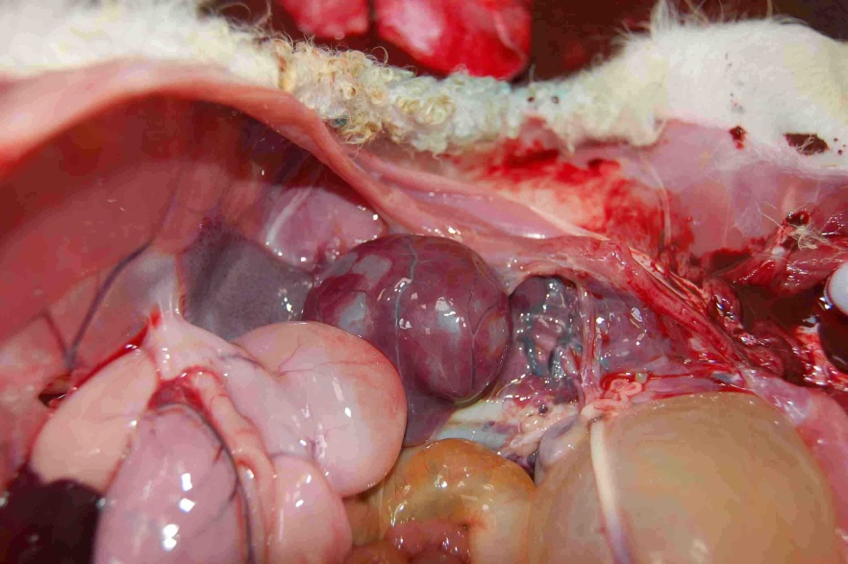
Has It Sucked?
Starvation/hypothermia - Metabolised brown fat, no milk in abomasum unless fed by stomach tube before death.

Slide 22
Powdered Colostrum
Sold as a supplement not a substitute.
Fine as a source of energy for heat production.
Don’t rely on it as a source of immunoglobulins.
Bovine in origin.
Variation in fat and immunoglobulin concentration between brands and batches.
First Thirst Super Lamb colostrum – pure, dried colostrum.
www.icne.co.uk/lamb_colostrum.html
Corke, MJ Cattle Practice, 2012, 20(2), 106-109 Imunoglobulin content of colostrum supplements for calves available in the UK.

Slide 23
Colostrum
Ewe colostrum from flock is best – contains flock specific antibodies (8.5% fat, 70-90g IgG per litre).
Well fed single bearing ewes produce more than their lamb needs.
Inject 10-15iu oxytocin and hand milk.
A smaller volume is required to prevent disease than to prevent hypothermia.
Mellor, D. and Murray, L. Veterinary Record, 1986, 118, 351-353 Making the most of colostrum at lambing.
Goat is next best as similar milk composition.
Must be CAE free.

Slide 24
Colostrum
Dairy cow.
Collect within 2 hours of calving.
Check quality with colostrometer.
Vaccinate with clostridial vaccine.
Make sure free of Johnes Disease.
Test for anti sheep RBC antibodies (or pool colostrum from several cows).
Feed 30% more as lower in fat.
OK to freeze for up to 1 year.
Do not over heat as will denature immunoglobulins.

Slide 25
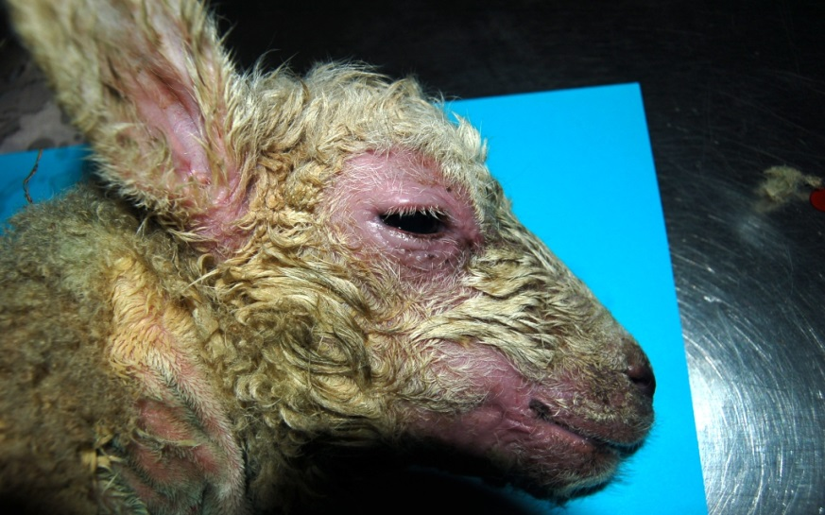
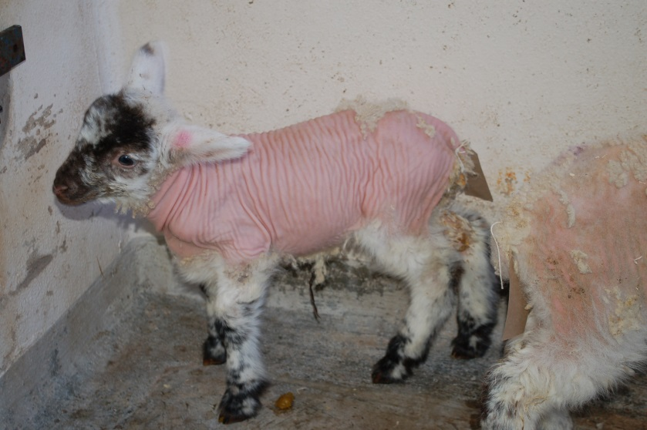
Milk Replacer Issues

Slide 26
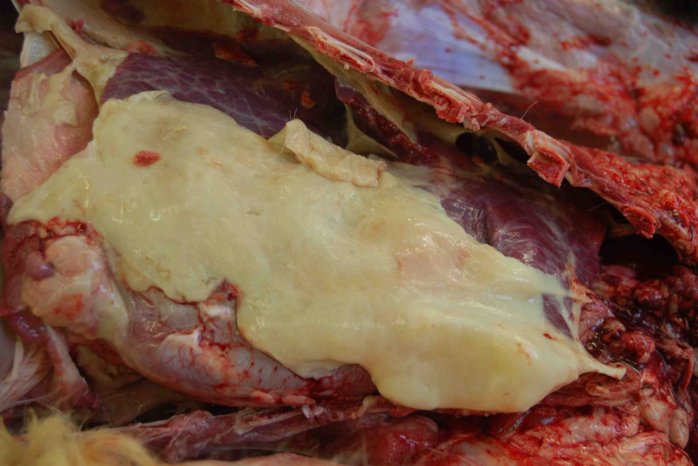
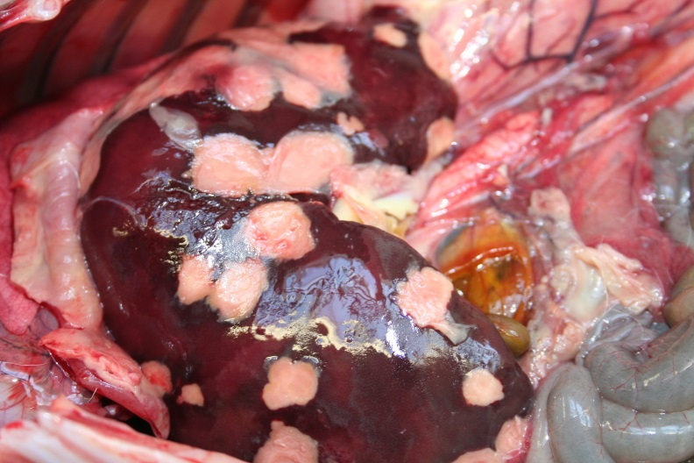
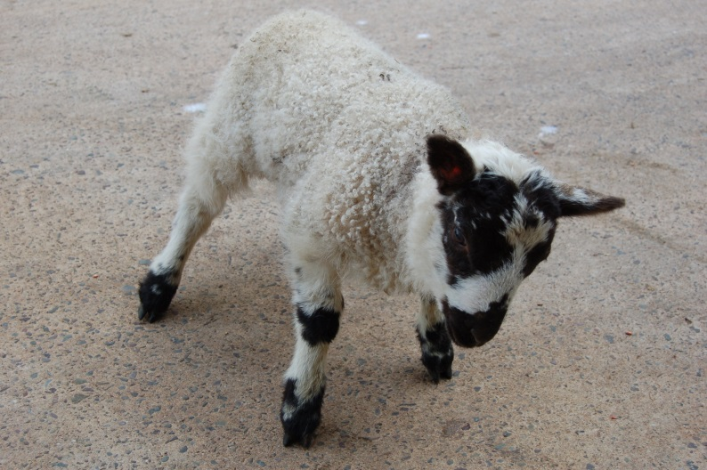
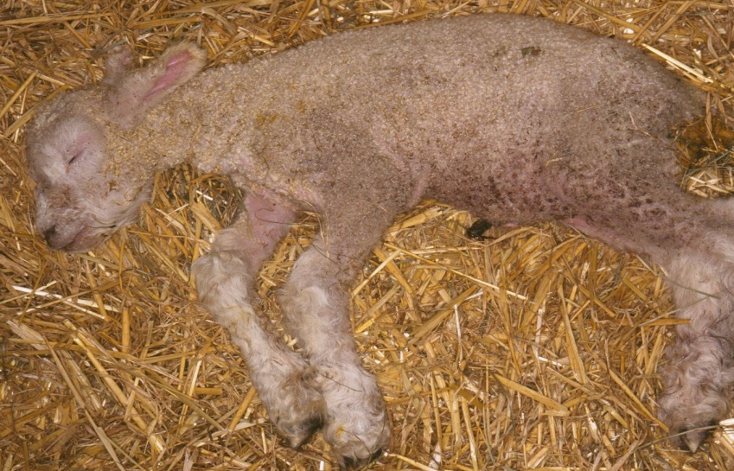

Slide 27
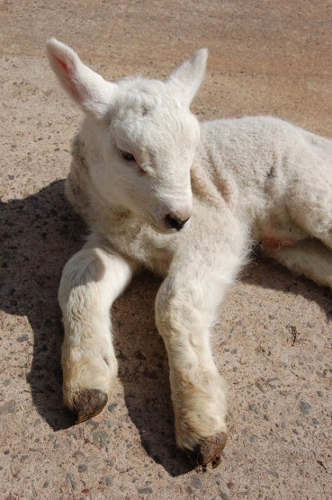
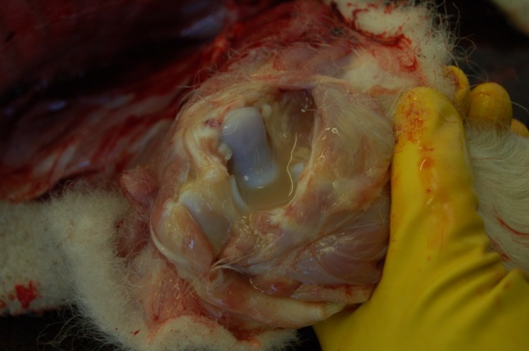
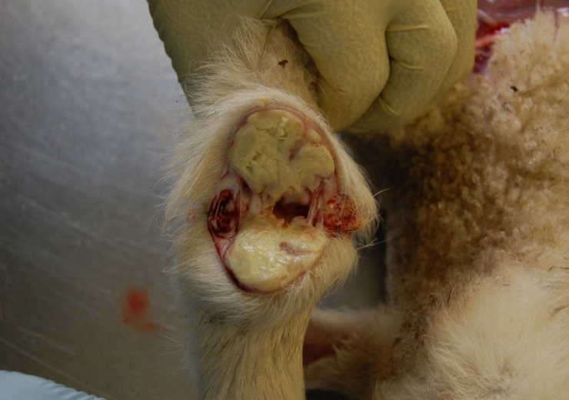
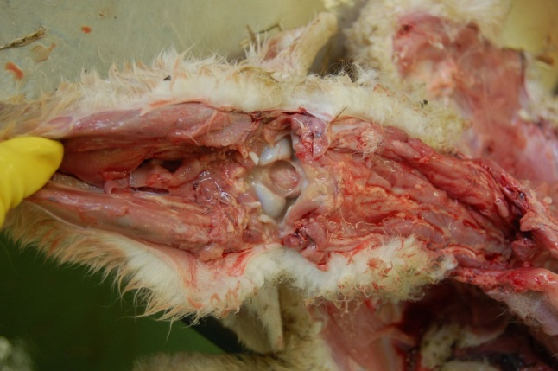
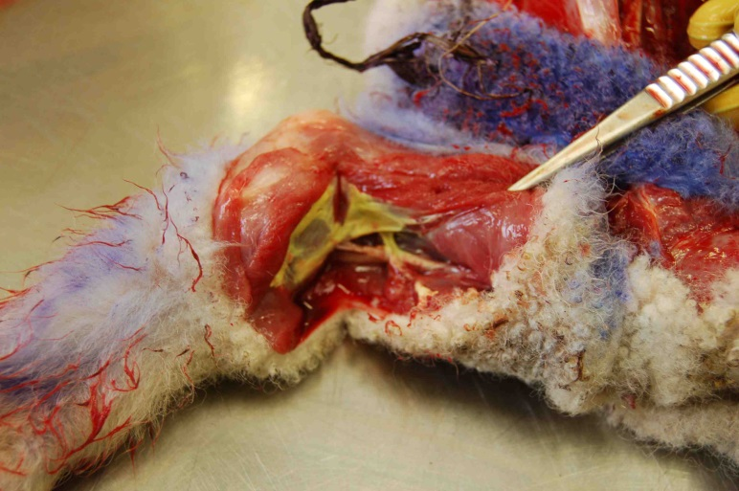
Joint Ill

Slide 28
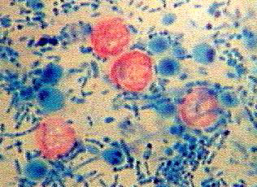
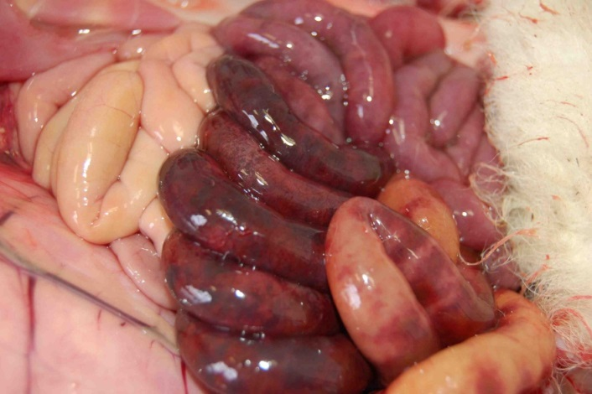
Scour
Lamb dysentery
E. coli K99
Cryptosporidia
Rotavirus
Salmonella
Isolate – stop spread.
Fluids.
Pre-treatment faecal samples.
Sample more than one affected lamb.
Zoonotic potential, cross species infection.

Slide 30
SAC Ovine Abortion Diagnoses 2015
614 submissions of foetal material.
Entire foetuses accounted for 70.1% of submissions.
Placenta received in 79.9% of cases.
Diagnosis reached in 47.1% where whole foetus plus placenta was received.
Diagnosis reached in 24.3% when samples without placenta were received.

Slide 31
Hypothermia (37-39°C)
Weak but still follow ewe and can suck.
Dry
Feed with colostrum/milk
Return to ewe
Monitor

Slide 32
Hypothermia (<37°,< 5 hours old)
Arched back, hollow, head down, unable to suck.
Dry
Warm to 37°C
Feed with colostrum (50ml/kg)
Warm to 39°
Return to ewe and monitor

Slide 33
Hypothermia (<37°, > 5 hours old)
Can’t hold head up.
Inject 20% glucose into the abdomen* (10ml/kg)
Dry
Warm to 37°C
Feed with colostrum (50ml/kg)
Warm to 39°C
Return to ewe and monitor
* Mix 50:50 boiled water:40% glucose (2cm to the side and 2cm below navel. 19g x 1” needle. Aim towards where tail joins body.)

